Slide 1


Priority-Based Concurrency and Shared Resource Access Mechanisms for Nested Intercomponent Requests in CAmkES Marion Sudvarg, Zhuoran Sun, Ao Li, Chris Gill, Ning Zhang Washington University in St. Louis St. Louis, Missouri, United States Work Accepted for Publication in Springer Real-Time Systems RTSS 2023 Funded by NSF grants CSR-1814739, CNS-17653503, and CNS-2229290, and NASA grant 80NSSC21K1741

Slide 2

seL4
Formally verified, capability-based, lightweight microkernel | Supports real-time and mixed-criticality systems | Provides resilience for real-world platforms (e.g. the Boeing Unmanned Little Bird H-6U)
Image courtesy of Boeing: https://www.boeing.com/defense/unmanned-little-bird-h-6u/

Slide 3
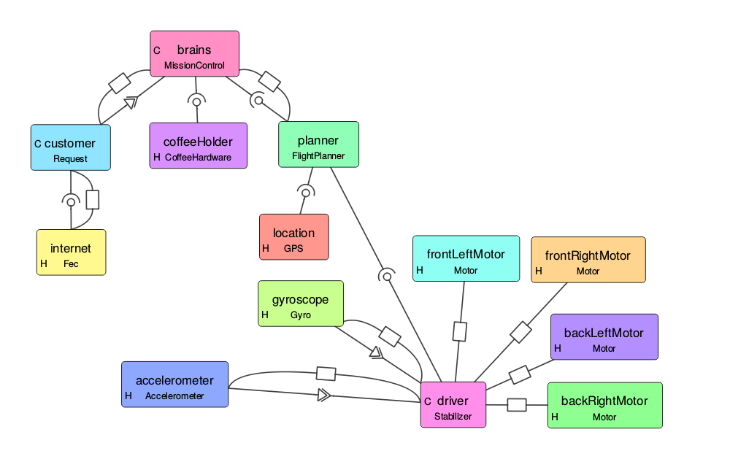
CAmkES: Components in seL4
Components encapsulate and isolate both state and functionality
Provide structure, modularity, and reusability
A component defines explicit interfaces for communication and control flow
Example Component-Based System for Drone
Set Speed
Calibrate
New Accelerometer
Poll
Diagram courtesy https://docs.sel4.systems/projects/camkes/visual-camkes/VisualCAmkES_Layout_Example.png

Slide 4

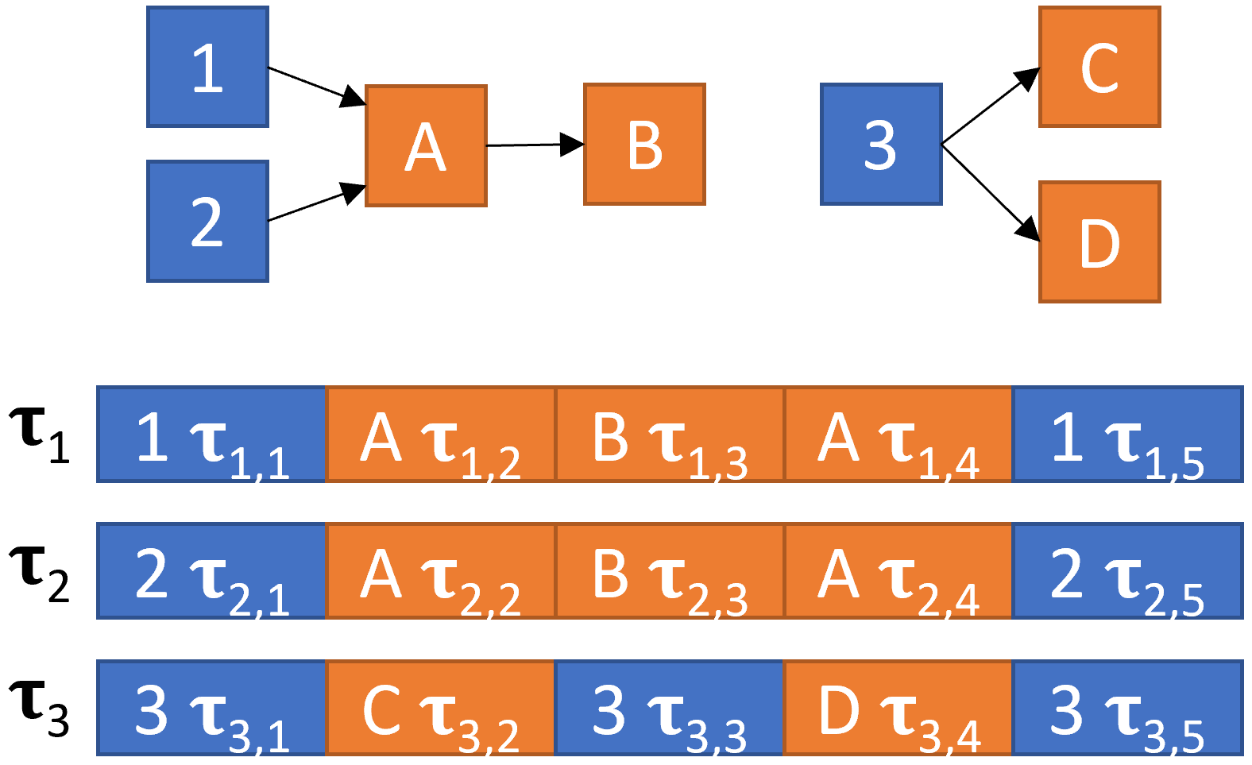
Real-Time Component-Based Systems
Timer or Event-Based Tasks
A component might originate a real-time task
Tasks may share common functionality or state, encapsulated by service components
Task execution begins in the originating component
Proceeds via synchronous RPC invocations across shared components
Shared Components
Camera L
Camera R
Object Detection
Record Event

Slide 5
Limitations of CAmkES
Provides Component Procedure Interfaces (CPIs) for Remote Procedure Call (RPC) requests
CPIs assigned a single thread that waits on an seL4 endpoint at a static priority specified at compile-time
This is not well-suited to task execution that cross-cuts components
Tasks of different priorities may concurrently send requests to the same CPI!

Slide 6
Our Original Solution
Presented at RTCSA 2022: “A Concurrency Framework for Priority-Aware Intercomponent Requests in CAmkES on seL4.”
Supports both reentrant execution and locked critical sections over shared state with the IPCP, NPCS, and PIP protocols
Requires minimal changes to component specifications
Bound overhead by using priority semantics to guarantee consistency over lock acquisition without additional atomic operations
RPC invocation overhead is not significantly increased
Did not support nested Priority Inheritance Protocol

Slide 7
This Work
Extends the prior work to support nested priority inheritance
Components coordinate to send priority updates to downstream components
Individual components only need direct communication from incoming requestor
Faster than Patina mutex service, which does not support nested locking

Slide 8

Thank You!
Any questions?
Full paper and code available from:
https://www.sudvarg.com/priority-aware-camkes

