Slide 1
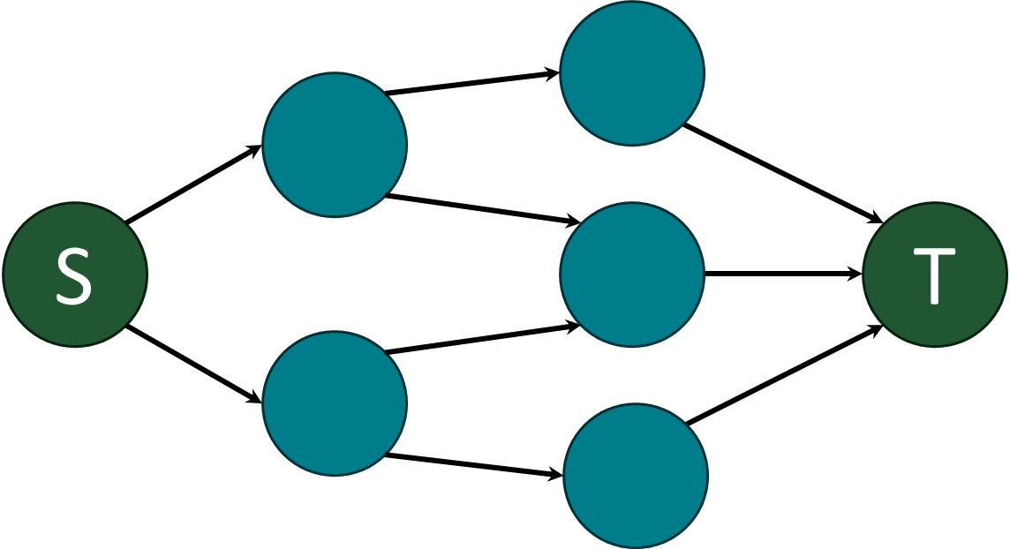
Subtask-Level Elastic Scheduling
RTSS 2024
York, England
This work was supported by NSF grants CPS-2229290
and CNS-2141256, NASA award 80NSSC21K1741, and WashU seed grants
Marion Sudvarg, Daisy Wang, Jeremy Buhler, Chris Gill
msudvarg@wustl.edu www.sudvarg.com

Slide 2
Real-Time Systems
Increasingly execute in dynamic environments

Slide 3
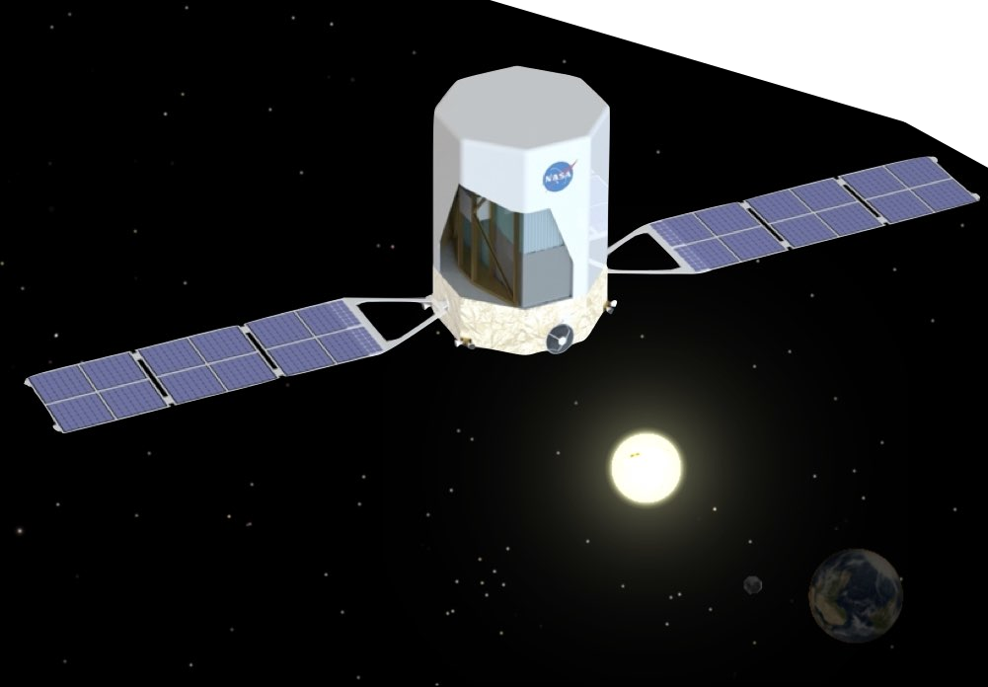
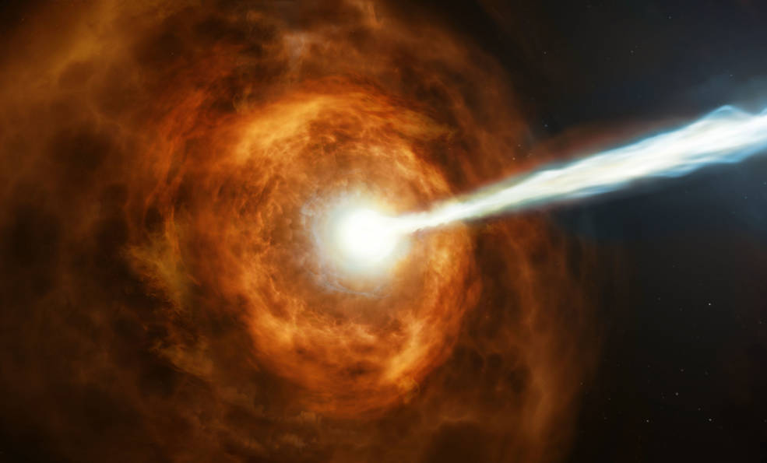

Slide 4
Elastic Scheduling
Real-time systems must adapt to maintain temporal guarantees even on overloaded computational platforms.
Giorgio Buttazzo, Giuseppe Lipari, and Luca Abeni. “Elastic Task Model for Adaptive Rate Control.” RTSS 1998

Slide 5
Elastic Scheduling
Each task’s utilization is decreased from its maximum proportionally to its elasticity until the system becomes schedulable
Task utilizations constrained to remain above their minimums

Slide 6
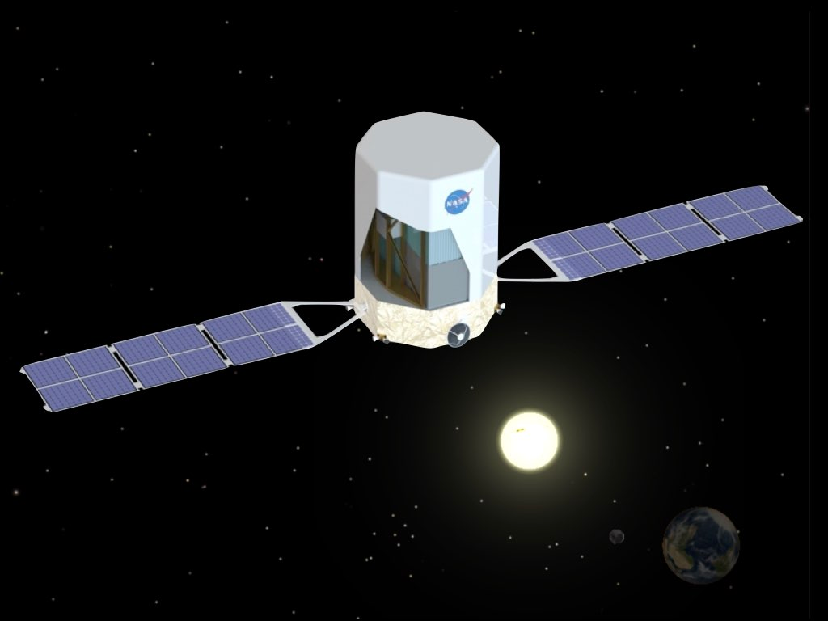
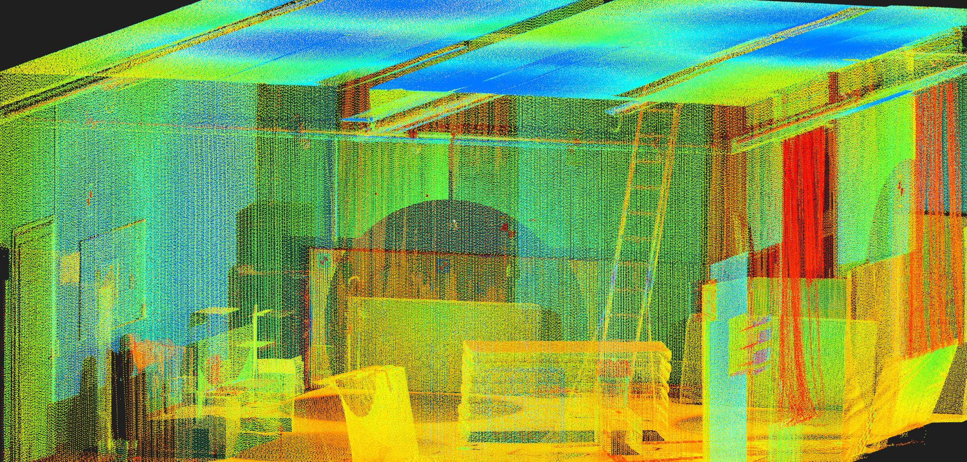
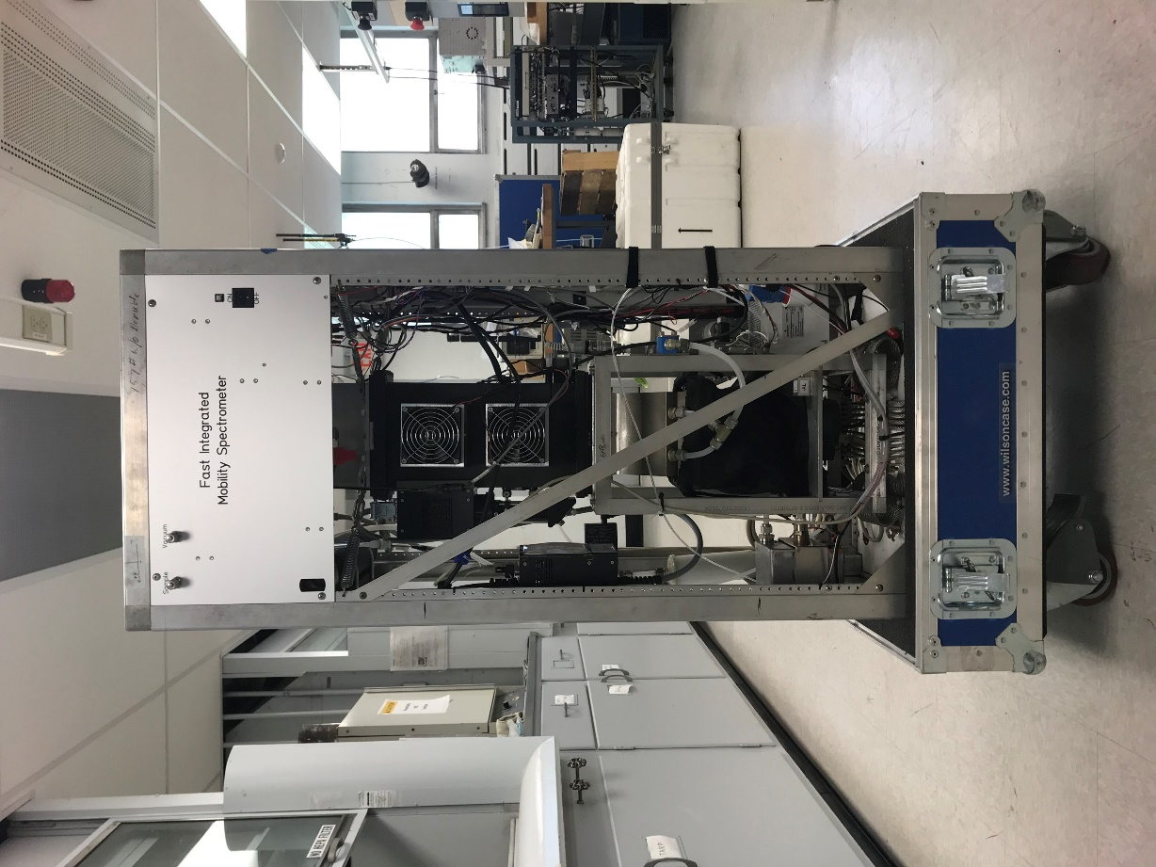
How is utilization compressed?
Extend Task Periods
Control Systems
Buttazzo et al. “Quality-of-Control Management in Overloaded Real-Time Systems.” IEEE Transactions on Computers 2007
Reduce Task Workloads
Gamma-Ray Burst Localization
Sudvarg, Buhler, Chamberlain, Gill, Buckley, Chen. “Parameterized Workload Adaptation for Fork-Join Tasks with Dynamic Workloads and Deadlines.” RTCSA 2023.
Image Masking
Atmospheric Aerosol Monitoring (FIMS)
Simultaneous Localization and Mapping (SLAM)
Sudvarg, Li, Wang, Baruah, Buhler, Gill, Zhang, Ekberg. “Elastic Scheduling for Harmonic Task Systems.” RTAS 2024.

Slide 7
Real-Time Systems
Are increasingly composed of complex DAG tasks

Slide 8
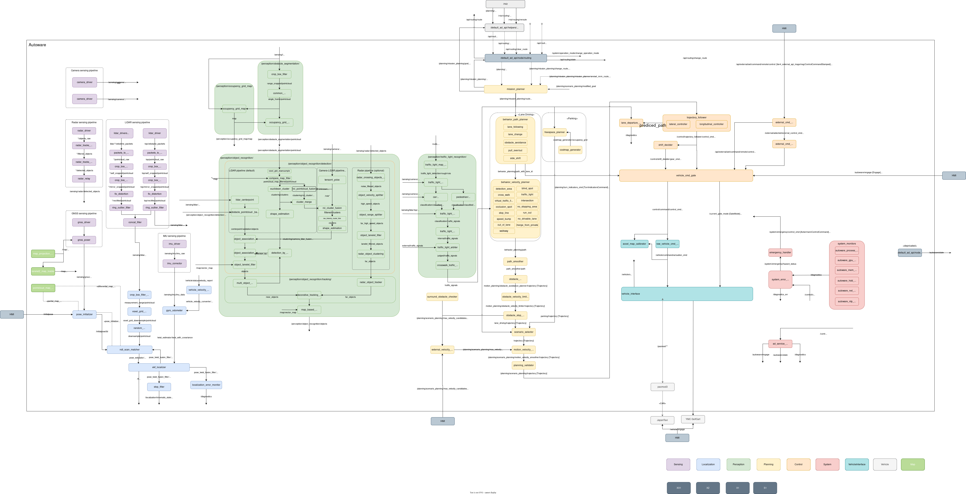
Image courtesy Autoware Foundation

Slide 9
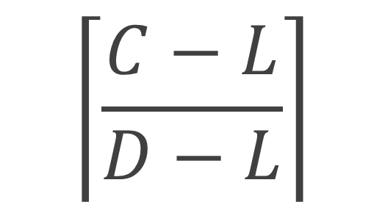
Federated Scheduling
Assign each parallel task its own dedicated cores
Workload
Span
$$\left\lceil \frac{C−L}{D−L}\right\rceil$$
Deadline
Jing Li, J.J. Chen, Kunal Agrawal, Chenyang Lu, Chris Gill, Abusayeed Saifullah.
“Analysis of Federated and Global Scheduling for Parallel Real-Time Tasks.” ECRTS 2014

Slide 10

Back to …
Elastic Scheduling

Slide 11
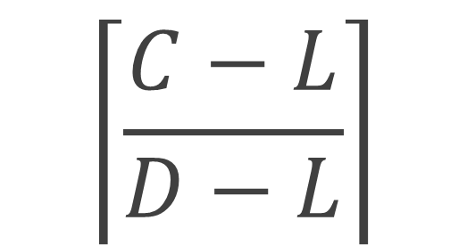
If assigned cores exceeds available cores …
Compress utilizations to decrease required core assignments
$$\left\lceil \frac{C−L}{D−L}\right\rceil$$

Slide 12
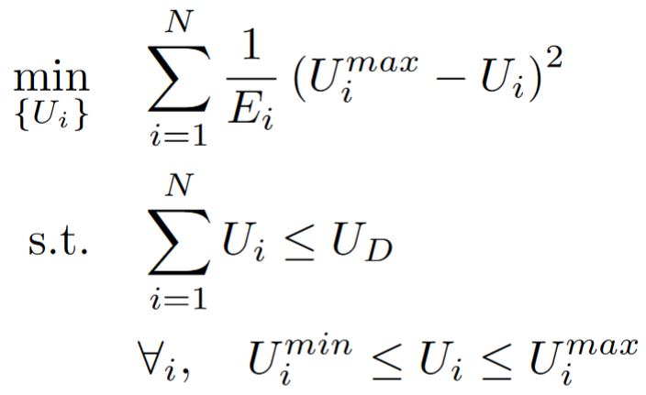
Thidapat (Tam) Chantem, Xiaobo (Sharon) Hu, and Michael D. Lemmon. “Generalized Elastic Scheduling.” RTSS 2006

Slide 13
All tasks are schedulable

Slide 14
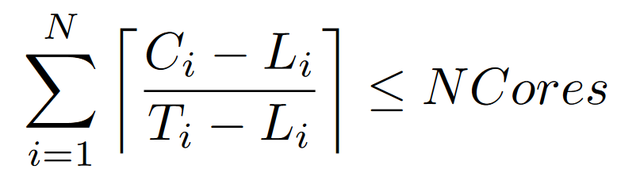
All tasks are schedulable
James Orr, Chris Gill, Kunal Agrawal, Sanjoy Baruah, Chritian Cianfarani, Phyllis Ang, Christopher Wong.
“Elasticity of Workloads and Periods of Parallel Real-Time Tasks.” RTNS 2018.

Slide 15
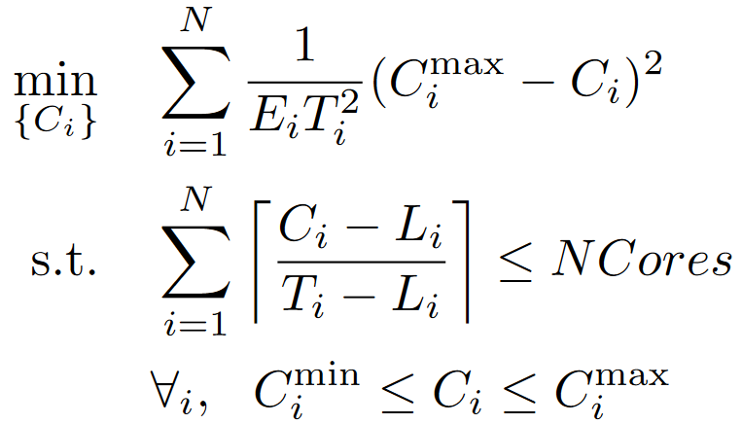
All tasks are schedulable
James Orr, Chris Gill, Kunal Agrawal, Sanjoy Baruah, Chritian Cianfarani, Phyllis Ang, Christopher Wong.
“Elasticity of Workloads and Periods of Parallel Real-Time Tasks.” RTNS 2018.

Slide 16
This does not address how and where to reduce workloads!
James Orr, Chris Gill, Kunal Agrawal, Sanjoy Baruah, Chritian Cianfarani, Phyllis Ang, Christopher Wong.
“Elasticity of Workloads and Periods of Parallel Real-Time Tasks.” RTNS 2018.

Slide 17

Problem 1
Which subtask workload(s) we compress may affect result quality

Slide 18

Problem 1
Which subtask workload(s) we compress may affect result quality

Slide 19



Problem 1
Which subtask workload(s) we compress may affect result quality

Slide 20
Problem 1
Which subtask workload(s) we compress may affect result quality

Slide 21

Problem 2
Which subtask workload(s) we compress may reduce task span
Workload
Span
c=5
$$\left\lceil \frac{C−L}{D−L}\right\rceil$$
c=3
c=2
c=8
Deadline

Slide 22
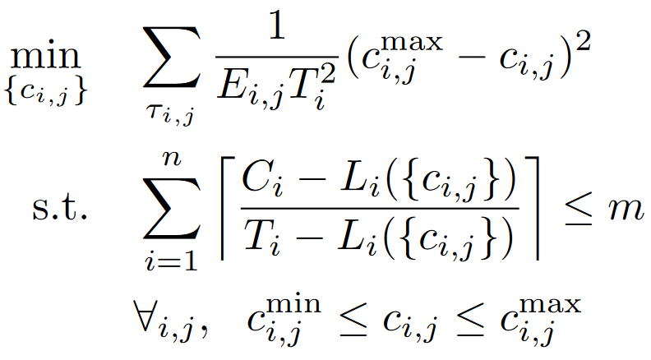
Subtask-Level Elastic Scheduling

Slide 23
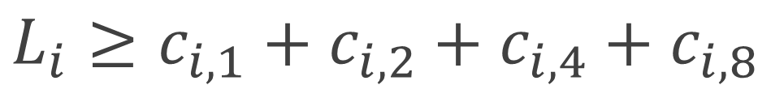
Representing the Span Constraint
c_{i,4}
c_{i,2}
c_{i,8}
c_{i,1}
c_{i,5}
c_{i,3}
c_{i,7}
$$L_{i}≥c_{i,1}+c_{i,2}+c_{i,4}+c_{i,8}$$
c_{i,6}
$$L_{i}≥c_{i,1}+c_{i,2}+c_{i,5}+c_{i,7}+c_{i,8}$$
$$L_{i}≥c_{i,1}+c_{i,3}+c_{i,6}+c_{i,7}+c_{i,8}$$

Slide 24
Representing the Span Constraint
Problem: Exponentially Many Constraints
S
…
T
3^{(k-2)/3} Paths

Slide 25
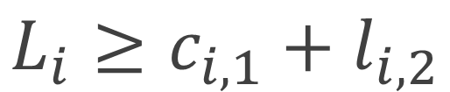
Representing the Span Constraint
c_{i,4}
$$L_{i}≥c_{i,1}+l_{i,2}$$
c_{i,2}
c_{i,8}
c_{i,1}
c_{i,5}
c_{i,3}
c_{i,7}
c_{i,6}

Slide 26
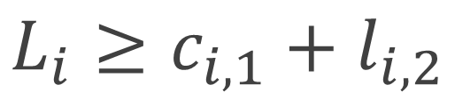
Representing the Span Constraint
c_{i,4}
$$L_{i}≥c_{i,1}+l_{i,2}$$
c_{i,2}
c_{i,8}
$$L_{i}≥c_{i,1}+l_{i,2}$$
c_{i,1}
c_{i,5}
c_{i,3}
c_{i,7}
c_{i,6}

Slide 27
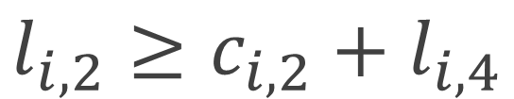
Representing the Span Constraint
c_{i,4}
$$L_{i}≥c_{i,1}+l_{i,2}$$
c_{i,2}
c_{i,8}
$$L_{i}≥c_{i,1}+l_{i,2}$$
c_{i,1}
c_{i,5}
c_{i,3}
c_{i,7}
$$l_{i,2}≥c_{i,2}+l_{i,4}$$
c_{i,6}

Slide 28
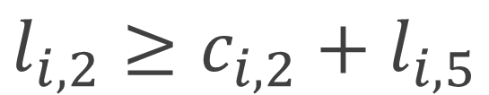
Representing the Span Constraint
c_{i,4}
$$L_{i}≥c_{i,1}+l_{i,2}$$
c_{i,2}
c_{i,8}
$$L_{i}≥c_{i,1}+l_{i,2}$$
c_{i,1}
c_{i,5}
c_{i,3}
c_{i,7}
$$l_{i,2}≥c_{i,2}+l_{i,4}$$
c_{i,6}
$$l_{i,2}≥c_{i,2}+l_{i,5}$$

Slide 29

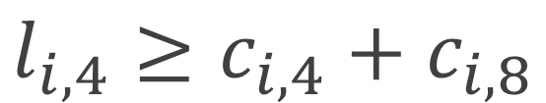
Representing the Span Constraint
c_{i,4}
$$L_{i}≥c_{i,1}+l_{i,2}$$
c_{i,2}
c_{i,8}
$$L_{i}≥c_{i,1}+l_{i,2}$$
c_{i,1}
c_{i,5}
c_{i,3}
c_{i,7}
$$l_{i,2}≥c_{i,2}+l_{i,4}$$
c_{i,6}
$$l_{i,2}≥c_{i,2}+l_{i,5}$$
Maximum $\left\lfloor \frac{k^{2}}{4}\right\rfloor$ Constraints
$$l_{i,4}≥c_{i,4}+c_{i,8}$$

Slide 30
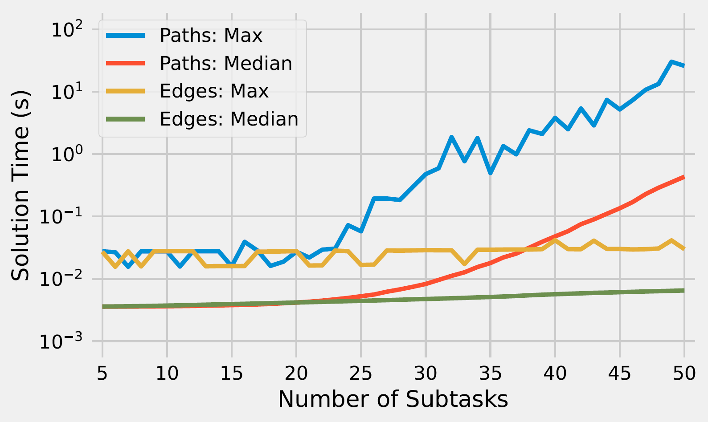
Solver Times (Gurobi)

Slide 31
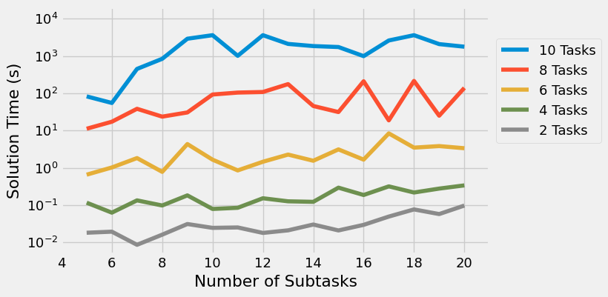
Joint Compression of Multiple Tasks
Option 1: Joint MIQP

Slide 32
Real-Time Systems
Increasingly execute in dynamic environments
And therefore must adapt online

Slide 33
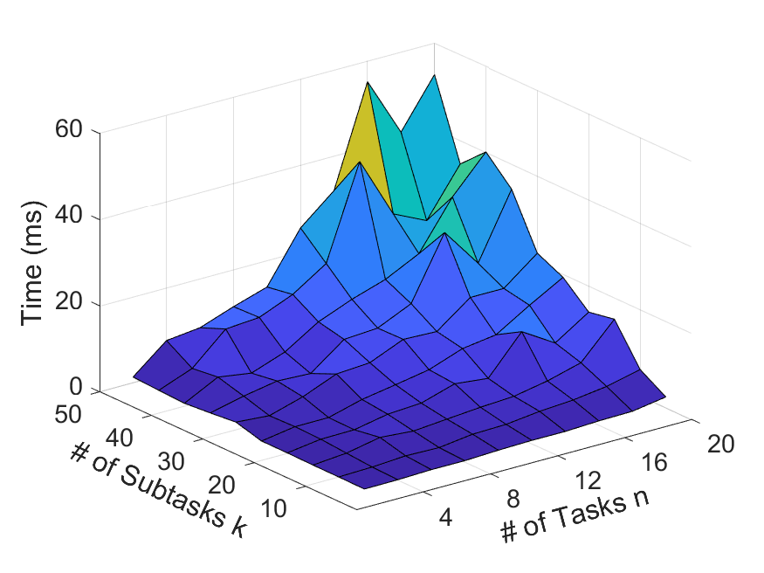
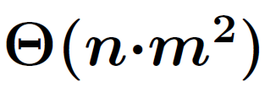
Joint Compression of Multiple Tasks
Option 2: Dynamic Programming
We already construct and characterize task DAGs offline
Why not also solve the MIQP for each task for each number of cores?
Multiple-Choice Knapsack:

Slide 34
Case Study
The Fast Integrated Mobility Spectrometer (FIMS)

Slide 35
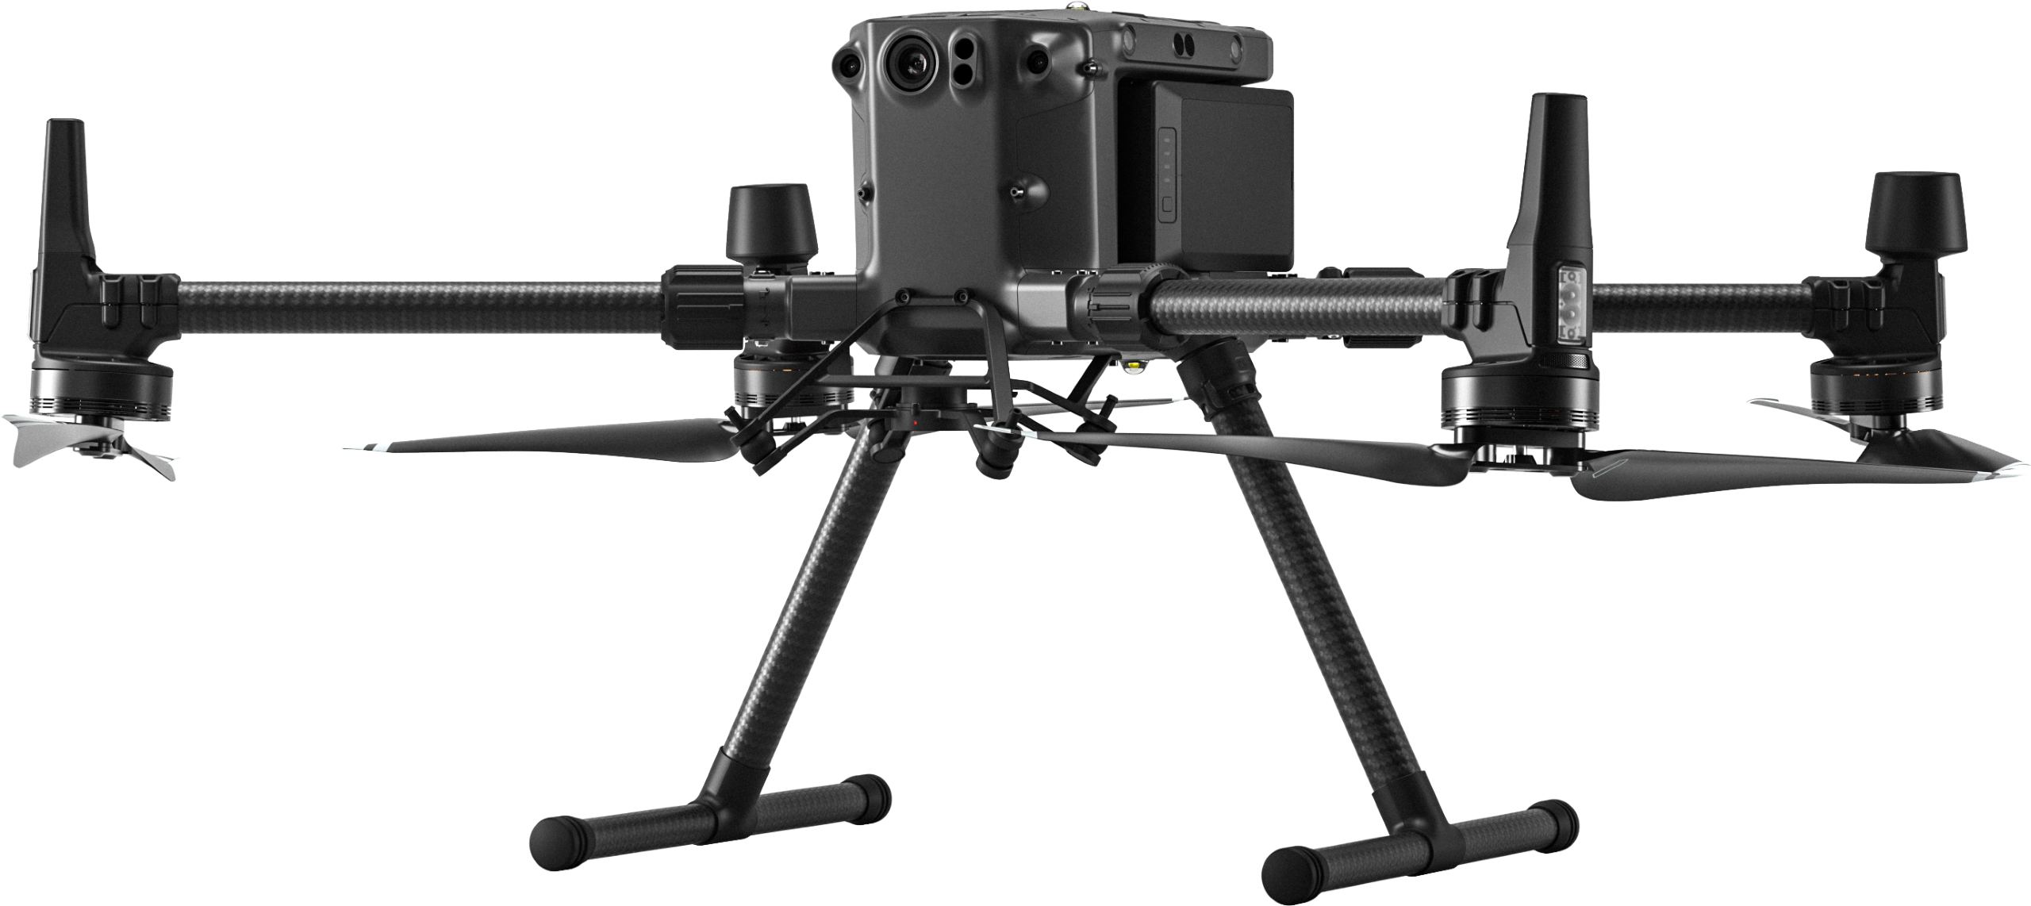
Case Study
The Fast Integrated Mobility Spectrometer (FIMS)
Image courtesy https://www.seilergeodrones.com/shop/dji-matrice-300-rtk/

Slide 36
FIMS Image Processing

Slide 37
FIMS Image Processing

Slide 38
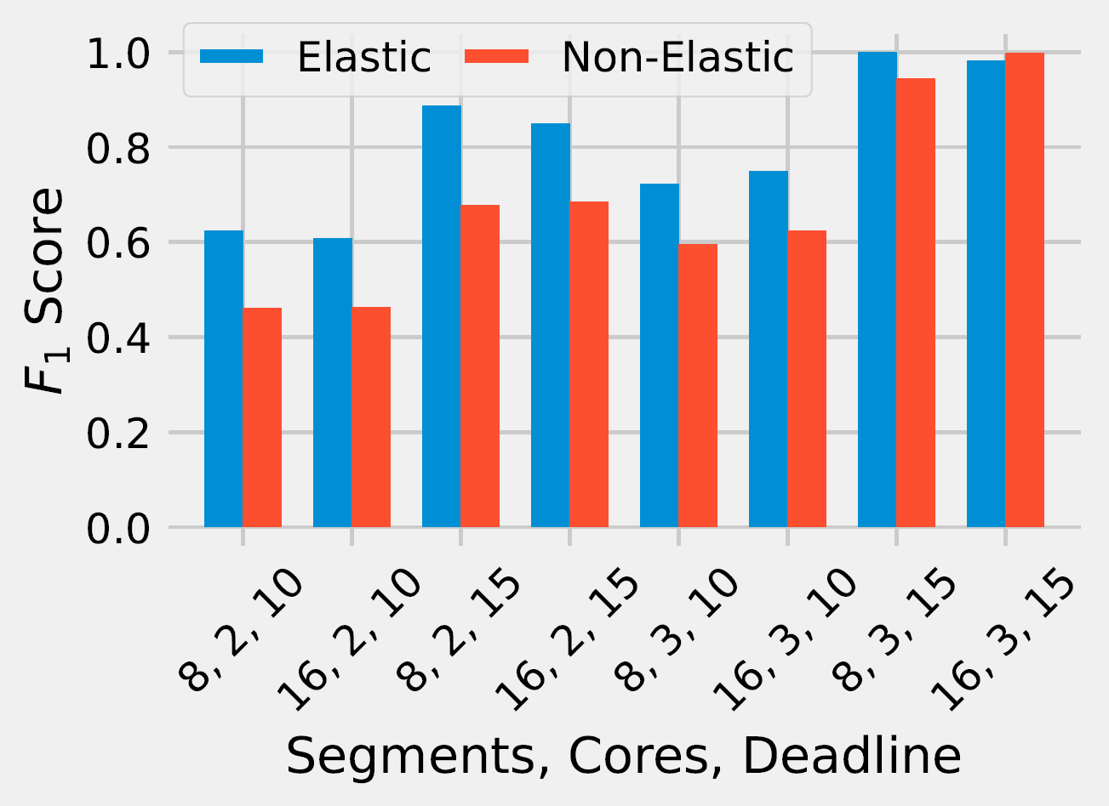
FIMS Image Processing

Slide 39
Conclusions
Elastic scheduling for workload elastic parallel DAG tasks should consider individual subtasks within the DAG
Allows better schedulability and less workload compression
Improves real-world application performance (aerosol particle classification)
Offline MIQP solver
Online pseudo-polynomial resource allocation
More evaluation
Joint compression of sequential tasks
ILP for elastic scheduling under partitioned EDF

Slide 40
Open Questions
Address hybrid-utilization tasks
Interdependent subtask workloads
Wrap DAG scheduling problem into QP

Slide 41

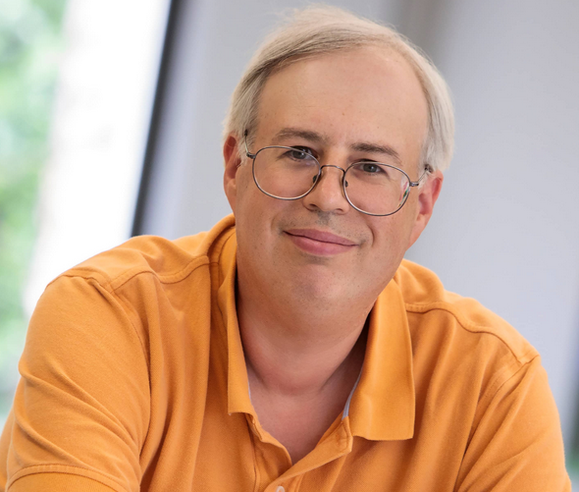
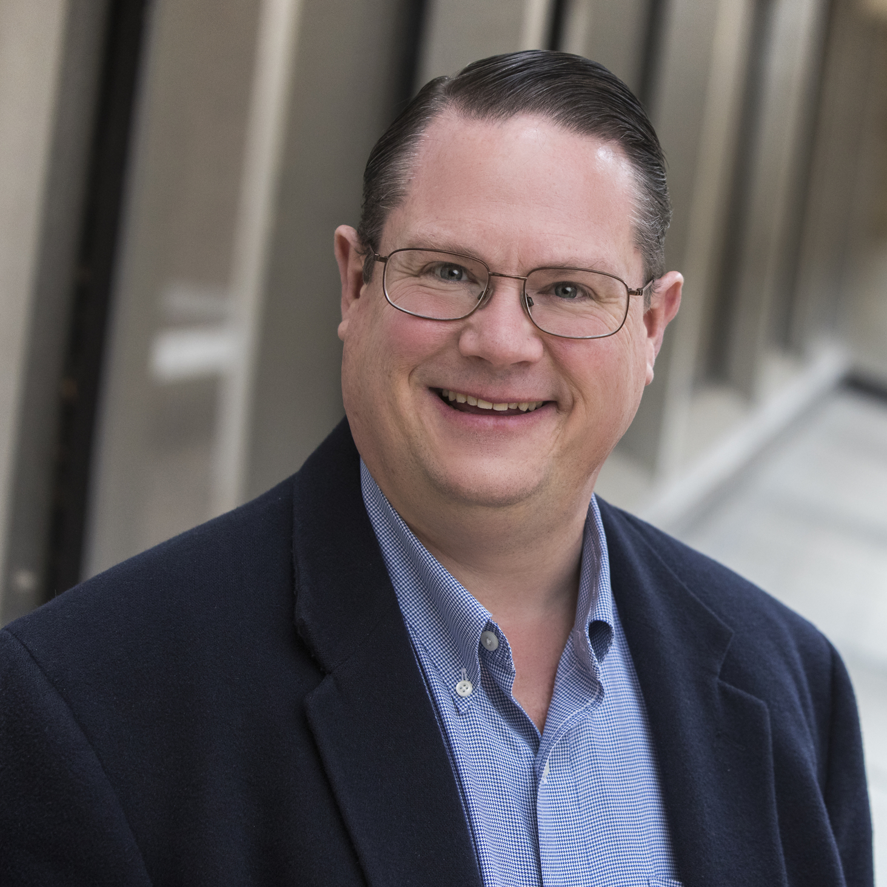

Thank You!
www.sudvarg.com
msudvarg@wustl.edu

Slide 42
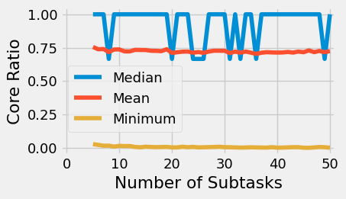
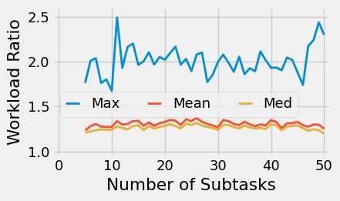
Advantages of Span Compression

Slide 43
Parallel DAG Task Scheduling
c=5
c=3
c=2
C=18
c=8

Slide 44
Parallel DAG Task Scheduling
C=18
c=5
L=13
c=3
c=2
c=8

Slide 45
Parallel DAG Task Scheduling
C=18
c=5
L=13
c=3
c=2
c=8

Slide 46

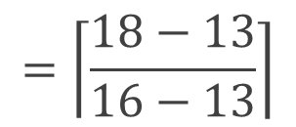
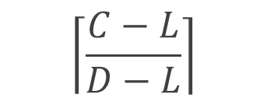

Parallel DAG Task Scheduling
C=18
$$\left\lceil \frac{C−L}{D−L}\right\rceil$$
$$=\left\lceil \frac{18−13}{16−13}\right\rceil$$
$$=2$$
c=5
L=13
D=16
c=3
c=2
c=8

Slide 47
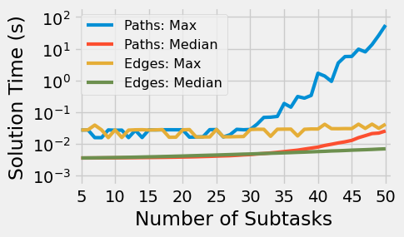
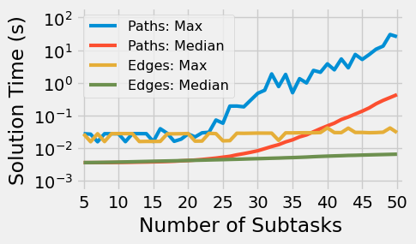
Solver Times: Gurobi
Edge Probability 0.2
Edge Probability 0.5

Slide 48
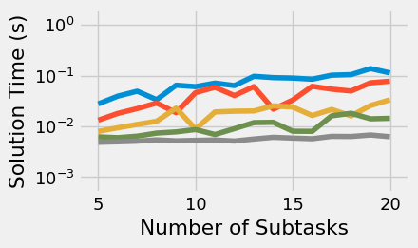
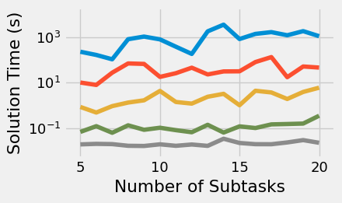
Joint Compression of Multiple Tasks: p=0.2
Median Times
Max Times

Slide 49
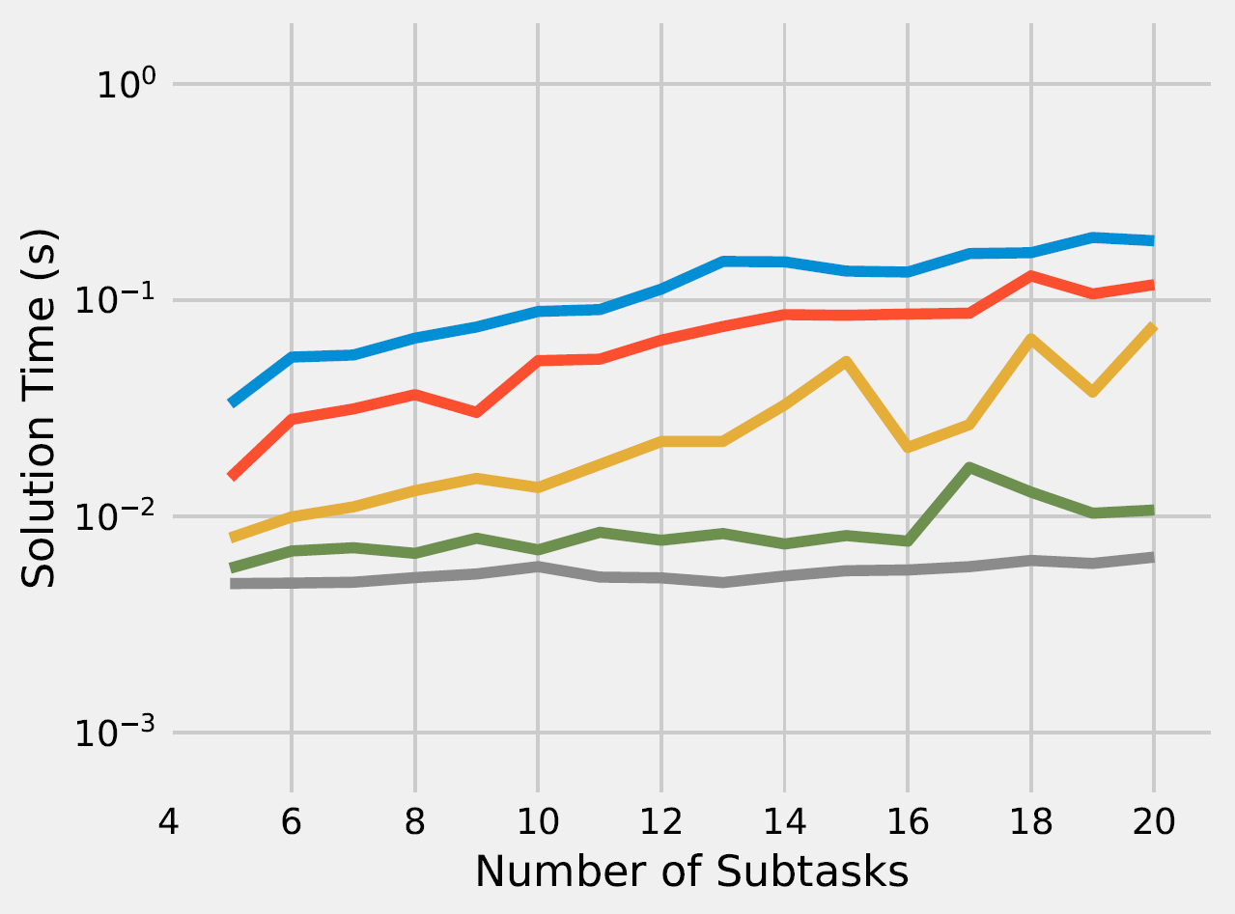
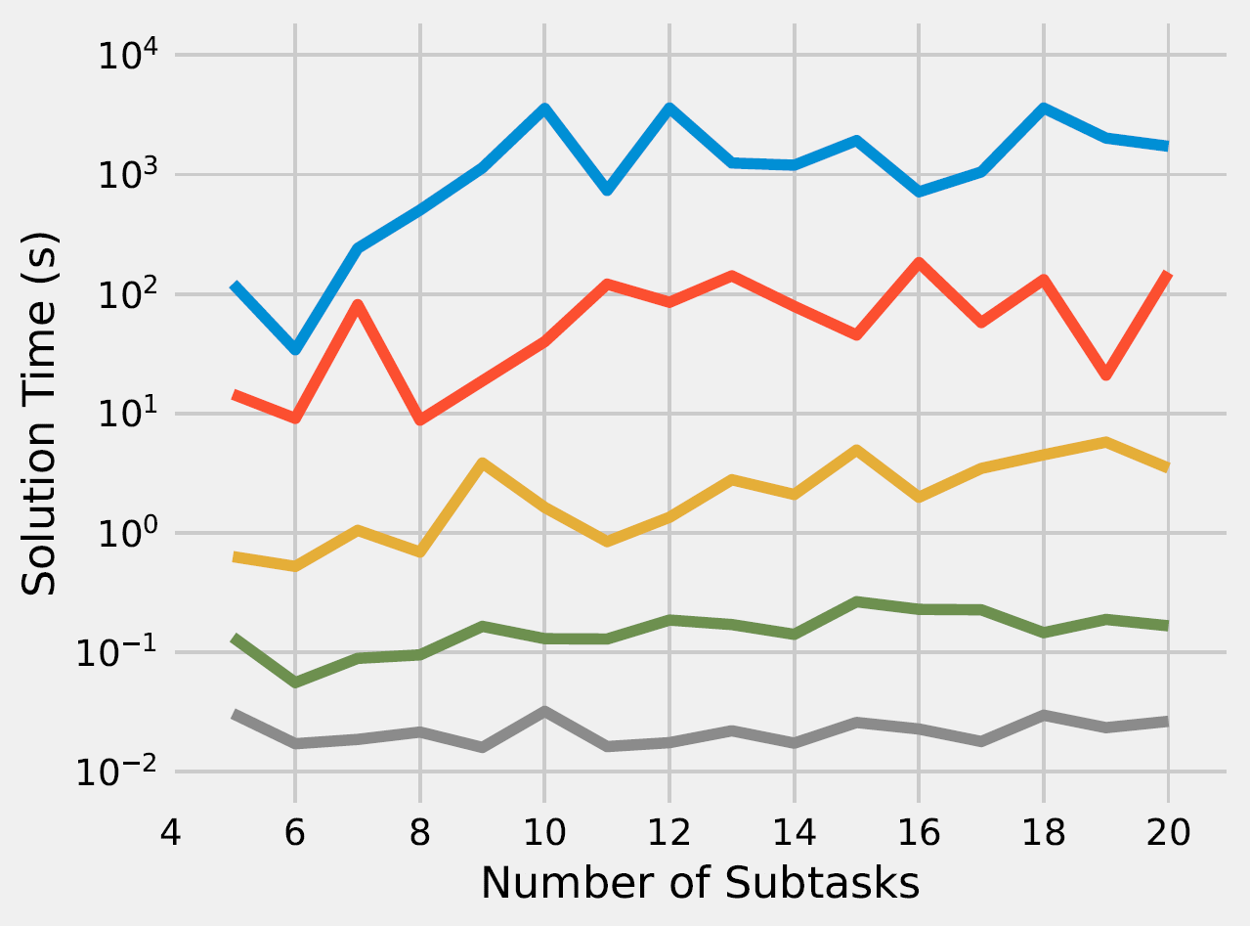
Joint Compression of Multiple Tasks: p=0.5
Median Times
Max Times

Slide 50
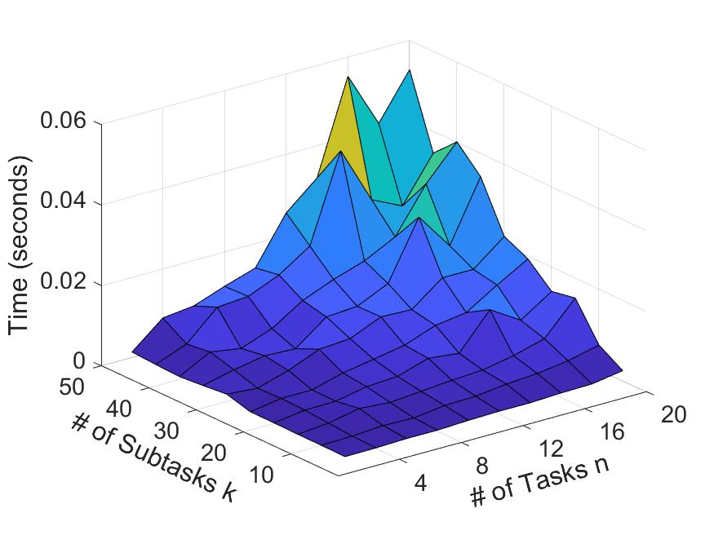
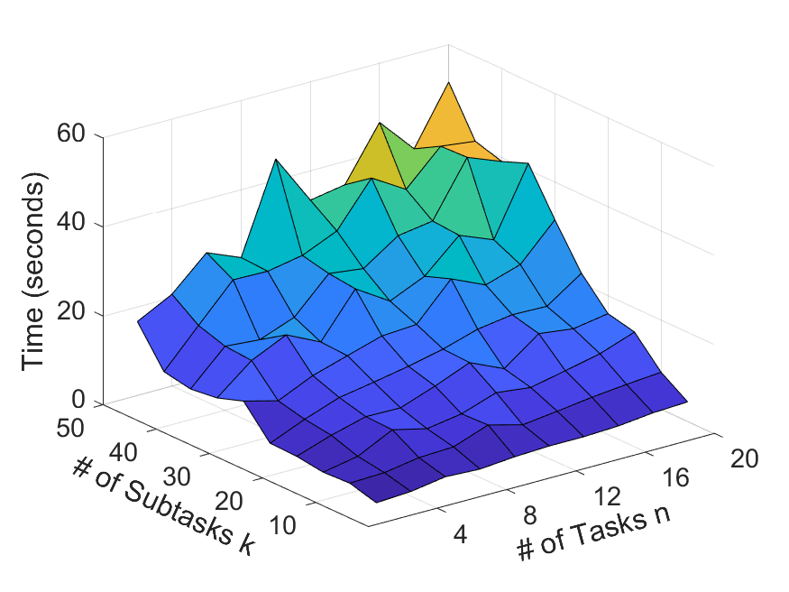
Joint Compression of Multiple Tasks: DP, Max
Online DP
Offline MIQP

Slide 51
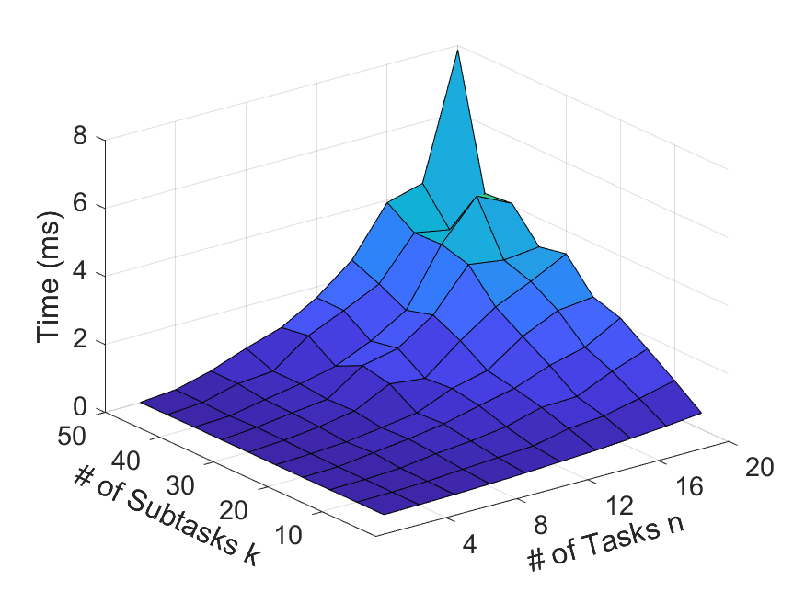
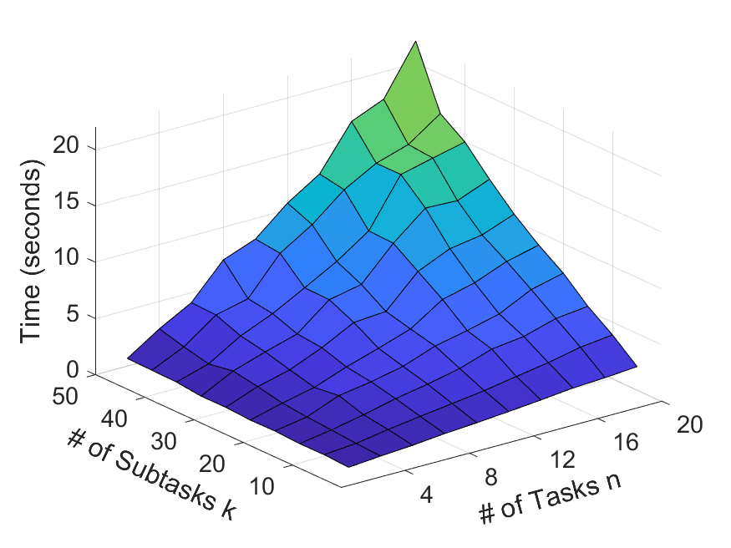
Joint Compression of Multiple Tasks: DP, Median
Online DP
Offline MIQP

Slide 52
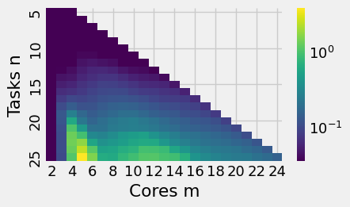
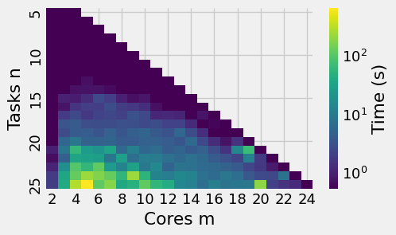
ILP for Partitioned Scheduling
Median
Max

