Slide 1
Analysis of Federated Scheduling for Integer-Valued Workloads
Marion Sudvarg, Chris Gill
Washington University in St. Louis
St. Louis, Missouri, United States
Presented by Marion Sudvarg
RTNS 2022
Supported in part by NSF grants CSR-1814739 and CNS-17653503 and NASA grant 80NSSC21K1741.

Slide 2
Overview
Federated scheduling of real-time tasks assigns dedicated cores to high-utilization parallel tasks
Goal 1: Assign sufficient cores to ensure each task meets its deadline
Goal 2: Assign only necessary cores to prevent resource waste
In general, finding the minimum number of cores necessary to guarantee that a parallel task meets its deadline is NP-Complete
We propose 3 methods for allocating sufficient cores to integer-valued tasks

Slide 3
Motivation: Integer-Valued Tasks
Deadlines and periods are often characterized as integers:
  5ms sampling period, 100ms target latency, …
Execution times are typically expressed by units within a few orders of magnitude of the periods/deadlines:
  second-scale period/ms-scale execution times
  ms-scale period/μs-scale execution times
Times measured at finer scales are often rounded (e.g., 9740ns → 10μs)
By using integer-multiples of the lowest-common-denominator units, we can decompose task execution into discrete unit time steps
This allows improved strategies for the assignment of dedicated cores

Slide 4
Parallel Task Model
𝜏₄
A task 𝜏 is composed of subtasks {𝜏₁,…,𝜏_{n}}
An individual subtask must execute sequentially
Subtask dependencies are described by a DAG:
𝜏_{i} →𝜏_{j} indicates 𝜏_{i} must complete before execution of 𝜏_{j} begins
A subtask becomes available when all of its successors have completed
𝜏₂
𝜏₃
𝜏₁

Slide 5
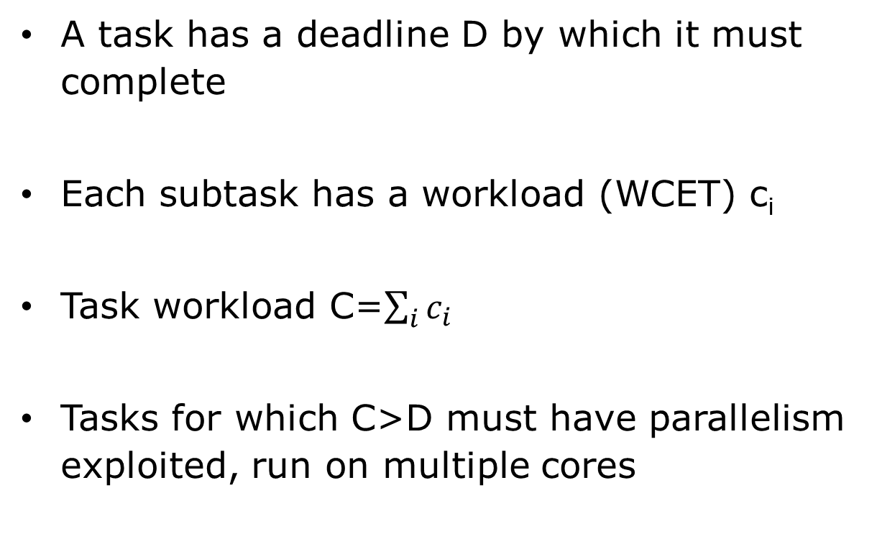
Parallel Task Scheduling
𝜏₄
c=1
A task has a deadline D by which it must complete
Each subtask has a workload (WCET) c_{i}
Task workload C=$\sum_{i}{c_{i}}$
Tasks for which C>D must have parallelism exploited, run on multiple cores
𝜏₂
c=3
𝜏₃
c=2
D=5
C=7
𝜏₁
c=1
t
=0
t
=1
t
=2
t
=3
t
=4
Core 0
𝜏
𝜏
𝜏
𝜏
𝜏
1
2
2
2
4
Core 1
𝜏
𝜏
3
3

Slide 6
Span and Subgraph Work
𝜏₄
c=1
𝓁=1
𝓌=1
Each subtask has a span (𝓁) indicating the longest path to completion
  Task span (L) is the greatest subtask span
  Indicates how long the task takes to complete on infinite cores
Each subtask has a subgraph work (𝓌) indicating the total workload of those vertices it precedes (and its own)
Each value can be found in O(|V|+|E|) time
𝜏₂
c=3
𝜏₃
c=2
𝓁=4
𝓁=3
𝓌=4
𝓌=3
𝜏₁
c=1
𝓁=5
𝓌=7
L=5

Slide 7
Integer-Valued Tasks
𝜏₄
c=1
𝓁=1
𝓌=1
We consider integer-valued tasks:
  Deadline is an integer
  Each subtask workload is an integer
This allows us to consider execution in discrete, unit time steps
𝜏₂
c=3
𝜏₃
c=2
𝓁=4
𝓁=3
𝓌=4
𝓌=3
𝜏₁
c=1
𝓁=5
𝓌=7

Slide 8
Integer-Valued Tasks
𝜏₄
c=1
𝓁=1
𝓌=1
We consider integer-valued tasks:
  Deadline is an integer
  Each subtask workload is an integer
This allows us to consider execution in discrete, unit time steps
An integer-valued DAG can be decomposed in O(C+|E|) time to a DAG of unit-workload subtasks
𝜏₂
c=3
𝜏₃
c=2
𝓁=4
𝓁=3
𝓌=4
𝓌=3
𝜏₁
c=1
𝓁=5
𝓌=7

Slide 9
Integer-Valued Tasks
𝜏₄
c=1
𝓁=1
𝓌=1
𝜏_{2,3}
c=1
𝓁=2
We consider integer-valued tasks:
  Deadline is an integer
  Each subtask workload is an integer
This allows us to consider execution in discrete, unit time steps
An integer-valued DAG can be decomposed in O(C+|E|) time to a DAG of unit-workload subtasks
𝓌=2
𝜏_{2,2}
c=1
𝜏₃
c=2
𝓁=3
𝓁=3
𝓌=3
𝓌=3
𝜏_{2,1}
c=1
𝓁=4
𝓌=4
𝜏₁
c=1
𝓁=5
𝓌=7

Slide 10
Integer-Valued Tasks
𝜏₄
c=1
𝓁=1
𝓌=1
𝜏_{2,3}
c=1
𝓁=2
We consider integer-valued tasks:
  Deadline is an integer
  Each subtask workload is an integer
This allows us to consider execution in discrete, unit time steps
An integer-valued DAG can be decomposed in O(C+|E|) time to a DAG of unit-workload subtasks
𝓌=2
𝜏_{3,2}
c=1
𝓁=2
𝓌=2
𝜏_{2,2}
c=1
𝓁=3
𝓌=3
𝜏_{3,1}
c=1
𝓁=3
𝜏_{2,1}
c=1
𝓌=3
𝓁=4
𝓌=4
𝜏₁
c=1
𝓁=5
𝓌=7

Slide 11
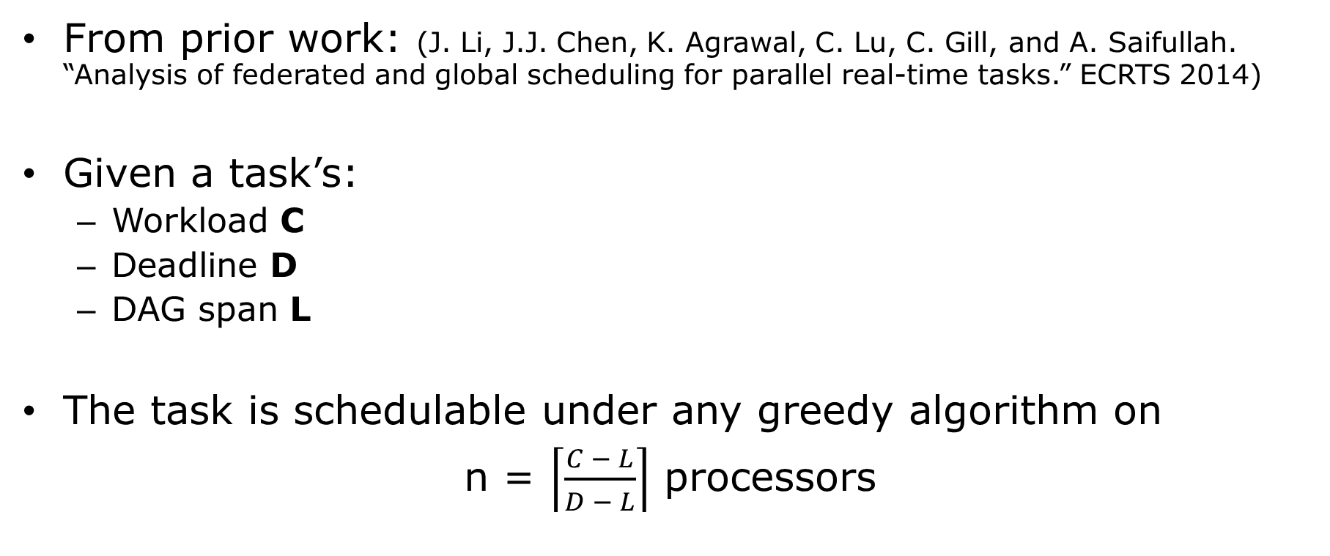
Constant-Time Processor Assignment
From prior work: (J. Li, J.J. Chen, K. Agrawal, C. Lu, C. Gill, and A. Saifullah. “Analysis of federated and global scheduling for parallel real-time tasks.” ECRTS 2014)
Given a task’s:
  Workload C
  Deadline D
  DAG span L
The task is schedulable under any greedy algorithm on
n = $\left\lceil \frac{C − L}{D − L}\right\rceil$ processors

Slide 12
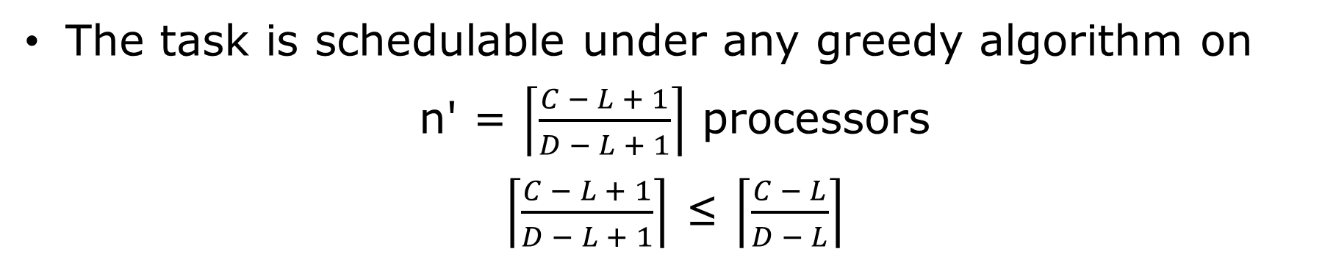
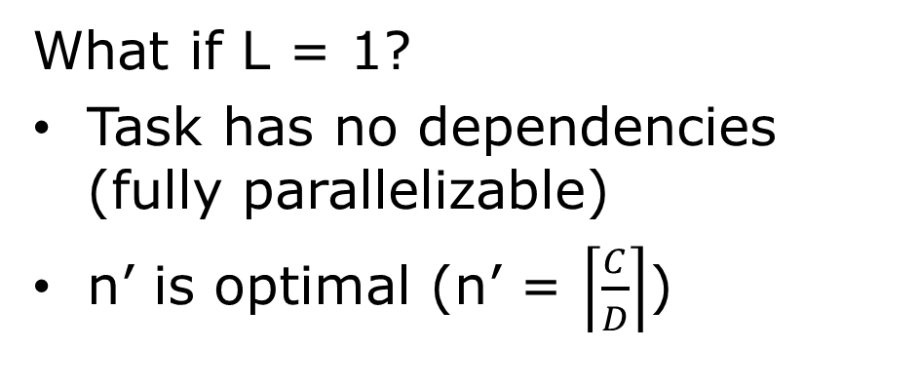
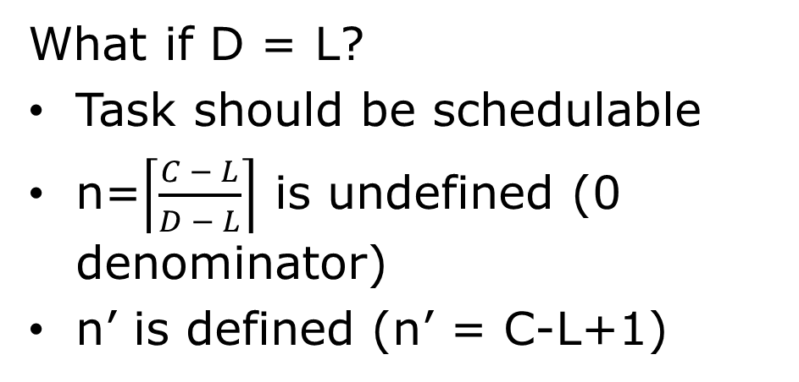
Constant-Time Assignment for Integer-Valued Tasks
The task is schedulable under any greedy algorithm on
n' = $\left\lceil \frac{C − L + 1}{D − L + 1}\right\rceil$ processors
$\left\lceil \frac{C − L + 1}{D − L + 1}\right\rceil$ ≤ $\left\lceil \frac{C − L}{D − L}\right\rceil$
  C Workload
  D Deadline
  L Span
What if D = L?
Task should be schedulable
n=$\left\lceil \frac{C − L}{D − L}\right\rceil$ is undefined (0 denominator)
n’ is defined (n’ = C-L+1)
What if L = 1?
Task has no dependencies (fully parallelizable)
n’ is optimal (n’ = $\left\lceil \frac{C}{D}\right\rceil$)
C=7
L=1
c=1
c=1
c=1
c=1
c=1
c=1
c=1
Notes:
Not only can this allocate fewer processors, it also addresses two cases.

Slide 13
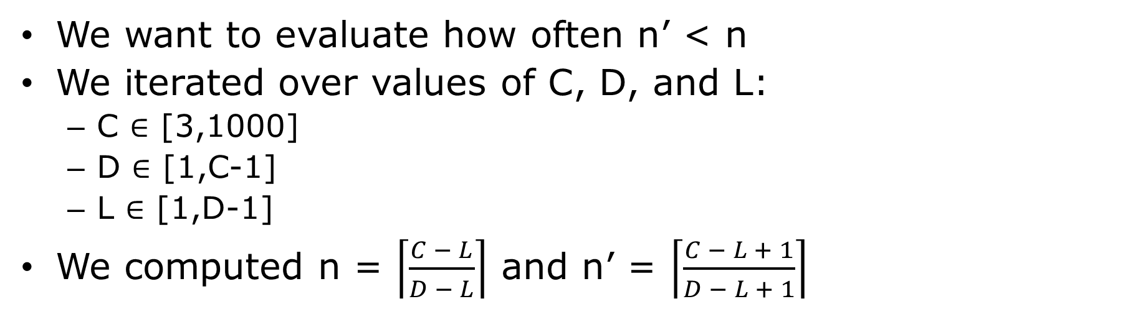
Comparing Processors Assigned
  C Workload
  D Deadline
  L Span
We want to evaluate how often n’ < n
We iterated over values of C, D, and L:
  C ∈ [3,1000]
  D ∈ [1,C-1]
  L ∈ [1,D-1]
We computed n = $\left\lceil \frac{C − L}{D − L}\right\rceil$ and n’ = $\left\lceil \frac{C − L + 1}{D − L + 1}\right\rceil$
C ∈ | Number of Tasks | % n’ < n | Σn’/Σn
[3,10] | 120 | 35.8 | 0.816
[11,100] | 161,580 | 21.7 | 0.820
[101,1000] | 166,005,300 | 8.70 | 0.864
Notes:
With C in the range 3-1000; given the scale at which deadlines and execution times are expressed, this should cover a broad range of real-world task sets.
We computed n and n’, and we found that n’ is often less than n, especially for smaller values of C. Even for larger values of C, the total number of cores assigned by the new method was significantly less than the total assigned by the old method.

Slide 14
Comparing Task Admission
We want to evaluate how often the new assignment allows admission of more task sets
We generated 1000 random task sets for each total utilization in [2-64]
For each task set, we computed the total cores assigned by the old versus new methods
We considered, given the total cores assigned, how many of these task sets would be admitted on systems with different core counts
Notes:
We found that qualitatively, the results are similar for smaller and larger numbers of cores: at the low end of utilization, most task sets can be admitted. For utilizations approaching the number of cores, very few task sets can be admitted. At utilizations in the middle, the new method admits more task sets than the old method.

Slide 15
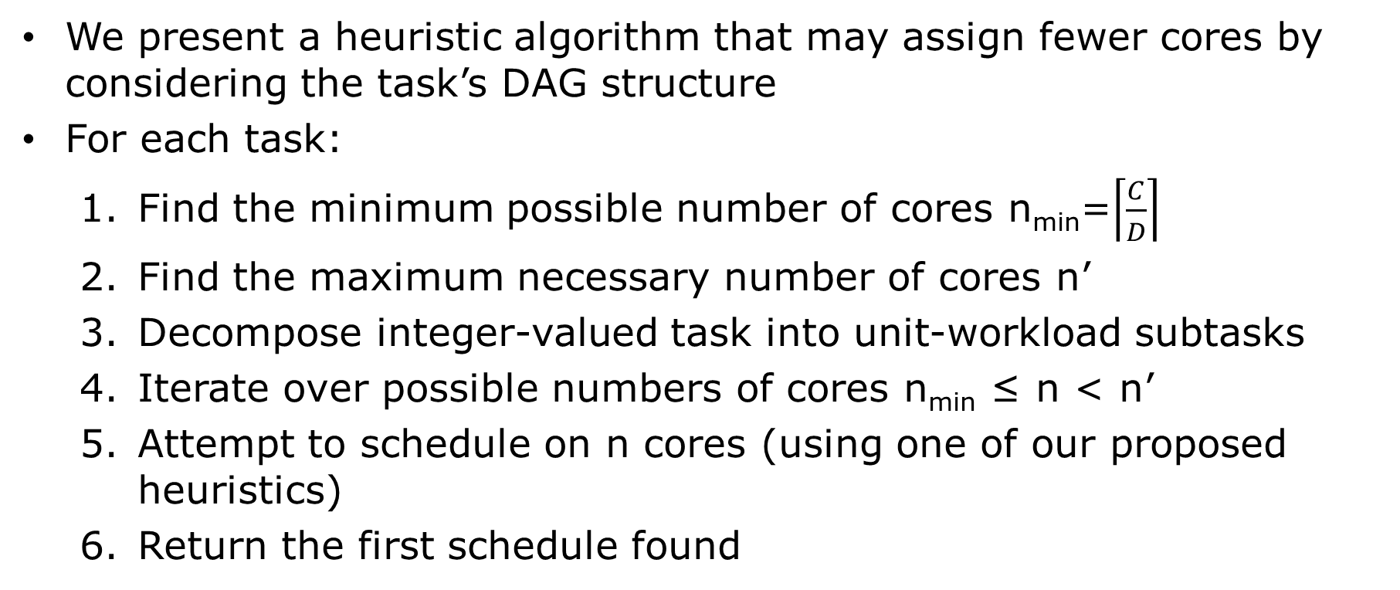
Heuristic Algorithm
We present a heuristic algorithm that may assign fewer cores by considering the task’s DAG structure
For each task:
Find the minimum possible number of cores n_{min}=$\left\lceil \frac{C}{D}\right\rceil$
Find the maximum necessary number of cores n’
Decompose integer-valued task into unit-workload subtasks
Iterate over possible numbers of cores n_{min} ≤ n < n’
Attempt to schedule on n cores (using one of our proposed heuristics)
Return the first schedule found

Slide 16
Proposed Heuristics
Input: a task decomposed into unit-value workloads
At each time step:
CP+LNS
Schedule subtasks according to greatest span first
Ties broken by greatest subgraph work
LNS+CP
Schedule urgent subtasks first
If available processors remain, schedule according to greatest subgraph work
Ties broken by greatest span
Notes:
We consider *both* because neither is always better than the other, as illustrated in the following examples.

Slide 17
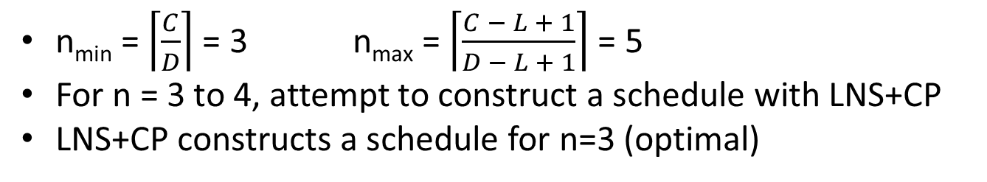
Example 1
v₉
𝓌=1
𝓁=1
v₁₀
𝓌=1
𝓁=1
v₁₁
𝓌=1
𝓁=1
v₁₂
𝓌=1
𝓁=1
v₁₃
𝓌=1
𝓁=1
v₁₄
𝓌=1
𝓁=1
v₁₅
𝓌=1
𝓁=1
LNS+CP
t
=0
t
=1
t
=2
t
=3
t
=4
Core 0
v
v
v
v
v
D=5
C=15
L=3
3
6
1
2
9
Core 1
v
v
v
v
v
v₂
𝓌=2
𝓁=2
4
7
10
12
14
Core 2
v
v
v
v
v
5
8
11
13
15
v₁
𝓌=3
𝓁=3
v₃
𝓌=8
𝓁=2
v₄
𝓌=8
𝓁=2
v₅
𝓌=8
𝓁=2
v₆
𝓌=8
𝓁=2
v₇
𝓌=8
𝓁=2
v₈
𝓌=8
𝓁=2
n_{min} = $\left\lceil \frac{C}{D}\right\rceil$ = 3 n_{max} = $\left\lceil \frac{C − L + 1}{D − L + 1}\right\rceil$ = 5
For n = 3 to 4, attempt to construct a schedule with LNS+CP
LNS+CP constructs a schedule for n=3 (optimal)

Slide 18
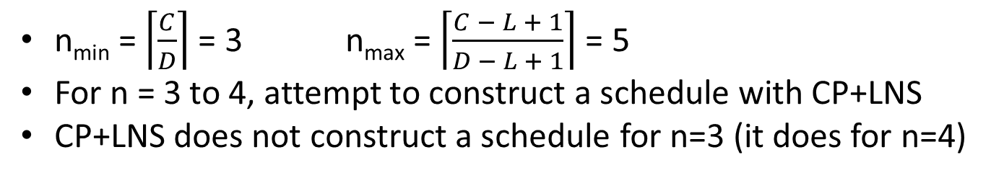
Example 1
v₉
𝓌=1
𝓁=1
v₁₀
𝓌=1
𝓁=1
v₁₁
𝓌=1
𝓁=1
v₁₂
𝓌=1
𝓁=1
v₁₃
𝓌=1
𝓁=1
v₁₄
𝓌=1
𝓁=1
v₁₅
𝓌=1
𝓁=1
LNS+CP
t
=0
t
=1
t
=2
t
t
=3
t
t
=4
Core 0
v
v
v
v
v
D=5
C=15
L=3
3
6
1
2
9
Core 1
v
v
v
v
v
v₂
𝓌=2
𝓁=2
4
7
10
12
14
Core 2
v
v
v
v
v
5
8
11
13
15
CP+LNS
v₁
𝓌=3
𝓁=3
v₃
𝓌=8
𝓁=2
v₄
𝓌=8
𝓁=2
v₅
𝓌=8
𝓁=2
v₆
𝓌=8
𝓁=2
v₇
𝓌=8
𝓁=2
v₈
𝓌=8
𝓁=2
t
=0
t
=1
t
=2
t
=3
t
=4
Core 0
v
v
v
1
5
8
Core 1
v
v
v
n_{min} = $\left\lceil \frac{C}{D}\right\rceil$ = 3 n_{max} = $\left\lceil \frac{C − L + 1}{D − L + 1}\right\rceil$ = 5
For n = 3 to 4, attempt to construct a schedule with CP+LNS
CP+LNS does not construct a schedule for n=3 (it does for n=4)
3
6
2
Core 2
v
v
4
7

Slide 19
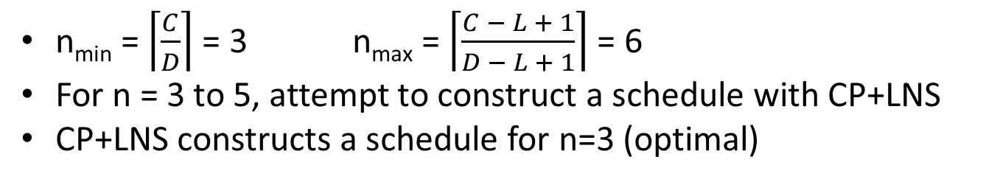
Example 2
v₁₄
𝓌=1
𝓁=1
CP+LNS
D=5
C=14
L=4
v₁₃
𝓌=2
𝓁=2
t
=0
t
=1
t
=2
t
=3
t
=4
v₄
𝓌=1
𝓁=1
v₅
𝓌=1
𝓁=1
v₆
𝓌=1
𝓁=1
v₇
𝓌=1
𝓁=1
Core 0
v
v
v
v
v
8
11
12
13
14
Core 1
v
v
v
v
v
9
1
3
4
6
v₁₂
𝓌=3
𝓁=3
Core 2
v
v
v
v
10
2
5
7
v₁
𝓌=5
𝓁=2
v₂
𝓌=5
𝓁=2
v₃
𝓌=5
𝓁=2
v₈
𝓌=4
𝓁=4
v₉
𝓌=4
𝓁=4
v₁₀
𝓌=4
𝓁=4
v₁₁
𝓌=4
𝓁=4
n_{min} = $\left\lceil \frac{C}{D}\right\rceil$ = 3 n_{max} = $\left\lceil \frac{C − L + 1}{D − L + 1}\right\rceil$ = 6
For n = 3 to 5, attempt to construct a schedule with CP+LNS
CP+LNS constructs a schedule for n=3 (optimal)

Slide 20
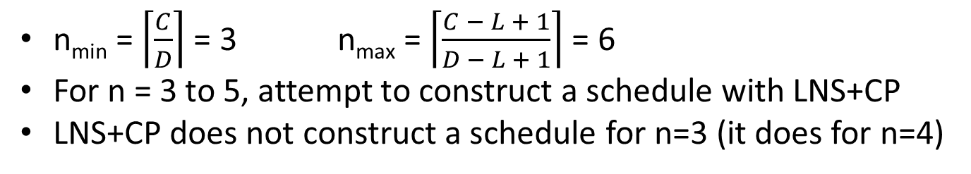
Example 2
v₁₄
𝓌=1
𝓁=1
CP+LNS
D=5
C=14
L=4
v₁₃
𝓌=2
𝓁=2
t
=0
t
=1
t
=2
t
=3
t
=4
v₄
𝓌=1
𝓁=1
v₅
𝓌=1
𝓁=1
v₆
𝓌=1
𝓁=1
v₇
𝓌=1
𝓁=1
Core 0
v
v
v
v
v
8
11
12
13
14
Core 1
v
v
v
v
v
9
1
3
4
6
v₁₂
𝓌=3
𝓁=3
Core 2
v
v
v
v
10
2
5
7
LNS+CP
v₁
𝓌=5
𝓁=2
v₂
𝓌=5
𝓁=2
v₃
𝓌=5
𝓁=2
v₈
𝓌=4
𝓁=4
v₉
𝓌=4
𝓁=4
v₁₀
𝓌=4
𝓁=4
v₁₁
𝓌=4
𝓁=4
t
=0
t
=1
t
=2
t
=3
t
=4
Core 0
v
v
1
8
Core 1
v
v
n_{min} = $\left\lceil \frac{C}{D}\right\rceil$ = 3 n_{max} = $\left\lceil \frac{C − L + 1}{D − L + 1}\right\rceil$ = 6
For n = 3 to 5, attempt to construct a schedule with LNS+CP
LNS+CP does not construct a schedule for n=3 (it does for n=4)
2
9
Core 2
v
v
3
10

Slide 21
Optimal Assignment: Subgraph Isomorphism
We represent the problem of finding a schedule on n cores by a deadline D as a subgraph isomorphism problem:
Decompose an integer-valued task DAG G to a unit-value workload DAG G*
Iterate over possible numbers of cores n_{min} ≤ n < n’
Construct a special DAG G_{CPU} defined by n and D
Attempt to find an isomorphism from G* to a subgraph of G_{CPU}, e.g. with the Glasgow Subgraph Solver *
If an isomorphism is found, return the corresponding schedule
* https://github.com/ciaranm/glasgow-subgraph-solver

Slide 22
Constructing G_{CPU}
G*
v₂
v₃
v₁
Create a graph with n*D vertices
  Each corresponds to execution on core m={0,…,n-1} at time t={0,…,D-1}
  Let’s call these v_{m,t}
From every vertex at time t, connect an edge to each vertex at any time t*>t
Find an isomorphism from G* to a subgraph of G_{CPU}
For each vertex in G*, the mapped vertex v_{m,t} in G_{CPU} indicates to execute the subtask on core m at time t
v₄
G_{CPU} for n=2, D=3
m₀
v₁
v₂
v₃
m₁
v₄
t₀
t₁
t₂

Slide 23
Evaluation Methods
We generate 19000 random task DAGs
Each DAG has 5-250 nodes with workloads from 5-10
We find the number of cores assigned by:
  CP+LNS
  LNS+CP
  Subgraph isomorphism (optimal)

Slide 24
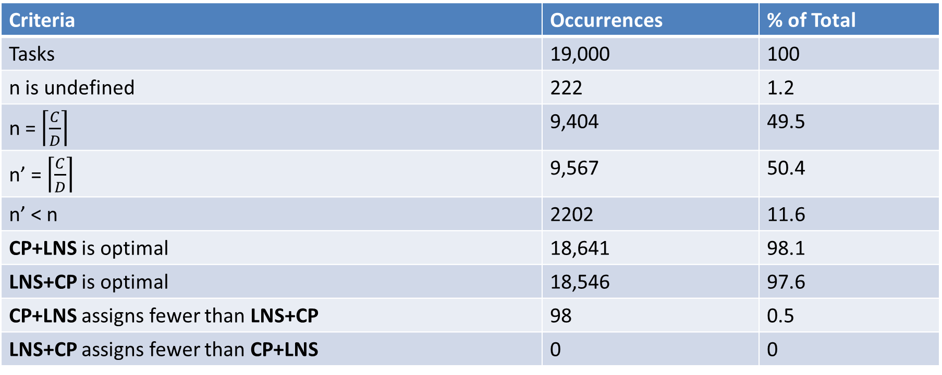
Heuristic Performance Over Random DAGs
Note: n = $\left\lceil \frac{C − L}{D − L}\right\rceil$ and n’ = $\left\lceil \frac{C − L + 1}{D − L + 1}\right\rceil$
Criteria | Occurrences | % of Total
Tasks | 19,000 | 100
n is undefined | 222 | 1.2
n = $\left\lceil \frac{C}{D}\right\rceil$ | 9,404 | 49.5
n’ = $\left\lceil \frac{C}{D}\right\rceil$ | 9,567 | 50.4
n’ < n | 2202 | 11.6
CP+LNS is optimal | 18,641 | 98.1
LNS+CP is optimal | 18,546 | 97.6
CP+LNS assigns fewer than LNS+CP | 98 | 0.5
LNS+CP assigns fewer than CP+LNS | 0 | 0

Slide 25
GSS Execution Times
Used Glasgow Subgraph Solver in single-threaded mode (parallelized instances across the 19000 random DAGs)
Ran on system with two Intel Xeon Gold 6130 Skylake CPUs running at 2.1GHz and 32GB of RAM
Notes:
We found that, as the probability of an edge between pairwise vertices increased (reflective of the DAGs becoming more connected), GSS execution times also increased. The mean execution time remained under 5 minutes even on a single-threaded instance of GSS, and the greatest execution time was under 22 minutes even running in single-threaded mode, demonstrating the feasibility of running GSS offline to find an optimal schedule.

Slide 26
Conclusions and Future Work
By assigning integer-valued workloads and deadlines to tasks, we can find a better sufficient core assignment in constant time
CP+LNS and LNS+CP heuristics run in polynomial time on task workload and often (>97% of the time) find optimal core assignments (for domain of DAGs tested)
Using Glasgow Subgraph Solver to find subgraph isomorphism feasibly finds optimal core assignment
We would like to consider other task DAG generation methods and test on real-world applications

Slide 27
Thank You!
Questions?

Slide 28
Comparing Task Admission
We want to evaluate how often the new assignment allows more task sets to be admitted
We generated random task sets:
  For each U ∈ [2,64]:
  Generate 1000 task sets
  Number of tasks chosen uniformly from [1,U/2]
  Random assignment of task utilizations
  Deadlines selected from log-uniform distribution over [2,1000]
  L selected uniformly over [1,D-1]
For each task set, compute Σn and Σn’

Slide 29
Existing Heuristics for Processor Assignment
Graham’s List Scheduling (R. L. Graham. “Bounds on Multiprocessing Timing Anomalies.” SIAM J. Appl. Math. 17, 2 (1969), 416–429)
  Prioritize subtasks according to some rule
  Schedule subtasks non-preemptively according to priority as they become available
  Critical-Path Rule (CP): Greatest critical path first
  Largest Number of Successors Rule (LNS): Greatest subgraph work first
Efficient Deterministic Scheduling (Son Dinh, Christopher Gill, and Kunal Agrawal. “Efficient Deterministic Federated Scheduling for Parallel Real-Time Tasks.” RTCSA 2020)
  Select urgent subtasks first (those with no slack time)
  If there are free processors, select according to LNS
  Allow preemption after unit execution time

Slide 30
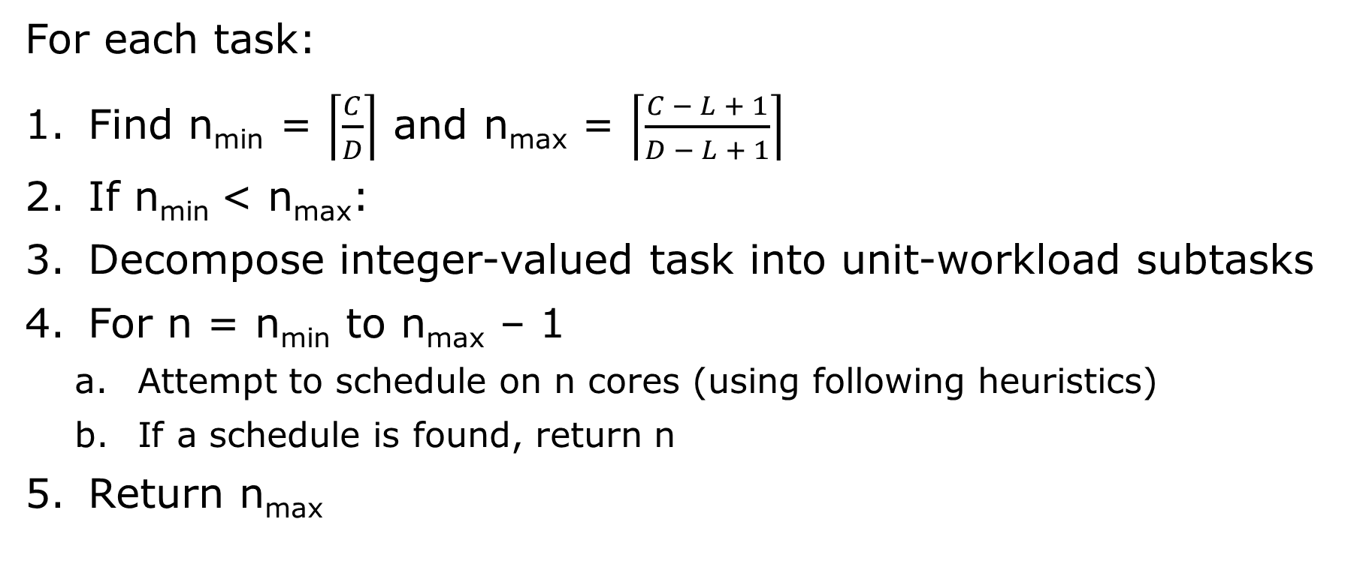
Pseudo-Polynomial Time Heuristic Algorithm
For each task:
Find n_{min} = $\left\lceil \frac{C}{D}\right\rceil$ and n_{max} = $\left\lceil \frac{C − L + 1}{D − L + 1}\right\rceil$
If n_{min} < n_{max}:
Decompose integer-valued task into unit-workload subtasks
For n = n_{min} to n_{max} – 1
  Attempt to schedule on n cores (using following heuristics)
  If a schedule is found, return n
Return n_{max}

Slide 31
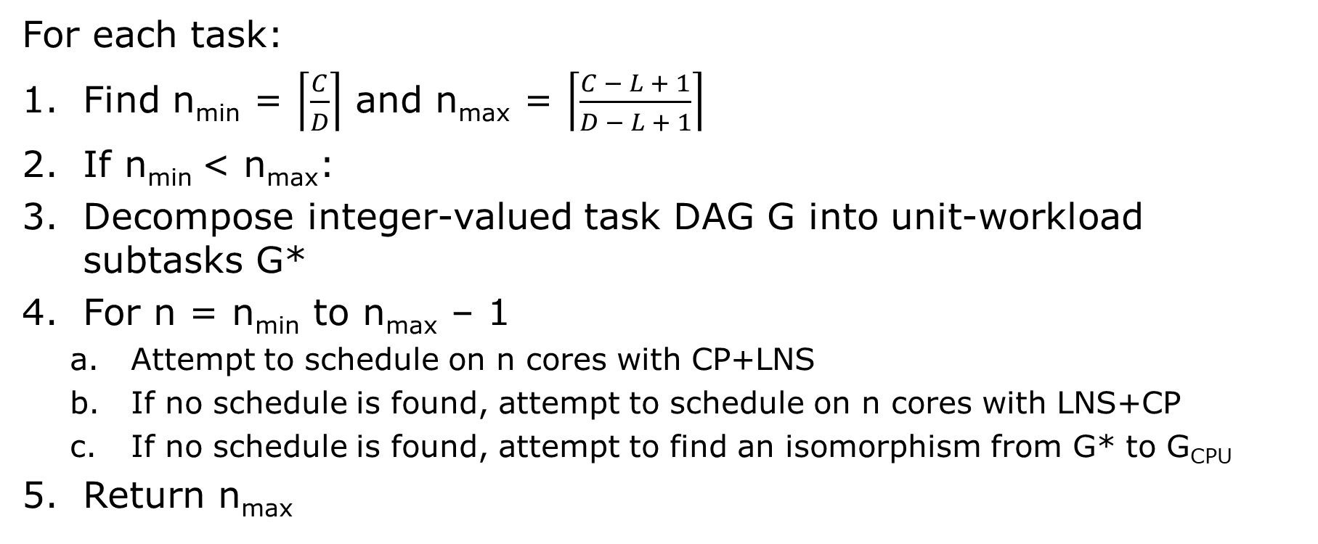
Final Federated Scheduling Algorithm
For each task:
Find n_{min} = $\left\lceil \frac{C}{D}\right\rceil$ and n_{max} = $\left\lceil \frac{C − L + 1}{D − L + 1}\right\rceil$
If n_{min} < n_{max}:
Decompose integer-valued task DAG G into unit-workload subtasks G*
For n = n_{min} to n_{max} – 1
  Attempt to schedule on n cores with CP+LNS
  If no schedule is found, attempt to schedule on n cores with LNS+CP
  If no schedule is found, attempt to find an isomorphism from G* to G_{CPU}
Return n_{max}

Slide 32
Evaluation Methods
We generate random task DAGs according to the Erdős-Rényi method: for each pair of vertices, an edge (directed from smaller to larger vertex index) connects them with probability p
For each p in 0.05-0.95, generate 1000 tasks:
  Number of nodes sampled uniformly from [5,250]
  Each node assigned a workload in [5-10]
  Calculate total workload C
  Connect vertices with probability p, then continue to randomly add edges until DAG is weakly connected
  Calculate span L
  Deadline D sampled uniformly from [L,C-1]
  Calculate n_{min} and n_{max}
  Find core assignment according to CP+LNS, LNS+CP, and subgraph isomorphism (using the Glasgow Subgraph Solver)

