Slide 1


Tintin: PMU Scheduling to Minimize Uncertainty
Marion Sudvarg, Ao Li, Tomson Li,
Sanjoy Baruah, Chris Gill, Ning Zhang
This work was supported by the NSF (CNS-2154930, CNS-2229427, CNS-2141256, CNS-2403758, CNS-2229290), the ARO (W911NF-24-1-0155), the ONR (N00014-24-1-2663), a WashU OVCR seed grant, and Intel

Slide 2


Slide 3
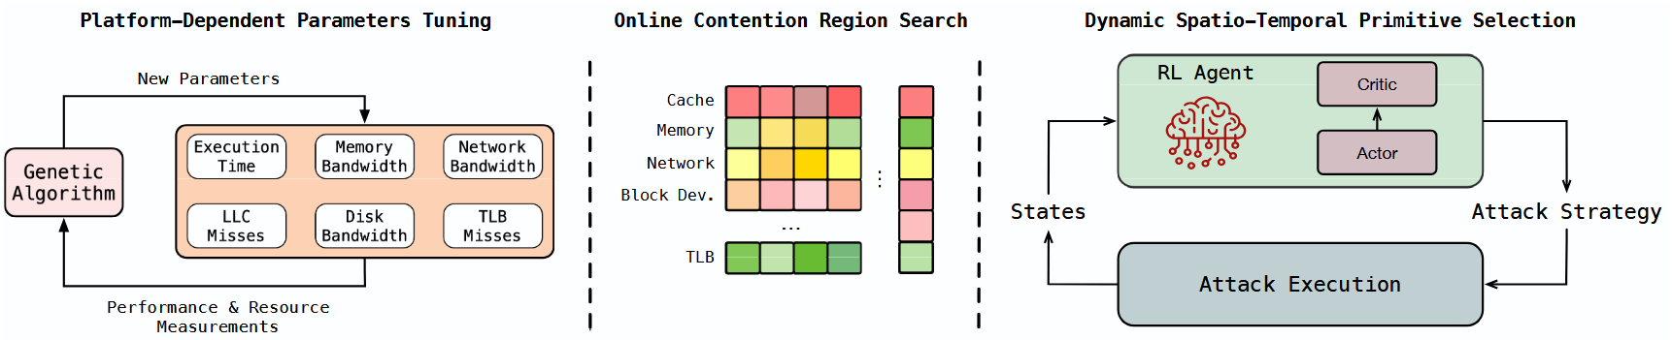
Real-Time Systems
Demand efficient + predictable execution times
Hardware access and contention patterns can make this challenging

Slide 4

Hardware Performance Monitoring
Characterize execution patterns
Predict contention
RT-Bench

Slide 5
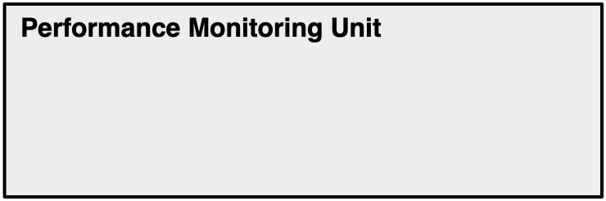

Background
PMU and HPCs

Slide 6
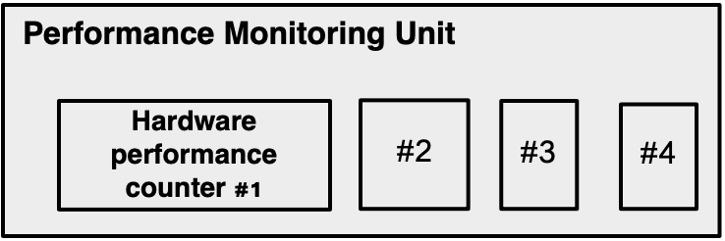
Background
PMU and HPCs

Slide 7
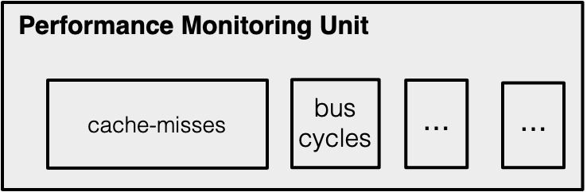

Background
PMU and HPCs
cache-misses
cache-misses
bus-cycles
bus-cycles
. . .

Slide 8


Use-Cases for HPC Data
Performance debugging
Dynamic resource orchestration
Power analysis
Intrusion detection ...

Slide 9
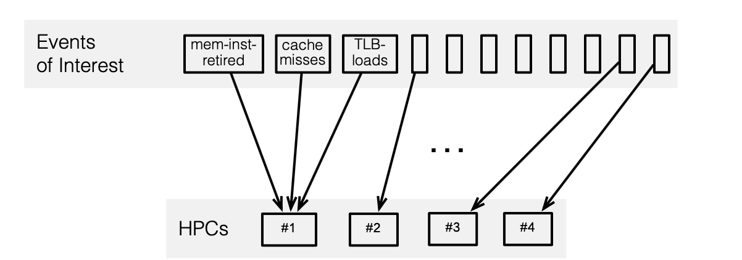

Problem
Number of counters is limited (2—8)
Number of events of interest is much greater (tens to hundreds)

Slide 10
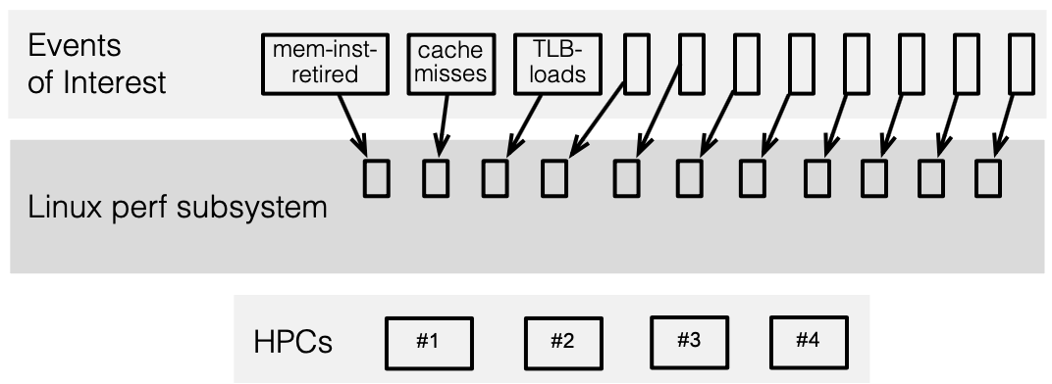
Existing Approach
Multiplexing events
Extrapolating event counts

Slide 11
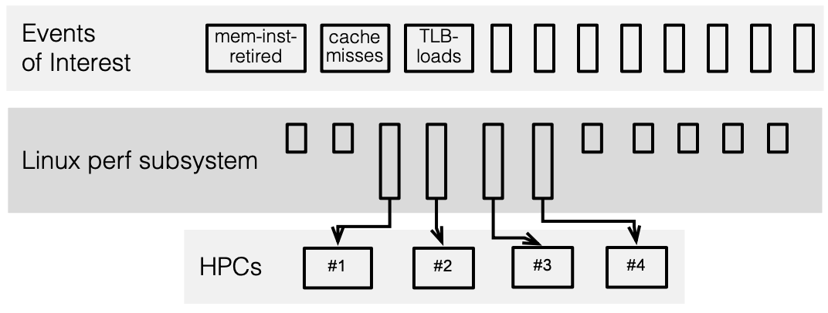
Existing Approach
Multiplexing events
Extrapolating event counts

Slide 12
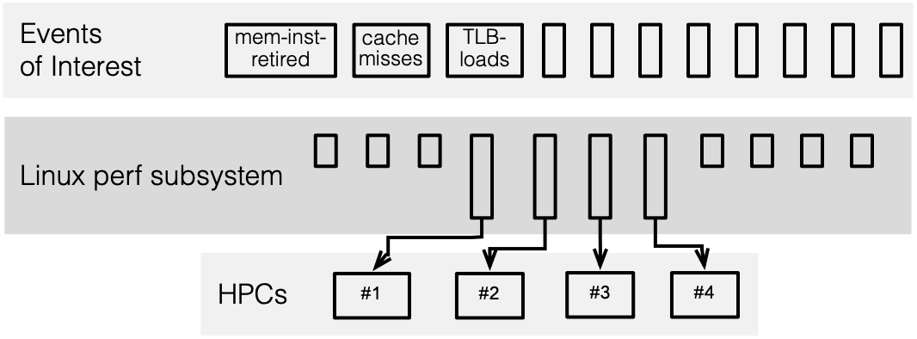
Existing Approach
Multiplexing events
Extrapolating event counts

Slide 13
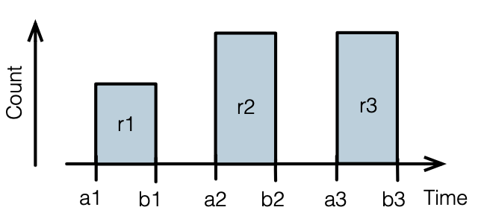
Existing Approach
Multiplexing events
Extrapolating event counts
unmonitored time
Monitored Time
Estimated Count = Observed Count x
Total Time

Slide 14
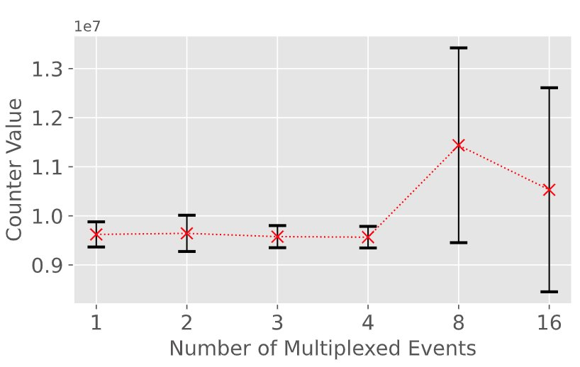
Examining Multiplexing Errors
Target machine has 4 HPCs
Run 541.leela_r Go engine benchmark in SPEC CPU2017
Results for LLC-load-misses

Slide 15
Key Insight
Intuitively, events with more uncertainty should be scheduled longer on HPC
Scheduling events on limited HPCs
≈
Scheduling tasks on limited CPUs

Slide 16



Tintin
A Unified Hardware Performance Profiling Infrastructure to Uncover and Manage Uncertainty

Slide 17
Tintin’s goals
Perform rate-based interpolation of multiplexed event counts
Track and report uncertainty in the estimate
Schedule to minimize uncertainty in a derived metric

Slide 18
Tintin’s goals
Perform rate-based interpolation of multiplexed event counts
Track and report uncertainty in the estimate
Schedule to minimize uncertainty in a derived metric

Slide 19
Recall: Typical Count-Based Interpolation
unmonitored time
Monitored Time
Estimated Count = Observed Count x
Total Time

Slide 20
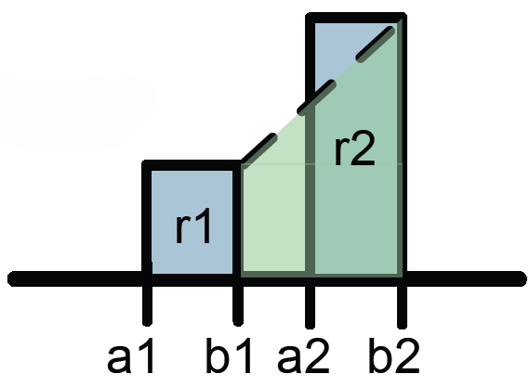
Trapezoid Area Method (TAM)
Uses rate-based instead of count-based interpolation
Assumes rate of event arrival changes linearly between measurements
Empirically found to be more accurate
T. Mytkowicz et al., “Time Interpolation: So Many Metrics, So Few Registers.” MICRO 2007

Slide 21
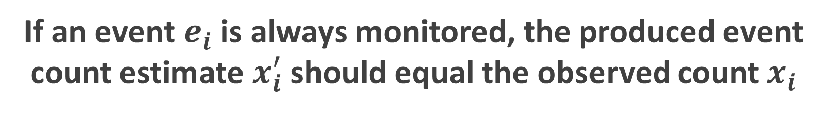
Fixing to Satisfy Invariant
If an event $e_{i}$ is always monitored, the produced event count estimate $x_{i}^{′}$ should equal the observed count $x_{i}$

Slide 22
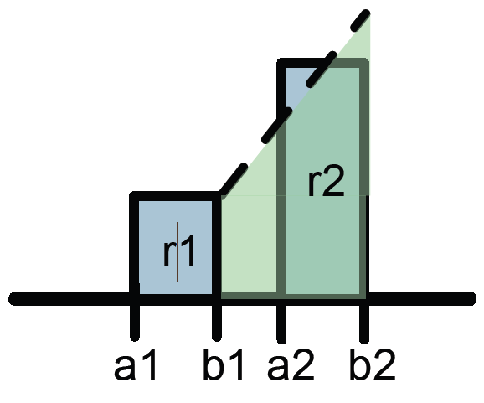
Fixing to Satisfy Invariant
If an event $e_{i}$ is always monitored, the produced event count estimate $x_{i}^{′}$ should equal the observed count $x_{i}$

Slide 23
Tintin’s goals
Perform rate-based interpolation of multiplexed event counts
Track and report uncertainty in the estimate
Schedule to minimize uncertainty in a derived metric

Slide 24
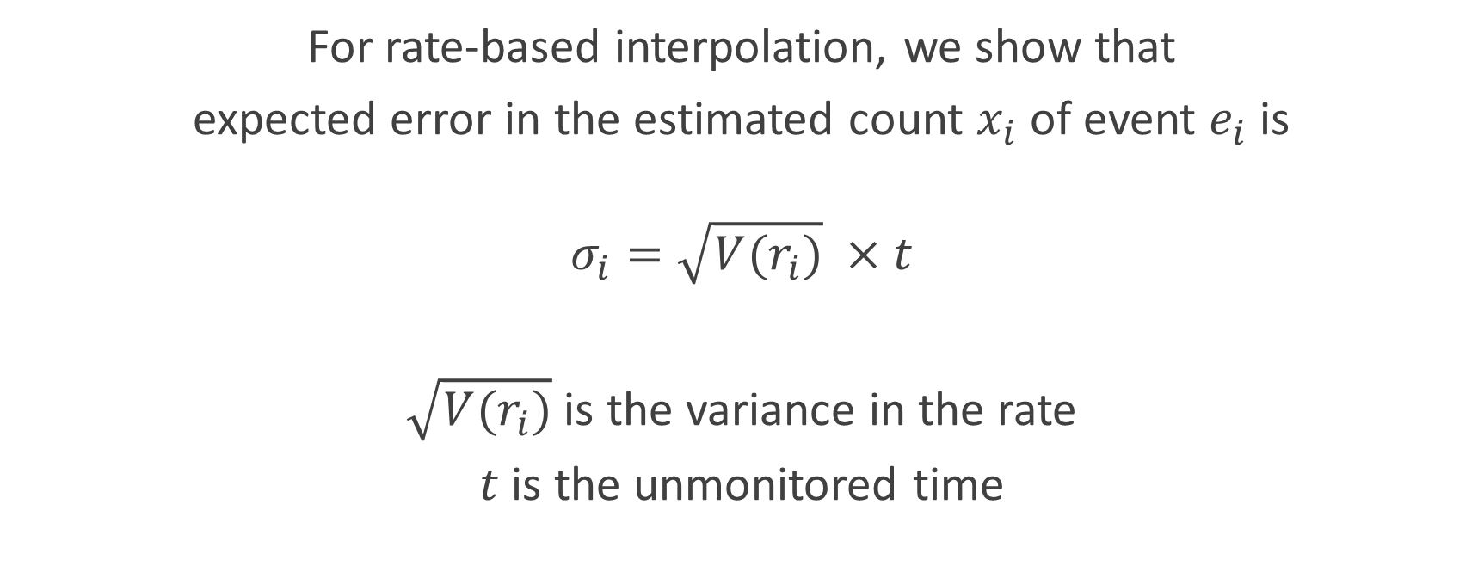
Expected Error in Interpolated Event Count
For rate-based interpolation, we show that
expected error in the estimated count $x_{i}$ of event $e_{i}$ is
$$σ_{i}=\sqrt{V(r_{i})} ×t$$
$\sqrt{V(r_{i})}$ is the variance in the rate
$t$ is the unmonitored time

Slide 25
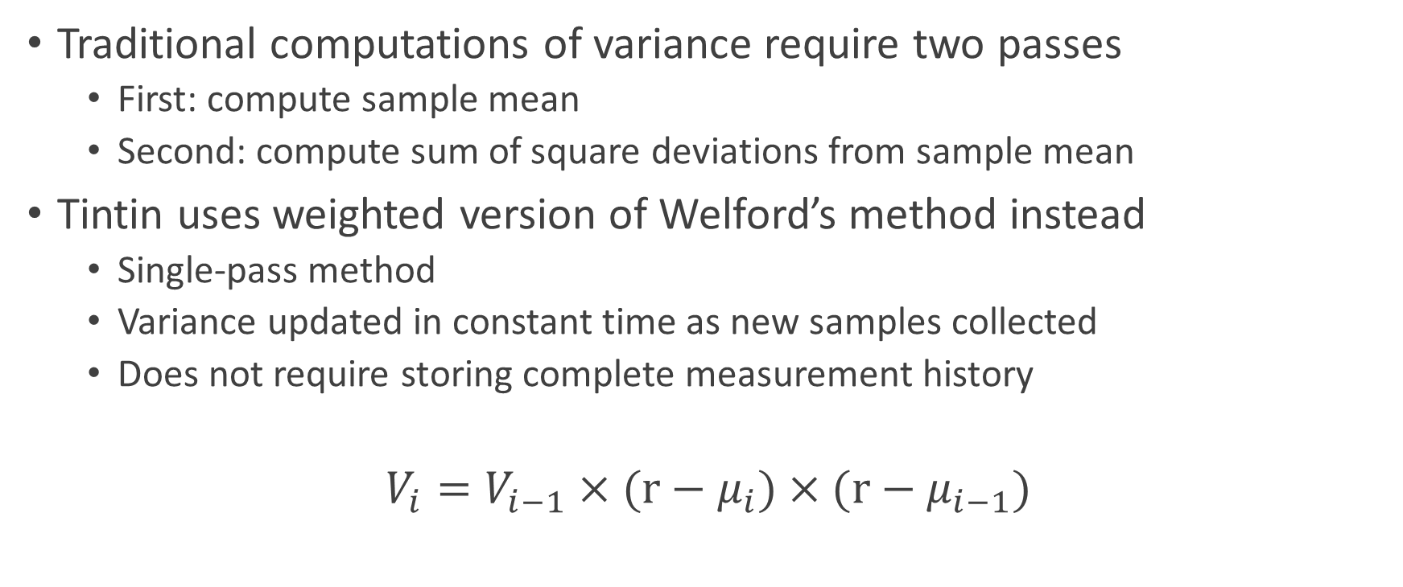
Tracking Variance with Welford’s Method
Traditional computations of variance require two passes
First: compute sample mean
Second: compute sum of square deviations from sample mean
Tintin uses weighted version of Welford’s method instead
Single-pass method
Variance updated in constant time as new samples collected
Does not require storing complete measurement history
$$V_{i}=V_{i−1}×(r−μ_{i})×(r−μ_{i−1})$$

Slide 26
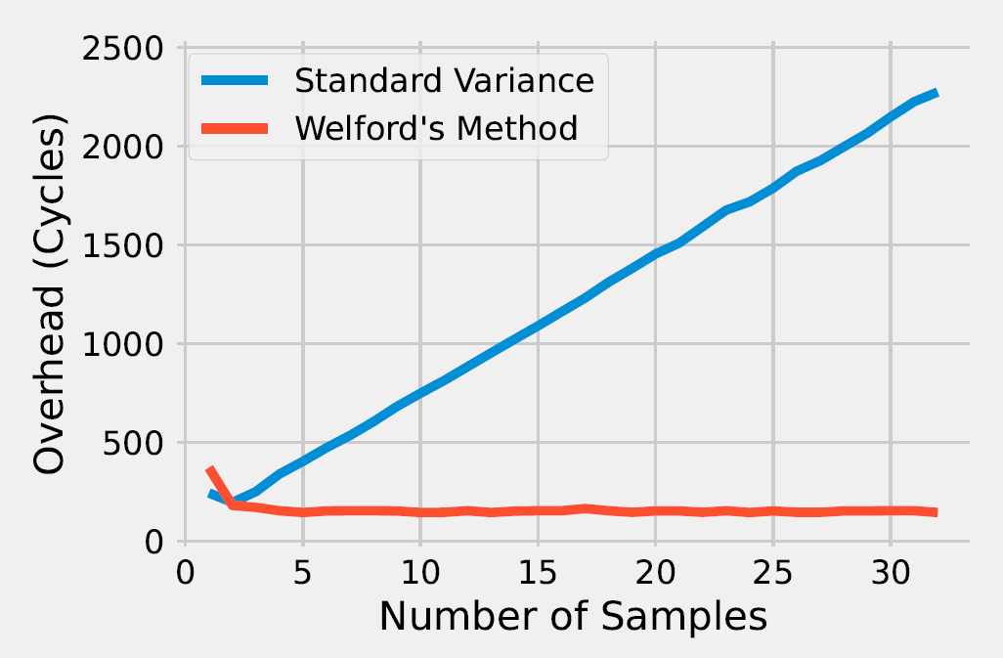
Comparison of Variance Tracking Overheads
Implement in Linux kernel module
Run on Raspberry Pi 3B+

Slide 27
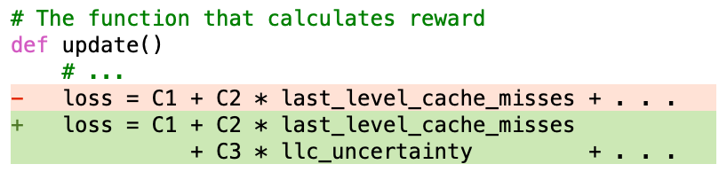
Tintin Reports Uncertainty to Userspace
cache-misses
bus-cycles
TLB-misses
original
inputs
Model-based approaches
Data-driven learning
Uncertainty as additional model inputs
ML Model
cache-misses uncertainty
bus-cycles uncertainty
TLB-misses uncertainty
additional
inputs
Rule-based approaches
Procedural logic based on domain expertise
Uncertainty can be used in additional conditional logic

Slide 28
Tintin’s goals
Perform rate-based interpolation of multiplexed event counts
Track and report uncertainty in the estimate
Schedule to minimize uncertainty in a derived metric

Slide 29
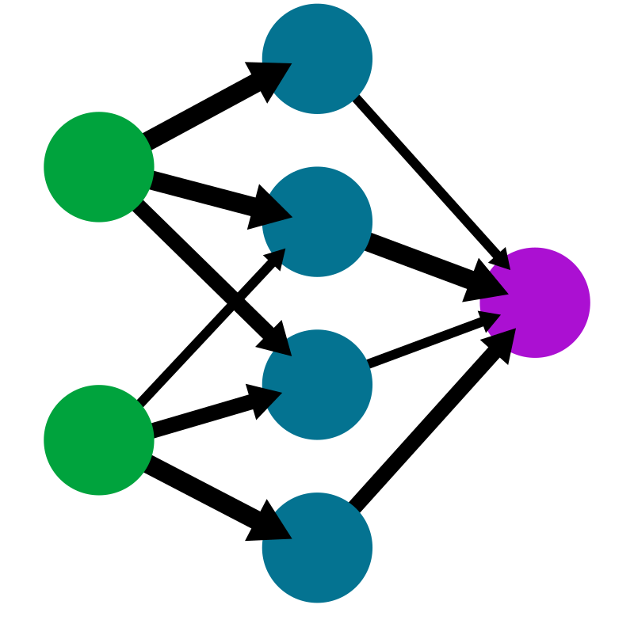
Uncertainty in Input → Uncertainty in Output
ML Model
cache-misses
bus-cycles
TLB-misses
Latency Sensitivity
Goal: Minimize Output Error
Weighted by sensitivity (Sobol Indices)
Minimize Total Input Variance
Minimize Output Variance

Slide 30
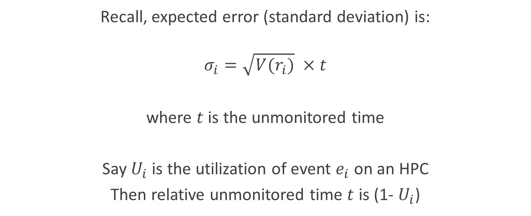
Elastic Scheduling to Minimize Uncertainty
Recall, expected error (standard deviation) is:
$$σ_{i}=\sqrt{V(r_{i})} ×t$$
where $t$ is the unmonitored time
Say $U_{i}$ is the utilization of event $e_{i}$ on an HPC
Then relative unmonitored time $t$ is (1- $U_{i}$)

Slide 31
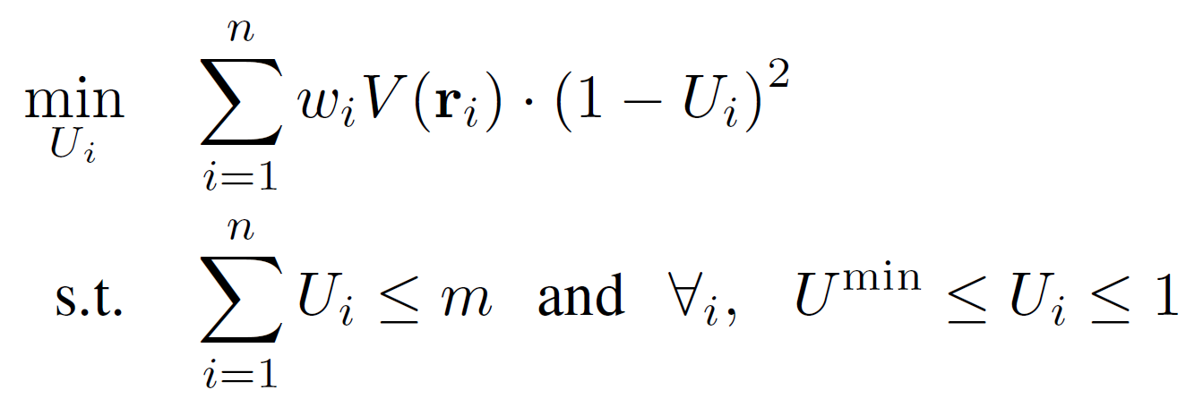
Elastic Scheduling to Minimize Uncertainty
Total Available HPCs

Slide 32
Elastic Scheduling to Minimize Uncertainty
Equivalent to elastic scheduling!
Buttazzo et al. “Elastic task model for adaptive rate control.” RTSS 1998
Chantem et al. “Generalized Elastic Scheduling.” RTSS 2006
We can solve in quasilinear time in the number of events
Sudvarg et al. “Improved Implicit-Deadline Elastic Scheduling.” SIES 2024

Slide 33
Evaluation and Case Studies

Slide 34
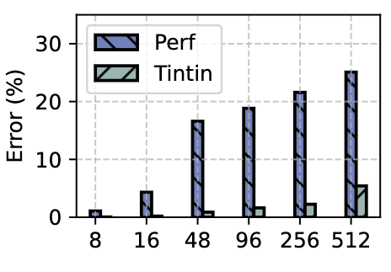
Accuracy
CPU SPEC 2017 benchmark
Different numbers of events
Linux perf
Error reduction -
~25% -> ~5%
Tintin
Number of Events

Slide 35
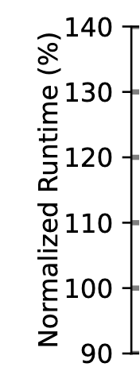
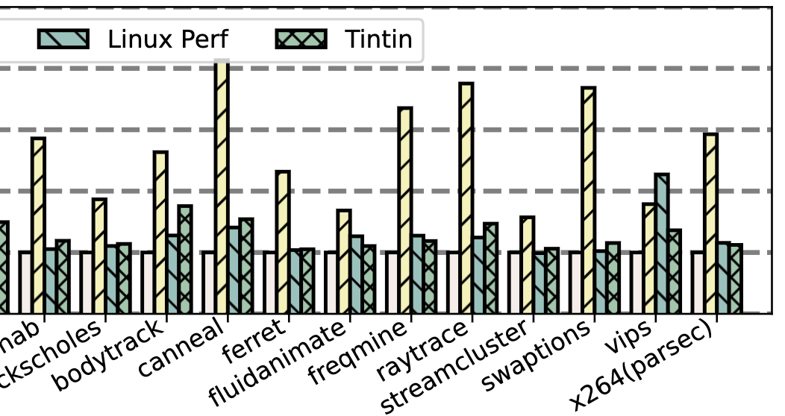
Overhead
runtime overhead -
1.9% -> 2.4%
Tintin
Linux perf

Slide 36
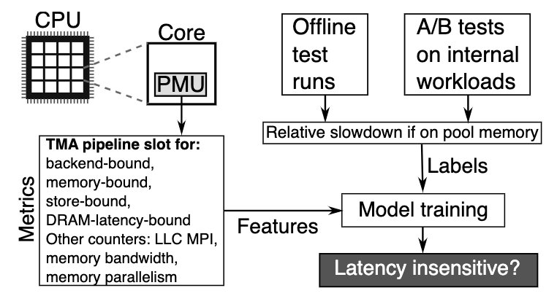

Case Study: Pond
Pond – ASPLOS' 23
Online resource orchestration
Microsoft Azure team
Predicts how much VM latency affected by pooled vs local memory
Model inputs: 7 derived metrics (20 events on Intel Skylake)
We train 100 random forest regressor models

Slide 37
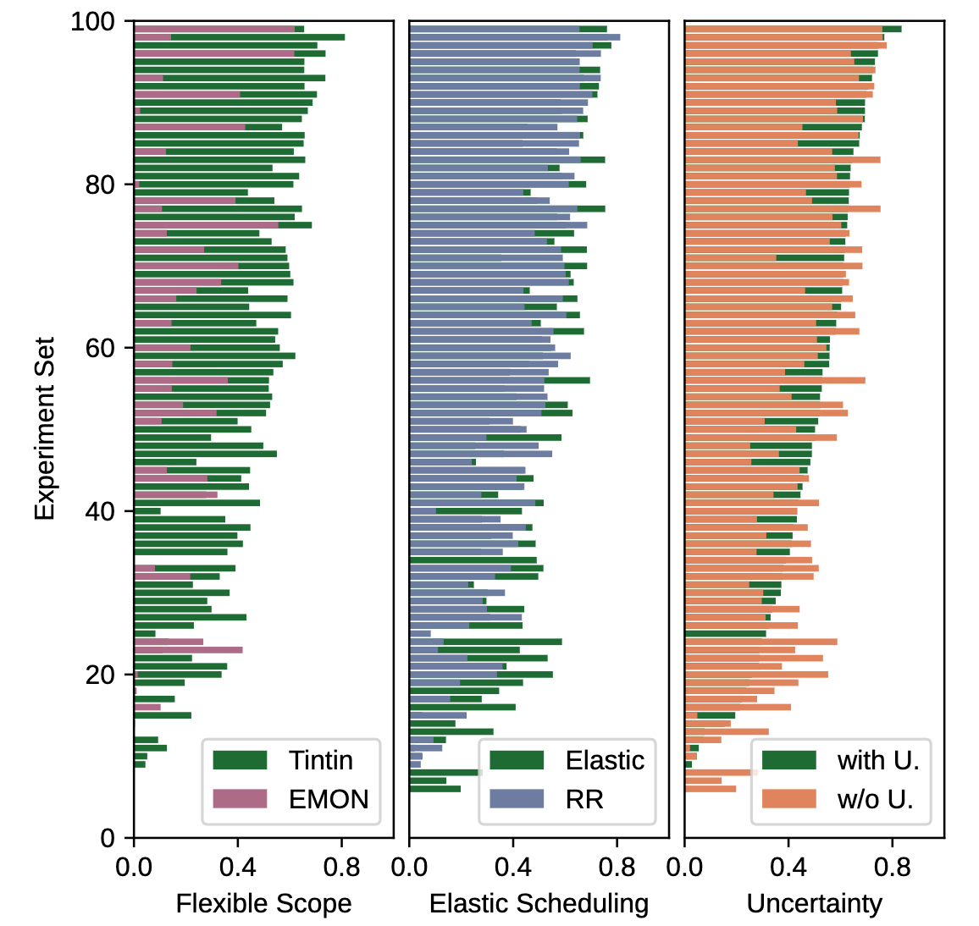
Case Study: Pond
Higher score is better
EMON (native) vs Tintin
Tintin outperforms in 95% cases

Slide 38
Case Study: Pond
Round robin vs Elastic scheduling
Elastic scheduling outperforms in 64% cases

Slide 39
Case Study: Pond
Is the reported uncertainty useful?
Two models trained with and without uncertainty
Uncertainty improves the results in 55% cases

Slide 40
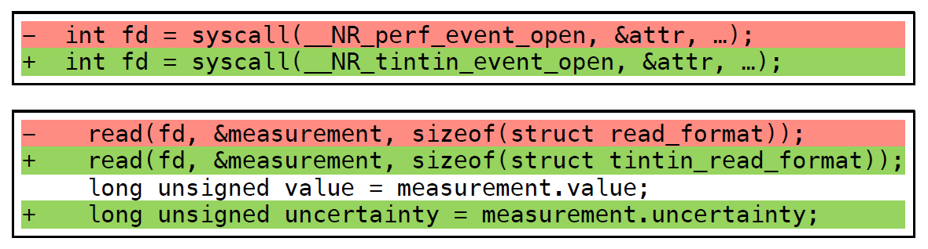
Usage: RT-Bench
Open-source benchmarking tool for real-time systems.
See Mattia’s talk at 4PM!
Wrapper to launch existing benchmarks as periodic workloads
Can launch dedicated performance monitoring thread to sample HPCs
Easy to incorporate Tintin instead of Linux perf_events
generator/src/performance_counters.c
generator/src/performance_sampler.c

Slide 41
Conclusions and Future Work
Tintin deals with multiplexing-based uncertainty in HPC counts
Uses rate-based extrapolation
Tracks variance to estimate error
Reports error to userspace
Elastic scheduling to minimize error
Easy to incorporate into existing applications using linux_perf_events
We will release Tintin-Miner for sensitivity analysis
We want to extend the elastic scheduling policy to deal with event groups
Address CPU platforms with HPC affinities

