Slide 1

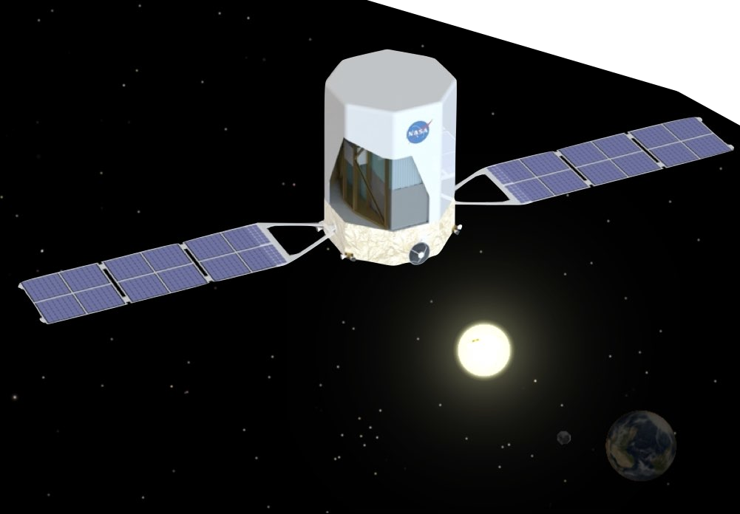
Call for Collaboration: Contributing to Multi-Messenger Astrophysics
Marion Sudvarg, Ye Htet,
Roger Chamberlain, Jeremy Buhler, Jim Buckley
OSPERT 2025, Brussels, Belgium
Supported by NASA and the WashU OVCR

Slide 2





Pathways to Discovery in Astronomy and Astrophysics for the 2020s
ASTRO2020 Decadal Survey
A “space-based time-domain and multi-messenger program”
is a top priority

Slide 3
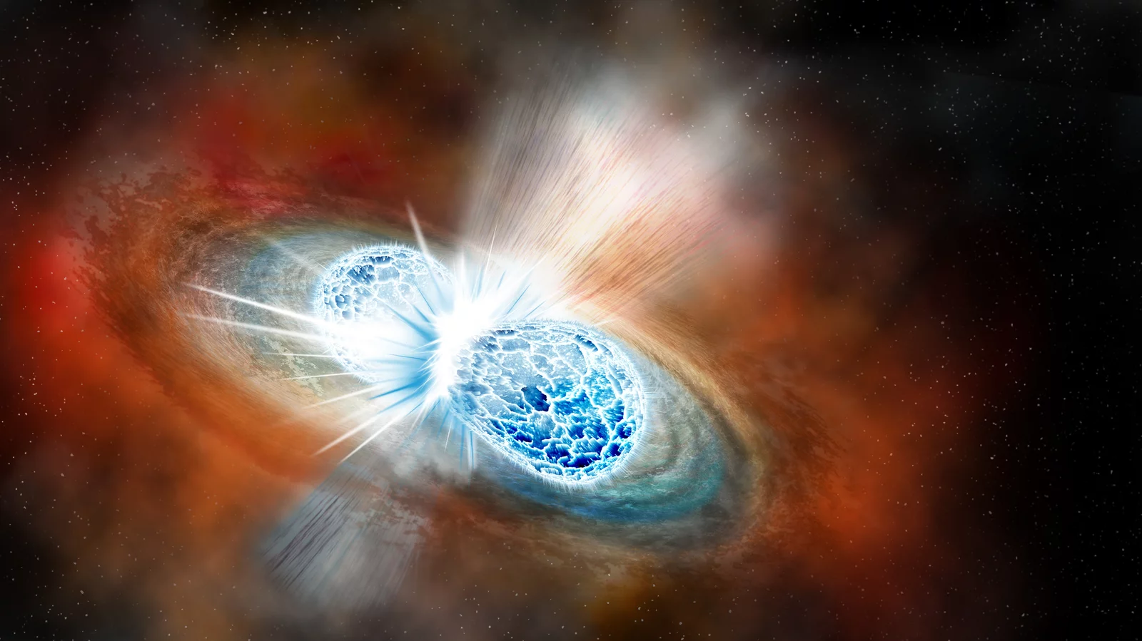
Image courtesy Robin Dienel/Carnegie Institution for Science (https://www.npr.org/sections/thetwo-way/2017/10/16/557557544/astronomers-strike-gravitational-gold-in-colliding-neutron-stars)
Notes:
The idea is to coordinate concurrent observations of astrophysical phenomena by instruments with different observational modalities.
For example, binary neutron star mergers are an event that can potentially reveal a lot of new physics. Neutron stars are stars that have collapsed under their gravitational field, and are extremely dense – a few cubic centimeters can weigh a billion tons. The gravity is strong enough that electrons and protons are squeezed together into neutrons. Not surprisingly, when two of these pull each other into their mutual orbits and merge, a lot of energy is released very quickly.

Slide 4
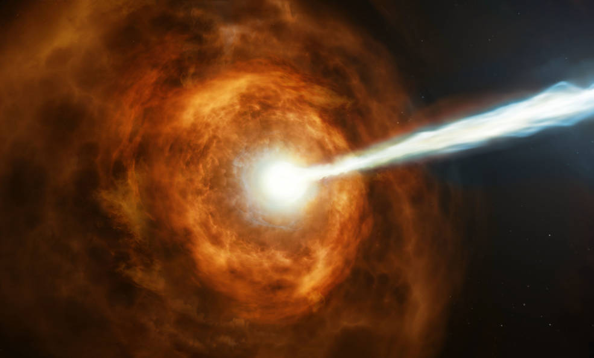
Image courtesy NASA, ESA and M. Kornmesser (https://www.nasa.gov/feature/goddard/2019/hubble-studies-gamma-ray-burst-with-highest-energy-ever-seen)
Notes:
This energy be in the form of gamma-rays, which are high energy photons. Not surprisingly, gamma ray bursts, which are a fast release of a huge number of gamma rays with an extreme energy density, are a component of BNS mergers. So we’d like to be able to coordinate observations of gamma ray bursts with other modalities, e.g., optical observations at lower energies of the EM spectrum (visible light, UV, infrared, etc.)

Slide 5
Notes:
This is a rendering of the Advanced Particle-Astrophysics Telescope, our proposed gamma-ray telescope. The interesting thing about gamma ray photons is that they are high energy enough that they act more as particles than waves. So they are difficult to optically lens. This has an advantage though. It means that a gamma ray detector doesn’t have to focus on one spot, so it can get a full sky field of view.

Slide 6
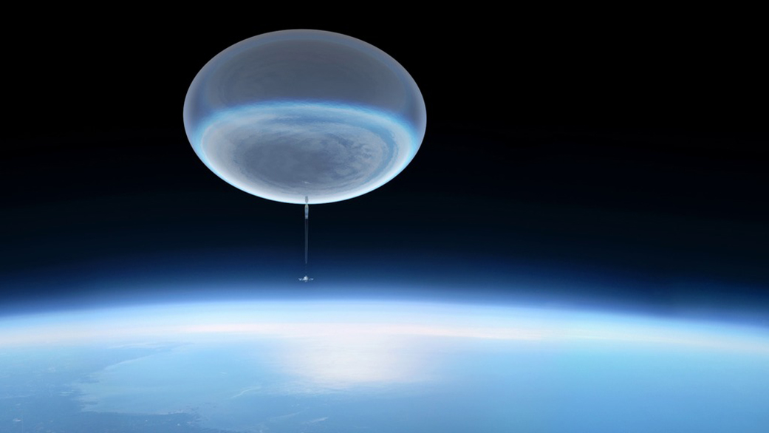
Notes:
The Antarctic Demonstrator for APT (ADAPT) is our demonstrator instrument for APT that will hopefully launch from a high-altitude balloon from Antarctica in December next year. It’s hard to get a sense of the scale of these launch vehicles, but these balloons have a volume of around 1 million cubic meters. This is equivalent to 400 Olympic size swimming pools

Slide 7
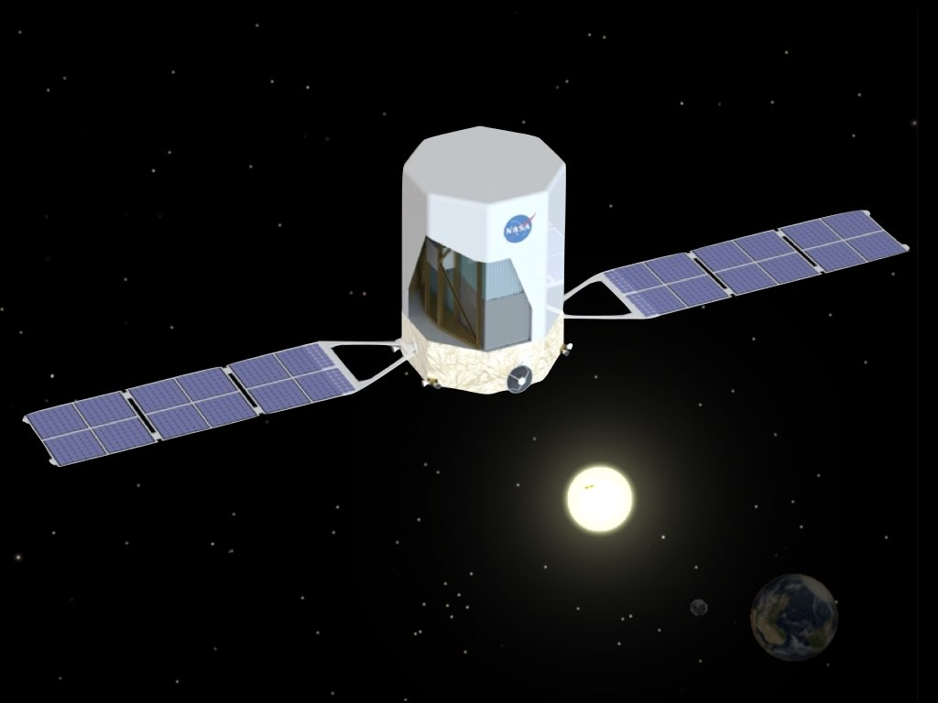

Original Goal:
Point-Source Localization
Localized
Direction
Burst
Optical Telescope FoV

Slide 8
Original Goal:
Point-Source Localization
Localized
Direction
Burst
Optical Telescope FoV

Slide 9
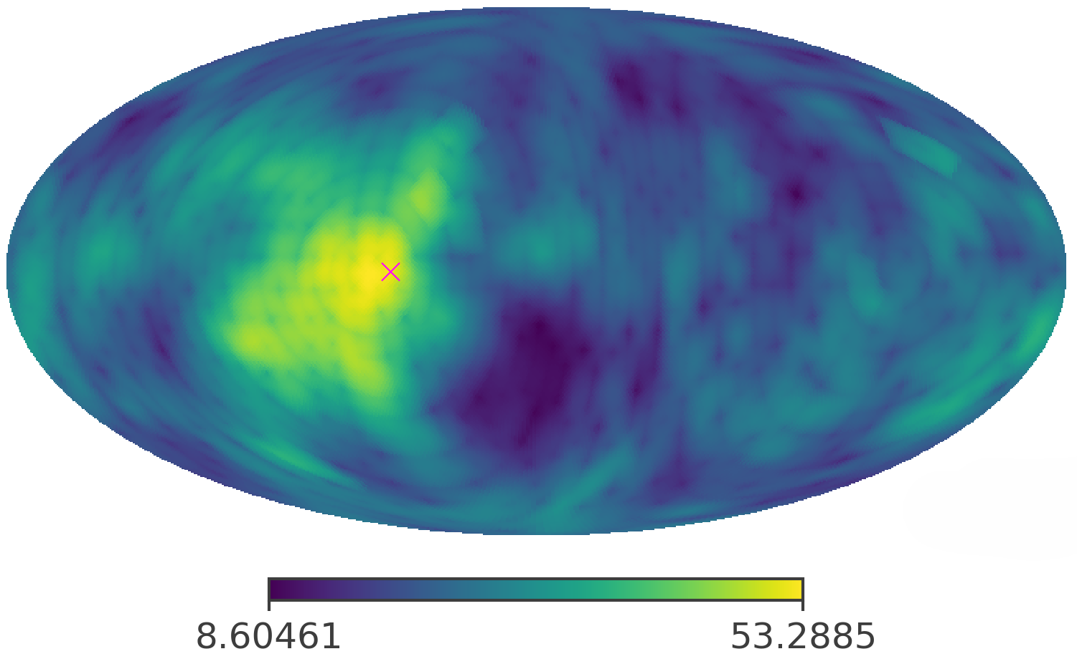
New Goal: Supplement with Likelihood Map

Slide 10
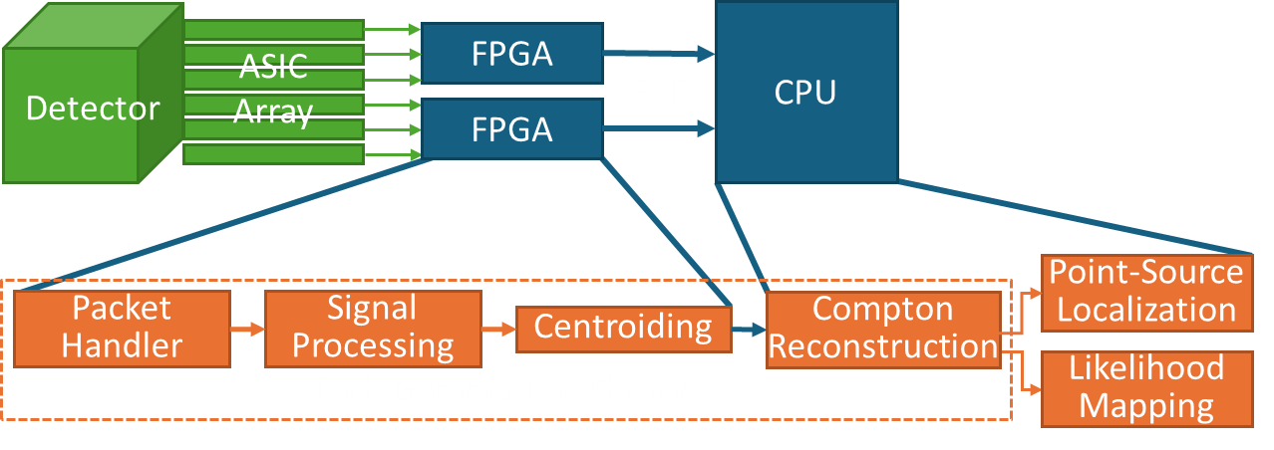
Solution: Real-time GRB localization in space (or on a high-altitude balloon)

Slide 11
Solution: Real-time GRB localization in space (or on a high-altitude balloon)

Slide 12
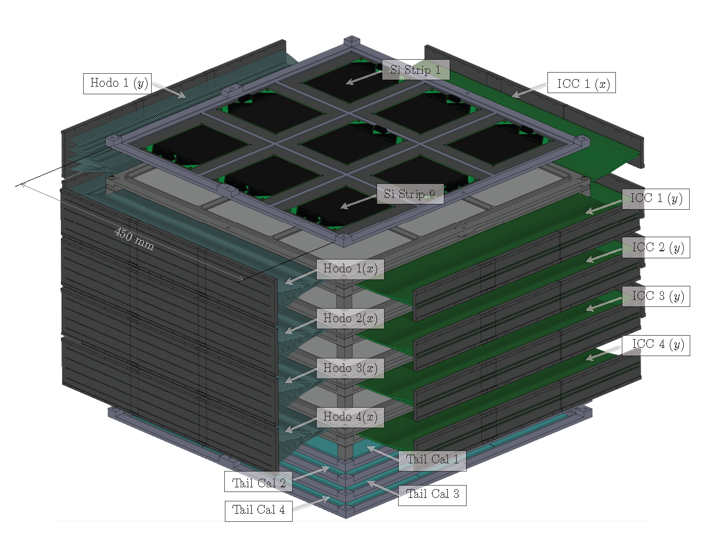

Slide 14
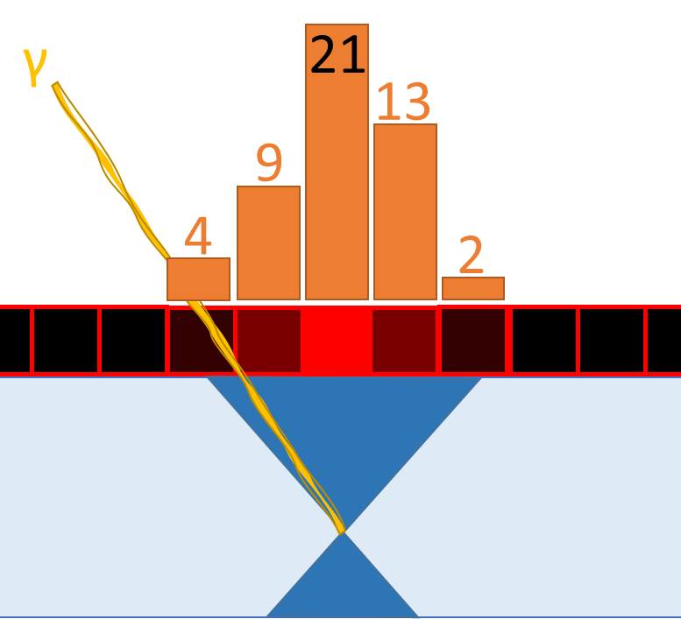

Slide 15
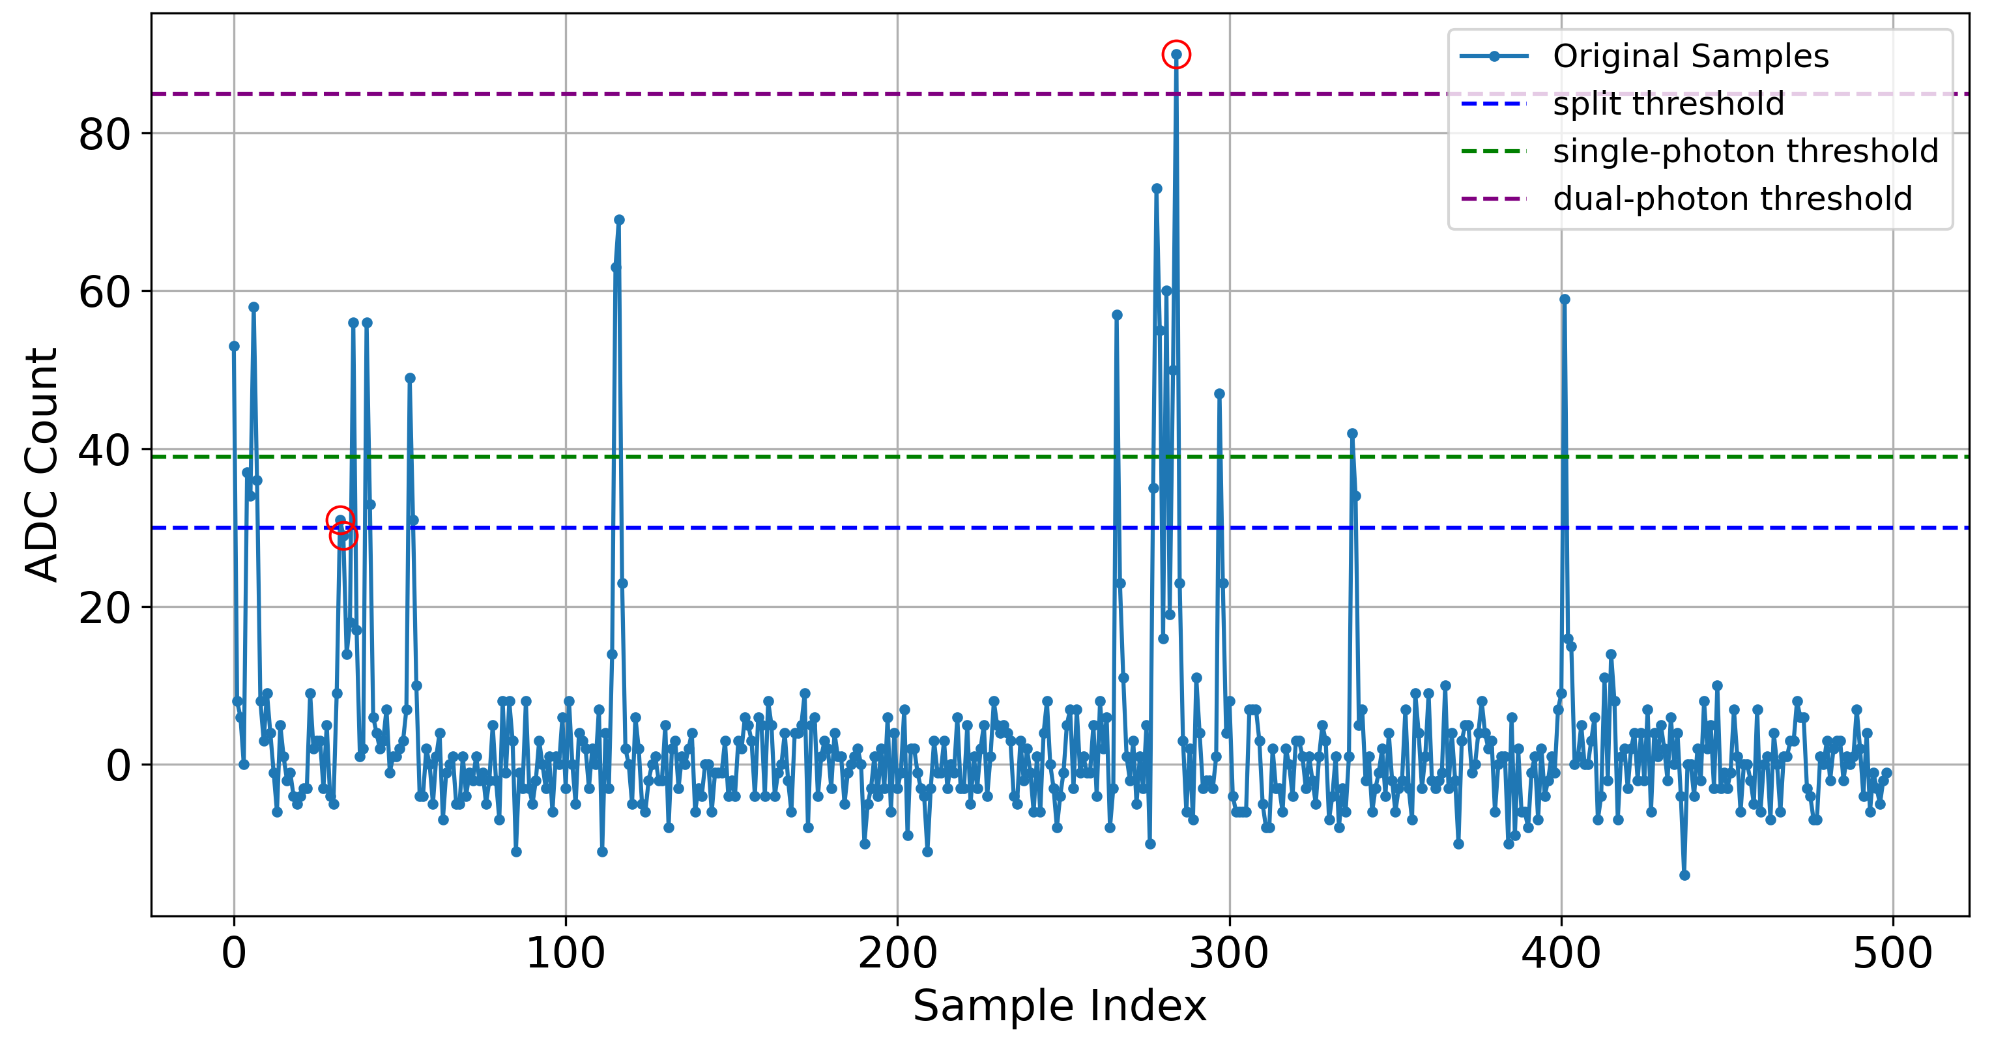
Open Challenge: Photon Counting

Slide 16
Open Challenge: Photon Counting
Approach 1:
Signal Integration
Problem: Too much noise contribution

Slide 17
Open Challenge: Photon Counting
Approach 2:
Thresholding
Problem: Too many parameters to tune, not robust to pileup

Slide 18
Open Challenge: Photon Counting
Seems promising!
But much slower.
(300k -> 64k events/sec)
Approach 3:
Integrate Around Peaks

Slide 19
Real-time GRB localization in space (or on a high-altitude balloon)

Slide 20
Real-time GRB localization in space (or on a high-altitude balloon)

Slide 21
Open Challenge: Data to CPU
ADAPT
x13

Slide 22
Open Challenge: Data to CPU
APT
X60?
?

Slide 23
Real-time GRB localization in space (or on a high-altitude balloon)

Slide 24
Real-time GRB localization in space (or on a high-altitude balloon)

Slide 25
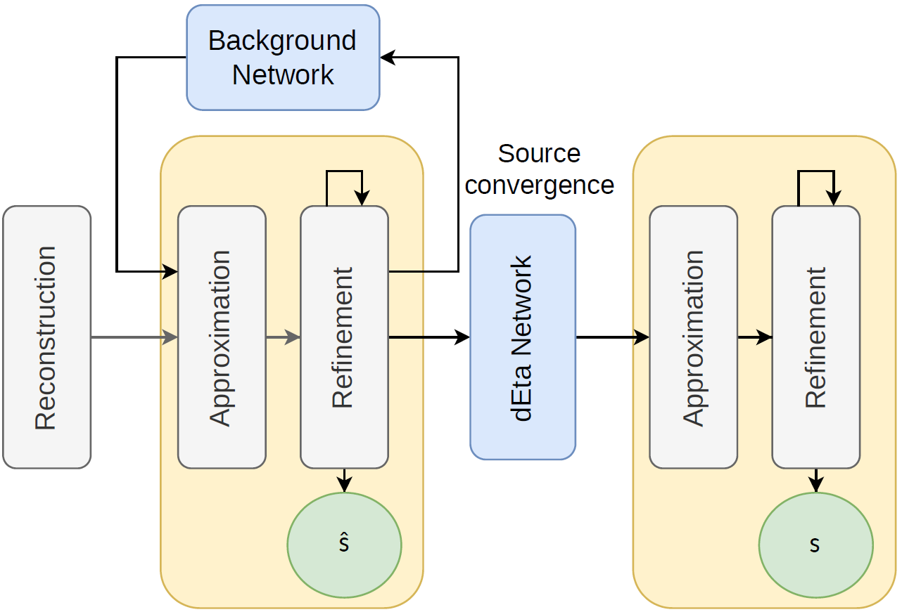
Existing Statistical Approaches may be Supplemented with ML/DNN

Slide 26
Existing Statistical Approaches may be Supplemented with ML/DNN
Open Problem:
Iterative approach enables workload/accuracy tradeoff
How to exploit this when running concurrently with each other and with mission- or safety-critical instrument control tasks?

Slide 27
Existing Statistical Approaches may be Supplemented with ML/DNN
Classification and rejection of background particles is crucial to accuracy of localization
Question:
Can we use an IDK classifier and leverage some of the recent work on scheduling IDK cascades?

Slide 28
The Big Question
What platform support (hardware + OS) is necessary to efficiently execute and schedule GRB localization on heterogeneous MPSoCs in space when:
There are stringent timing requirements to complete the localization if we want to enable follow-up observations?
The components of the localization pipeline must run concurrently with critical instrument control tasks?

Slide 29
Conclusions
Members of the real-time systems community (you!) are uniquely equipped to help us solve these problems
Efficient FPGA-based signal processing (photon counting)
Real-time transmission of data from dozens of FPGAs to CPU
Exploring tradeoff space between execution time and accuracy
Computational offloading of ML models
IDK cascades
Co-scheduling with critical tasks on heterogeneous platforms

