Slide 1

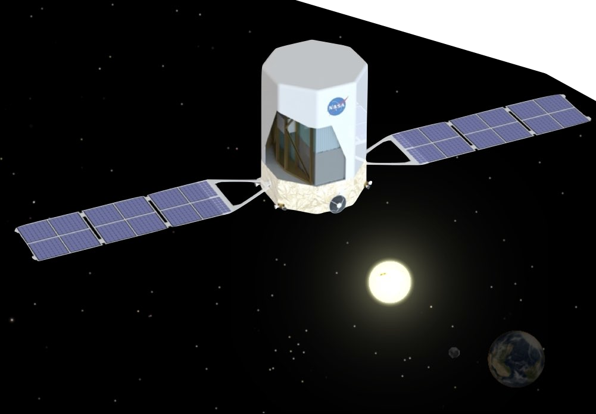
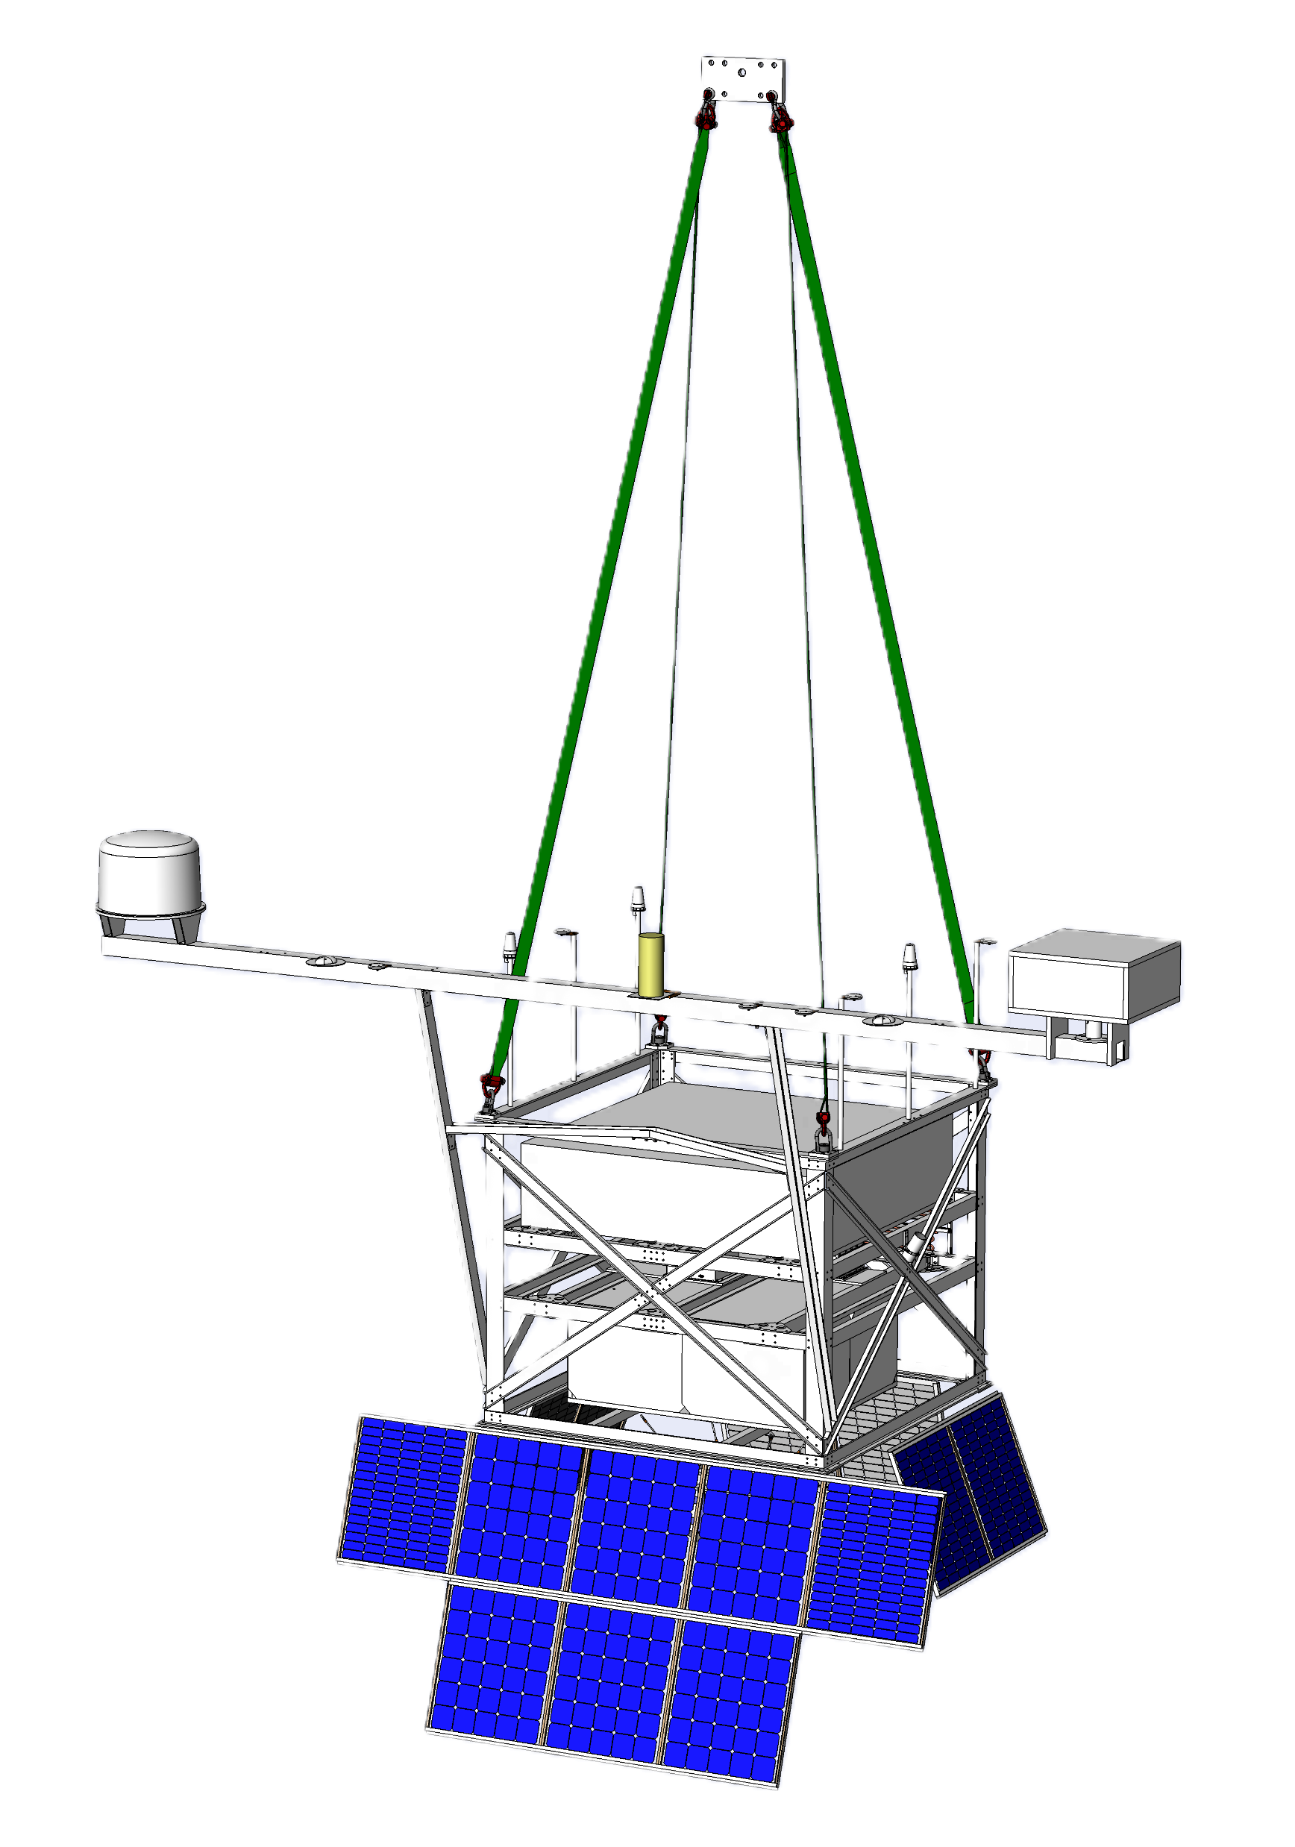

Real-Time GRB Localization on the Antarctic Demonstrator for the Advanced Particle-astrophysics Telescope (ADAPT)
Marion Sudvarg, Jim Buckley, and the APT Collaboration
AAS HEAD 22, October 14, 2025
Supported by NASA and Washington University in St. Louis

Slide 2





Pathways to Discovery in Astronomy and Astrophysics for the 2020s
A “space-based time-domain and multi-messenger program”
is a top priority

Slide 3
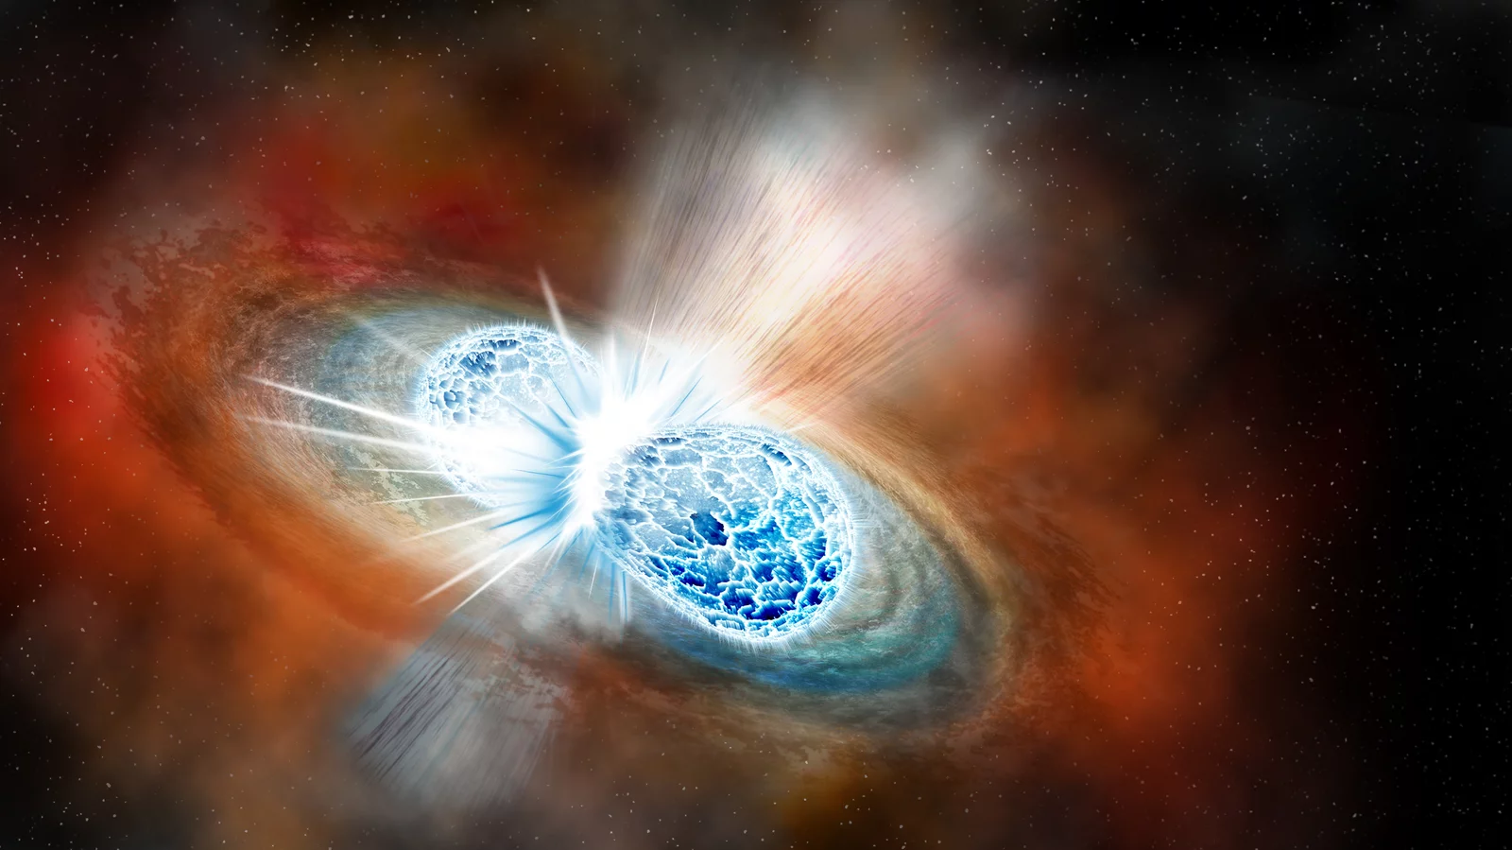
Coordinate concurrent observations of astrophysical phenomena by instruments operating in different modalities
Image courtesy Robin Dienel/Carnegie Institution for Science (https://www.npr.org/sections/thetwo-way/2017/10/16/557557544/astronomers-strike-gravitational-gold-in-colliding-neutron-stars)
Notes:
The idea is to coordinate concurrent observations of astrophysical phenomena (e.g., binary neutron star mergers) by instruments with different observational modalities.

Slide 4
Rendering of the Advanced Particle-astrophysics Telescope (APT), our proposed gamma-ray/cosmic-ray instrument
Notes:
This is a rendering of the Advanced Particle-Astrophysics Telescope, our proposed gamma-ray telescope.

Slide 5
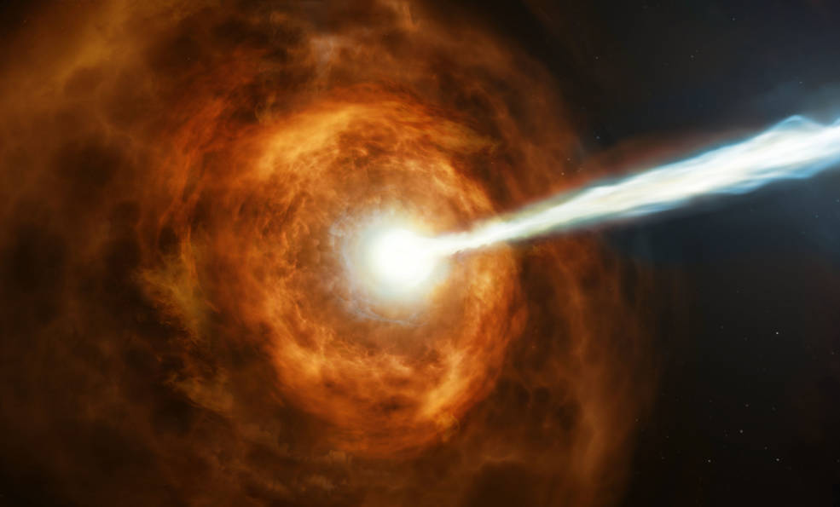
APT will detect and localize GRBs in real time on board the instrument
Image courtesy NASA, ESA and M. Kornmesser (https://www.nasa.gov/feature/goddard/2019/hubble-studies-gamma-ray-burst-with-highest-energy-ever-seen)
Notes:
It will detect and localize GRBs in real time onboard the instrument

Slide 6
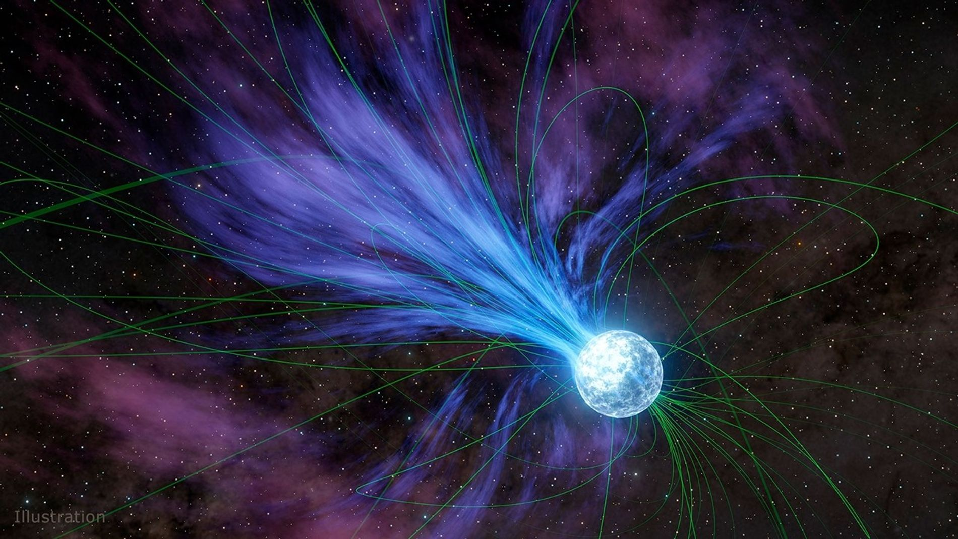
This will enable rapid multi-messenger follow-up observations (e.g., by optical telescopes)
Image courtesy NASA/JPL-Caltech (https://science.nasa.gov/universe/stars/neutron-stars/magnetars/where-does-gold-come-from-nasa-data-has-clues/)
Notes:
This is important to enable rapid multi-messenger follow-up observations, especially in optical bands, to observe new physics in magnetar giant flares, supernova shock breakouts, etc.

Slide 7
1.1M m³ zero-pressure high-altitude balloon
The Antarctic Demonstrator for APT (ADAPT)

Slide 8
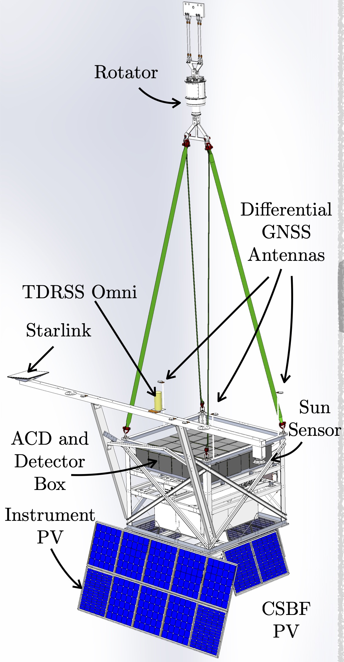
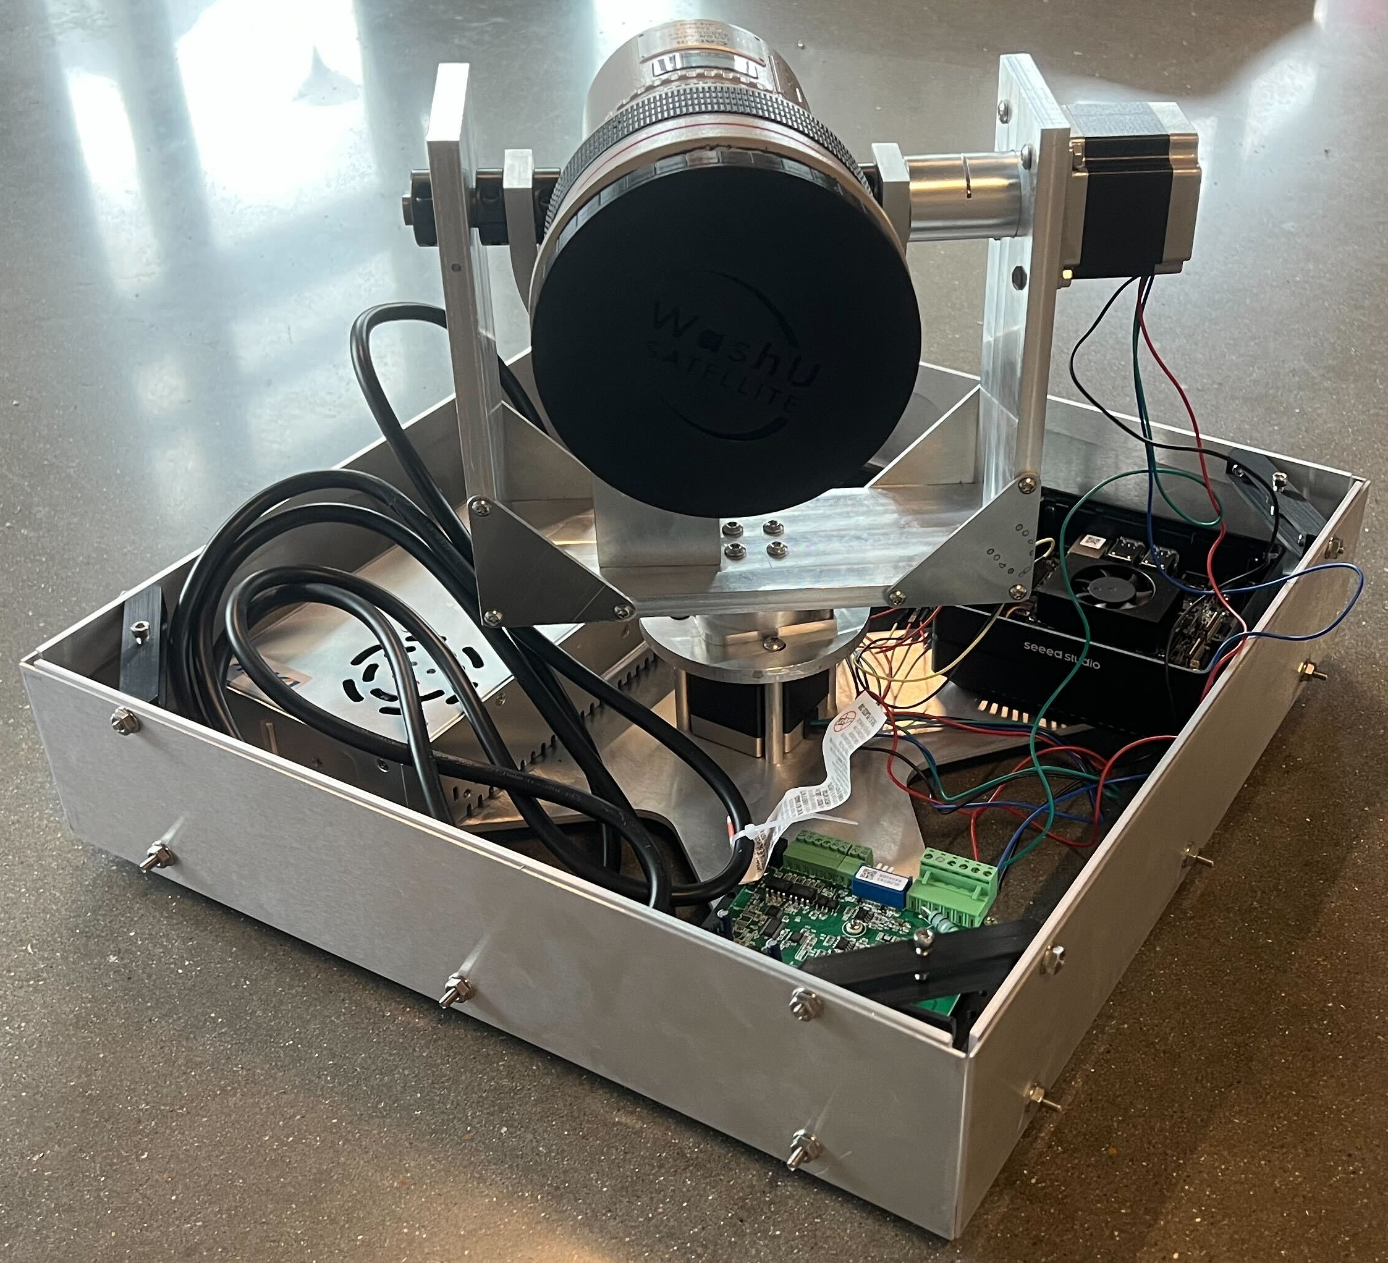
Poster 111.07 - AIRIS: Pushing the Boundaries of GRB Optical Afterglow Observation
Notes:
ADAPT payload and AIRIS

Slide 9
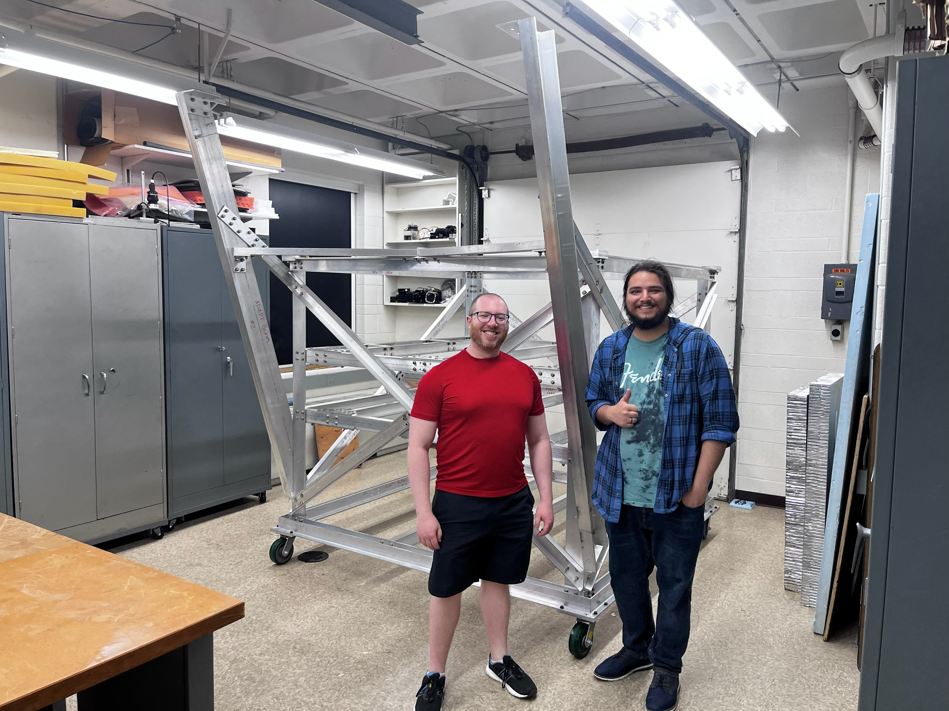
Notes:
ADAPT gondola

Slide 10
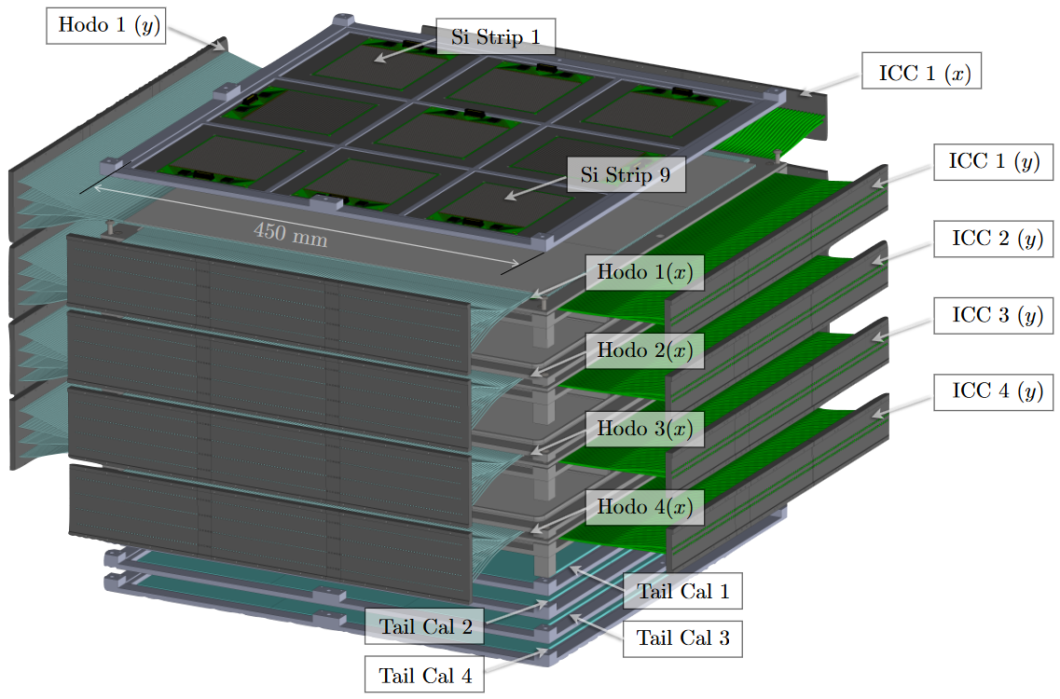
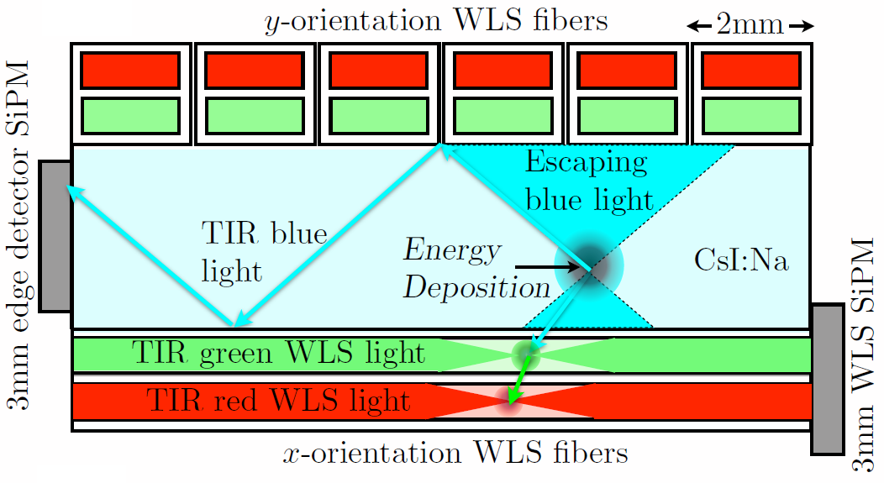
Notes:
Detector stack

Slide 11
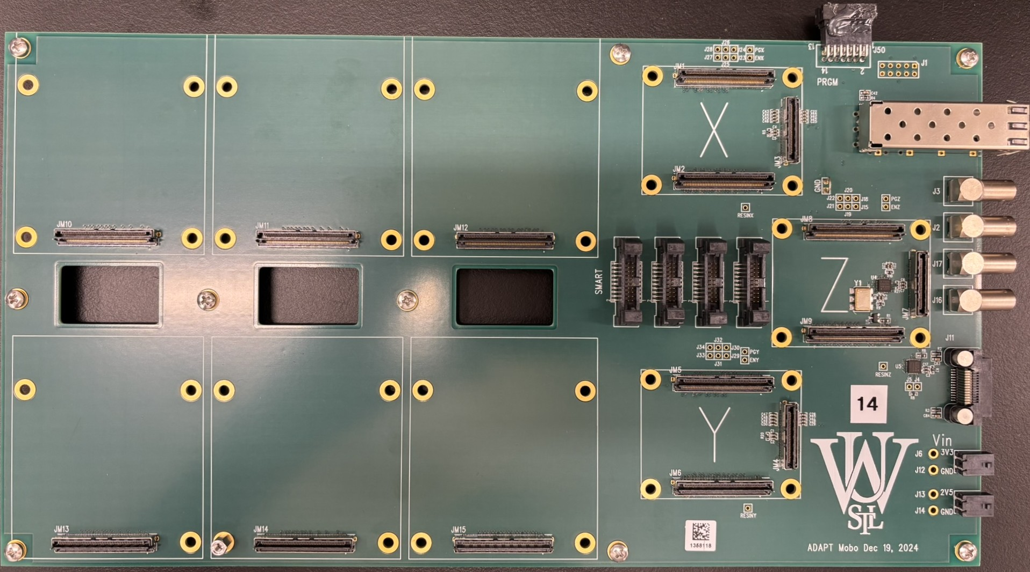
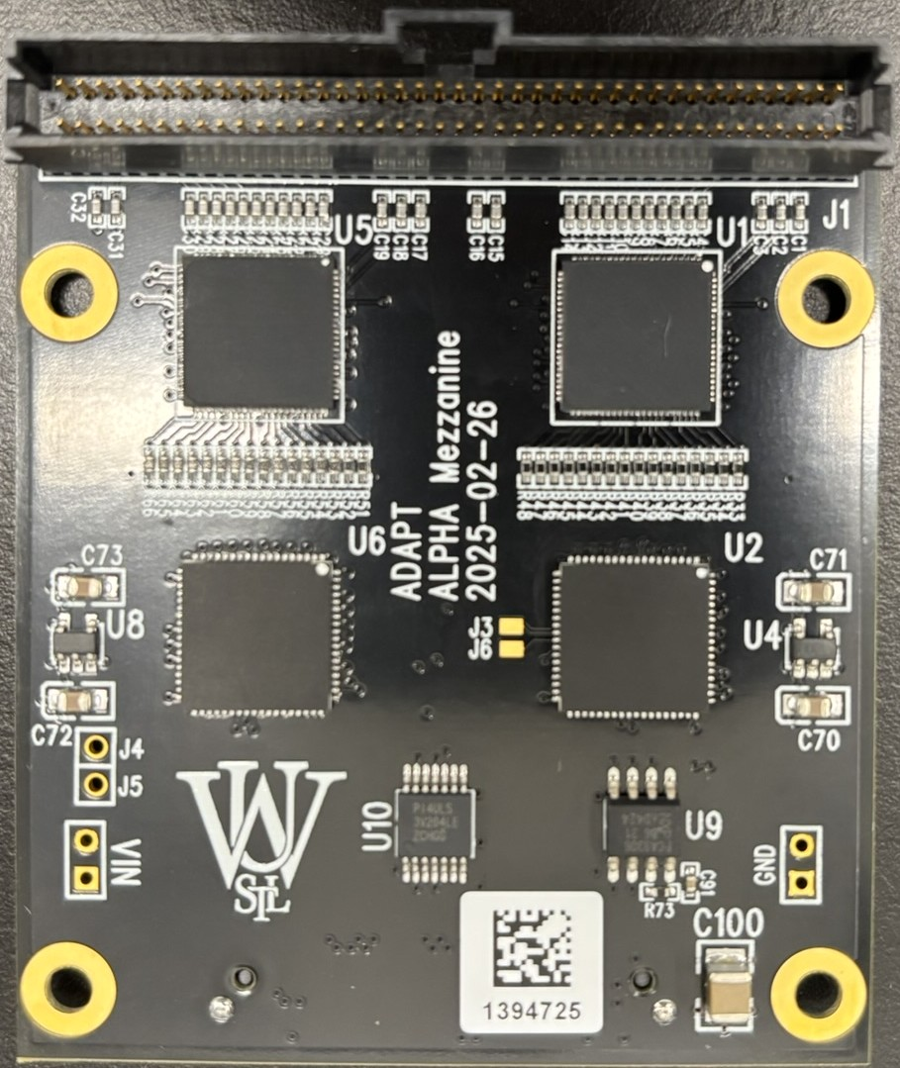
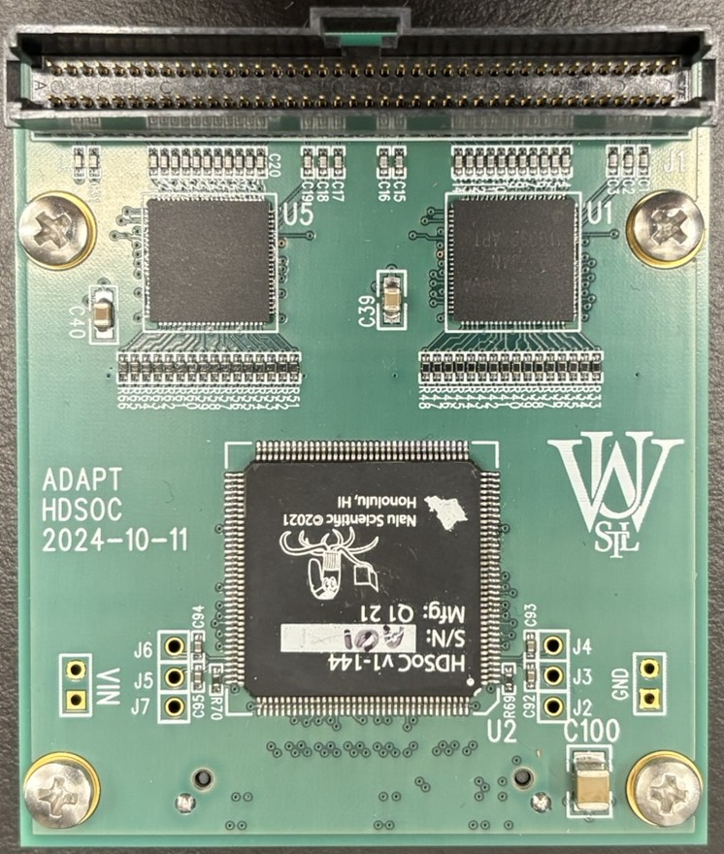
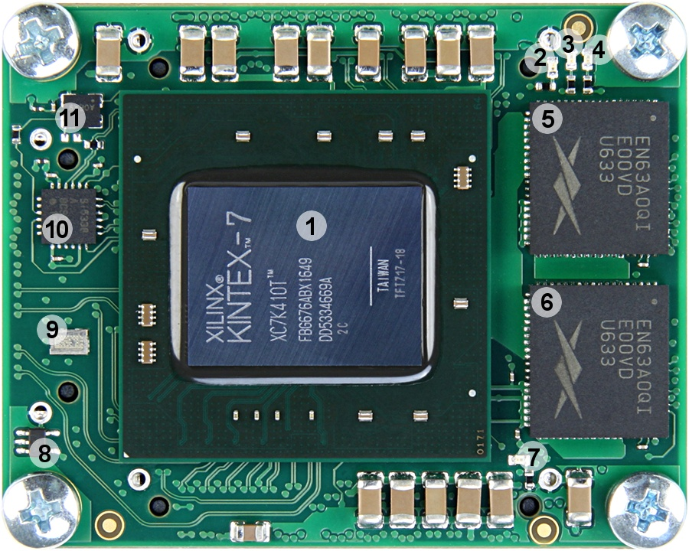
CT5TEA
ALPHA
HDSoC
Notes:
Motherboard, FPGA, HDSoC carrier board with ASIC and CT5TEA, ALPHA carrier board from Gary Varner lab

Slide 12
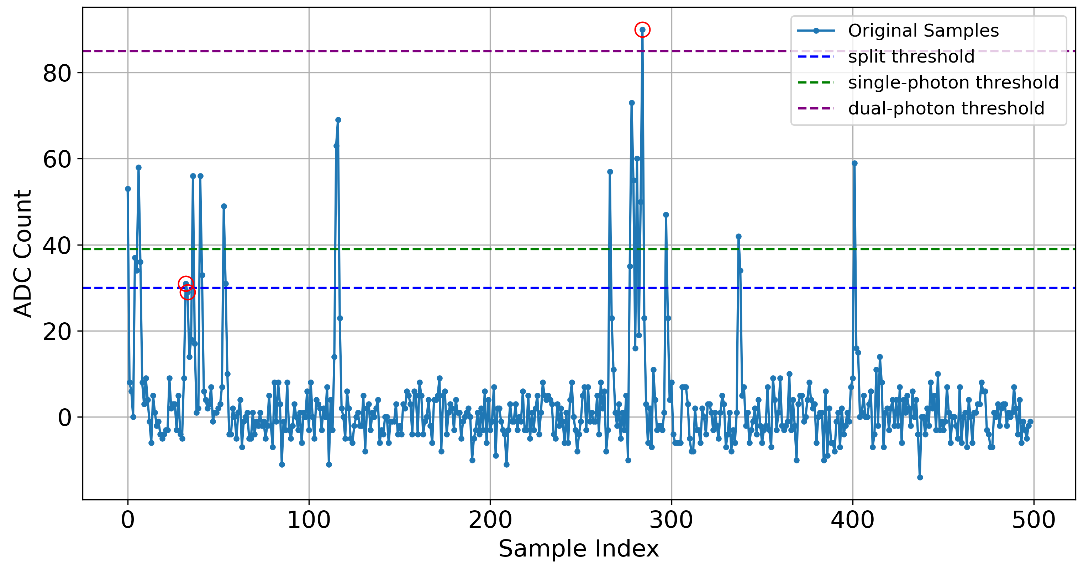
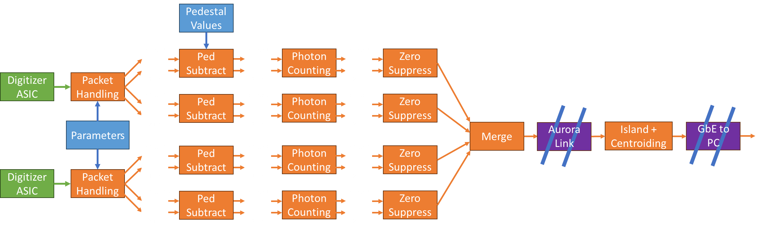
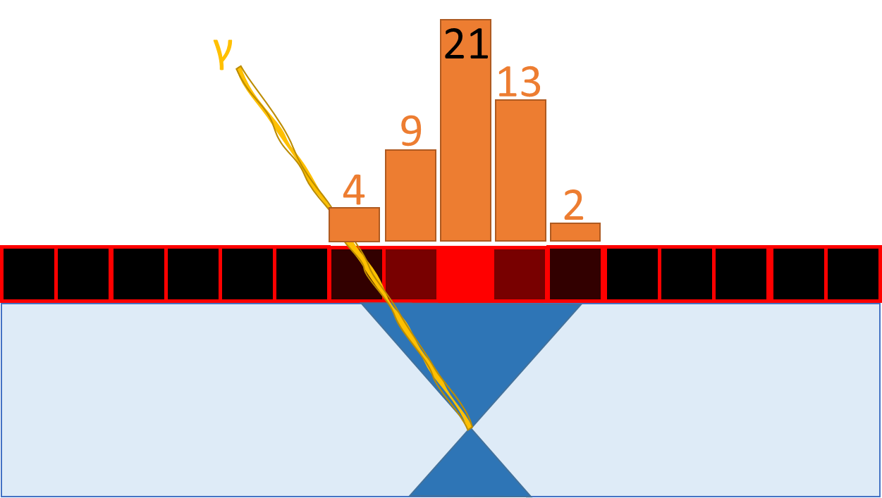
Poster 111.22 - Front-End Data Acquisition and Signal Processing for the ADAPT Telescope
Notes:
HLS

Slide 13
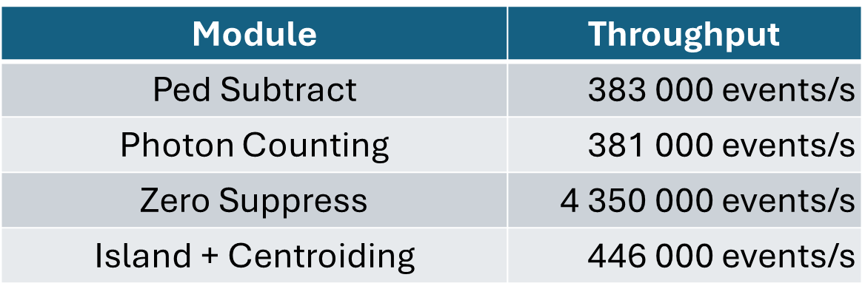
Notes:
HLS

Slide 14
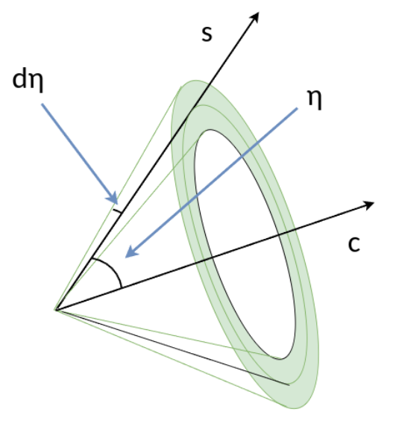
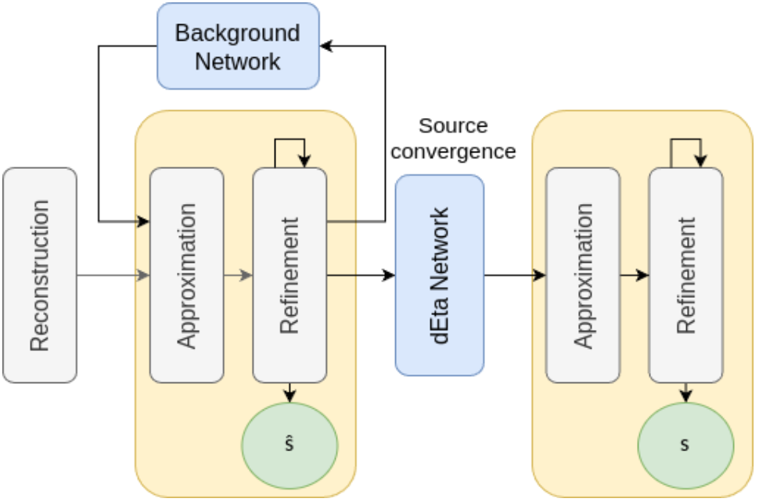
Compton Reconstruction and Point-Source Localization
Poster 111.25 – Neural Network Extensions for the GRB Localization Pipeline on the ADAPT Gamma-Ray Telescope

Slide 15
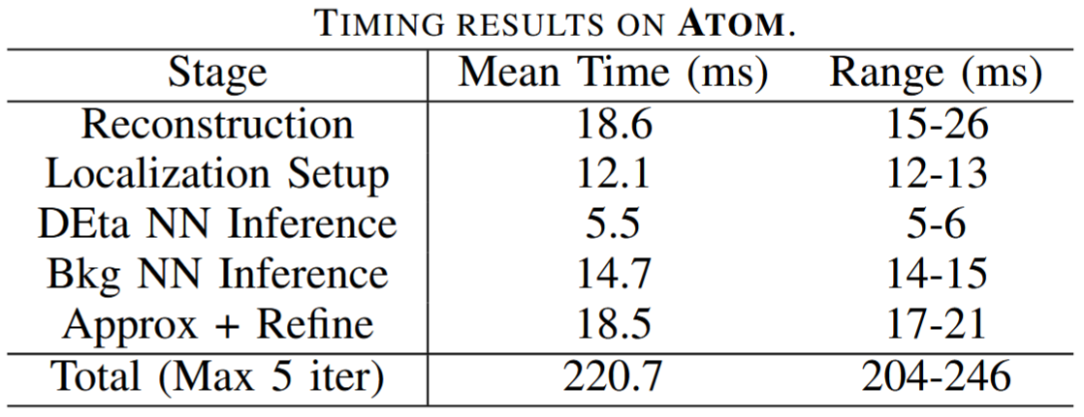
Localization Latency for 1MeV/cm² short (1s) GRB

Slide 16
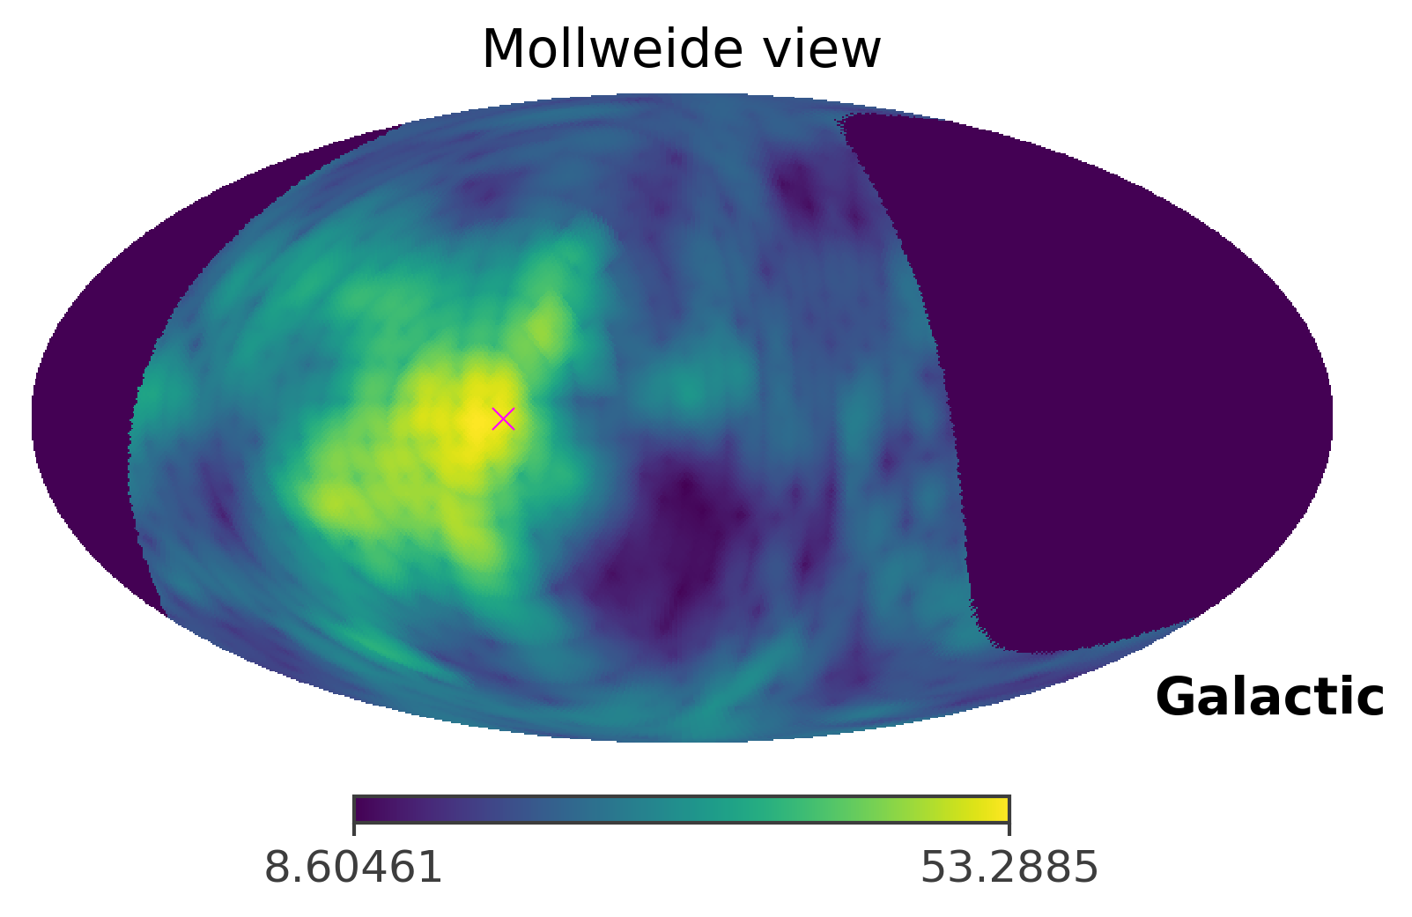
Simulated likelihood map for GRB GBM08127680 in COSI Data Challenge 3
Notes:
Likelihood mapping

Slide 17
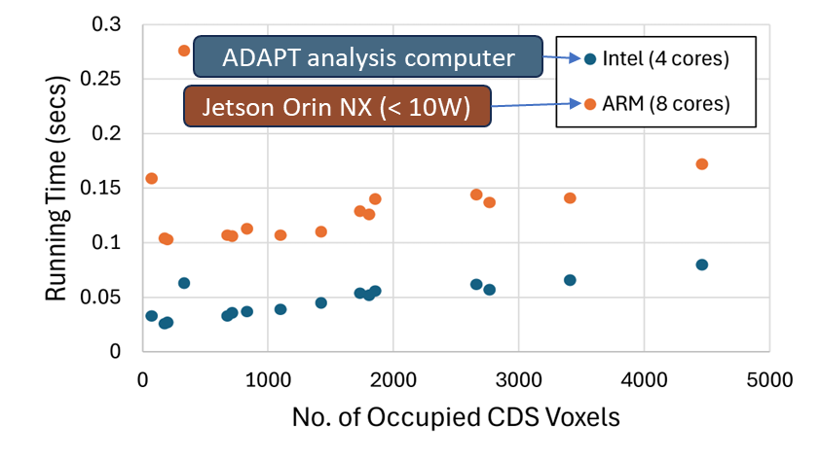
Time to Produce N_{side}=64 Map of 90% Containment Region
Presentation 306.02 (Pushing the Boundaries: The Evolving Landscape of MeV Gamma-Ray Astronomy, Wed. 1:30-3)
“Real-Time Analysis of Gamma-ray Transients Aboard a High-Energy Telescope,” (Buhler).
Notes:
Likelihood mapping

Slide 18

An optical telescope searches the space using an observational schedule that maximizes detection probability within a mission-specified deadline
Presentation 302.04 (Multi-messenger Astronomy, Wed. 10:15-12)
“Strategies to Plan Time-Critical Optical Follow-Up of Transient Astrophysical Events,” (Wang).

Slide 19

adapt.physics.wustl.edu
Thank You!
Work supported by NASA award 80NSSC21K1741 and a WashU OVCR Seed Grant

