Slide 1
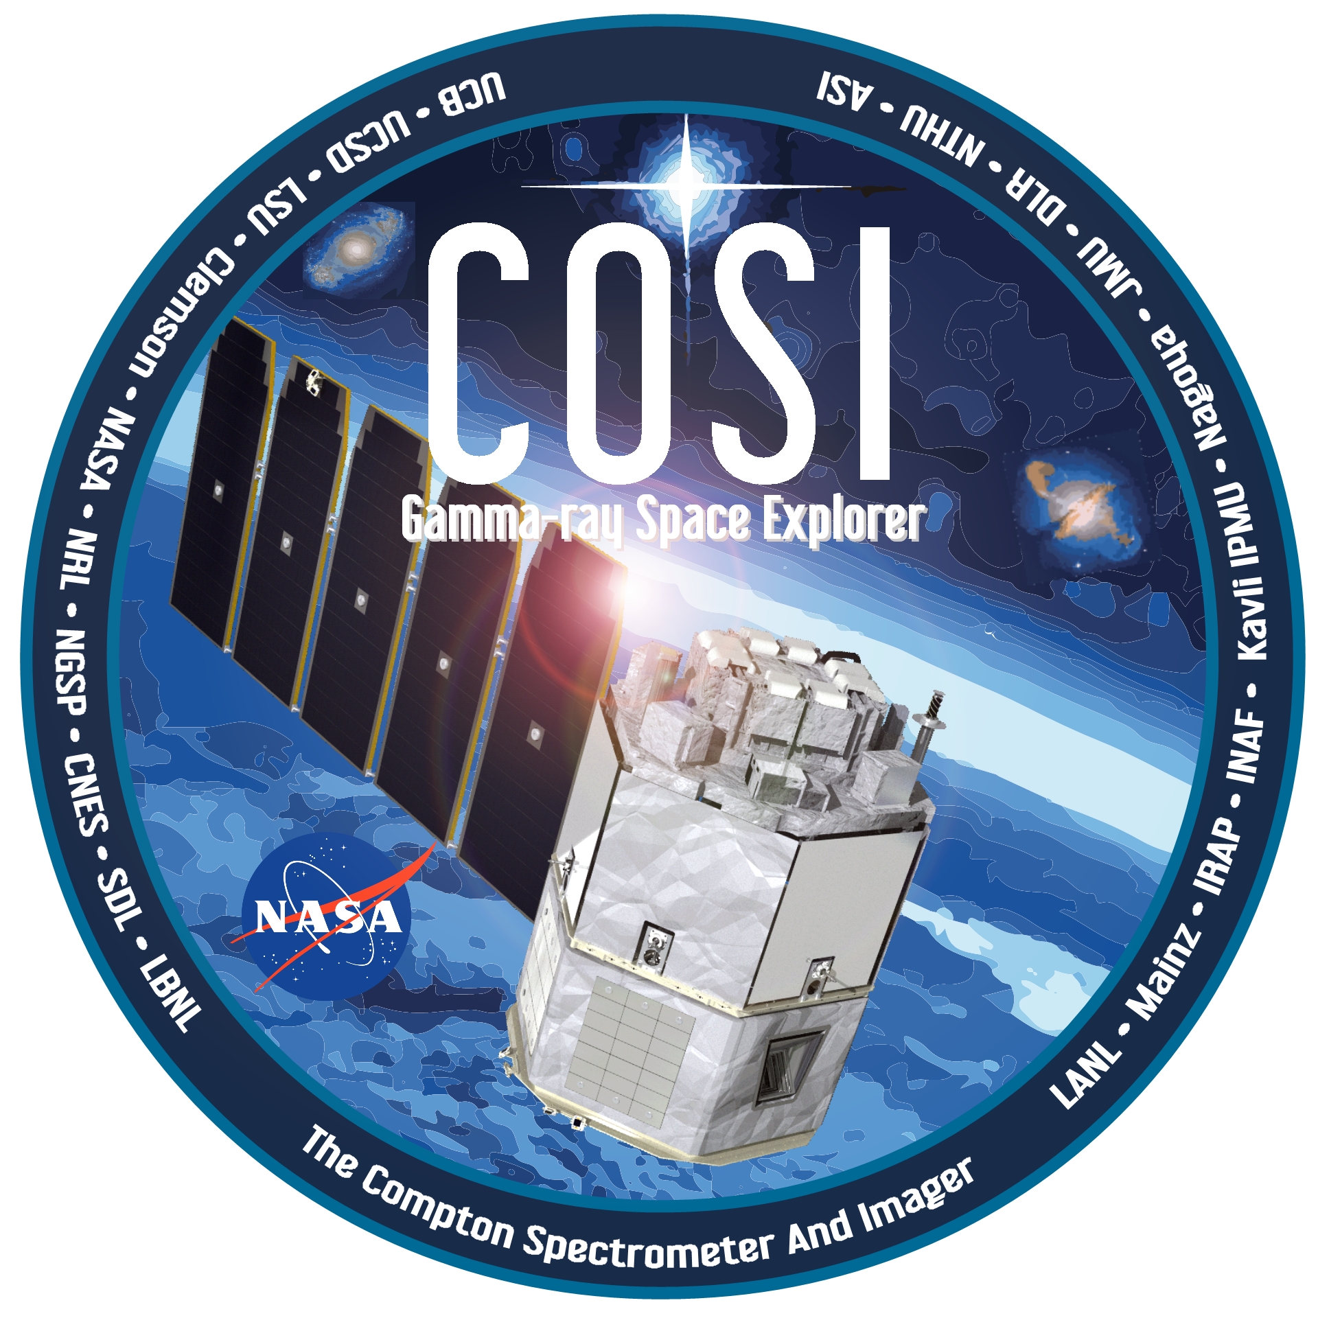

ADAPT and COSI Synergies
Marion Sudvarg
(with credit to Jim Buckley, Jeremy Buhler, Wenlei Chen, Ye Htet, Daisy Wang, Hannah Gulick)
COSIFest, October 17, 2025

Slide 2
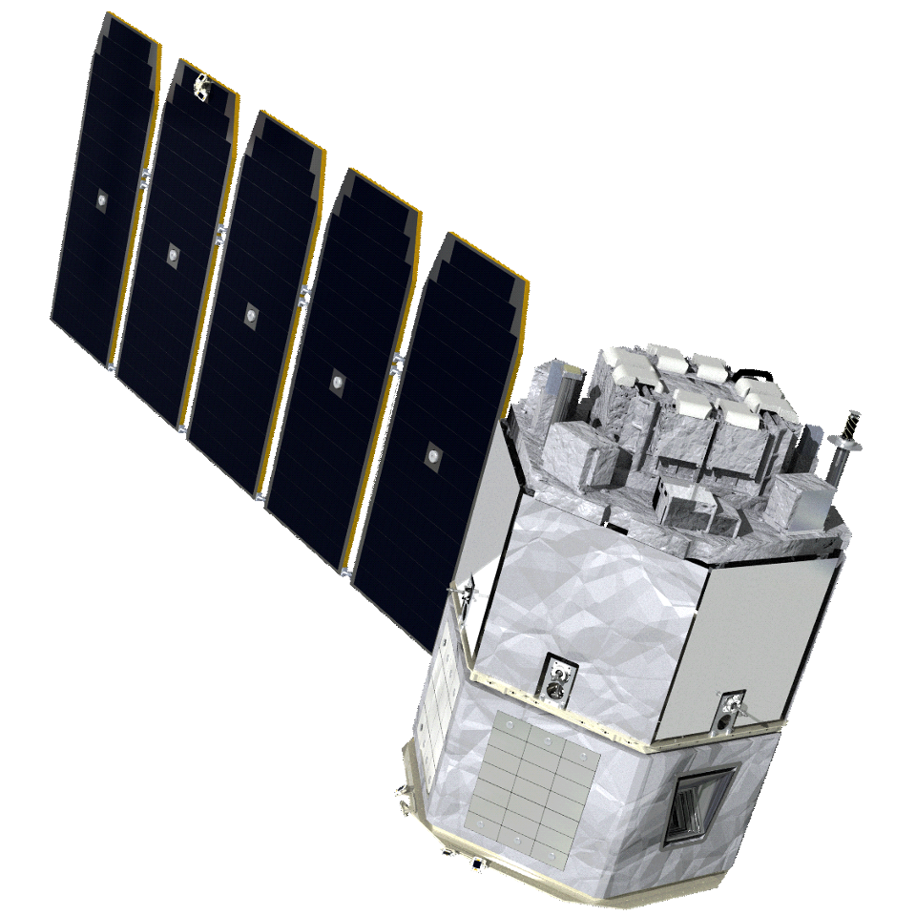
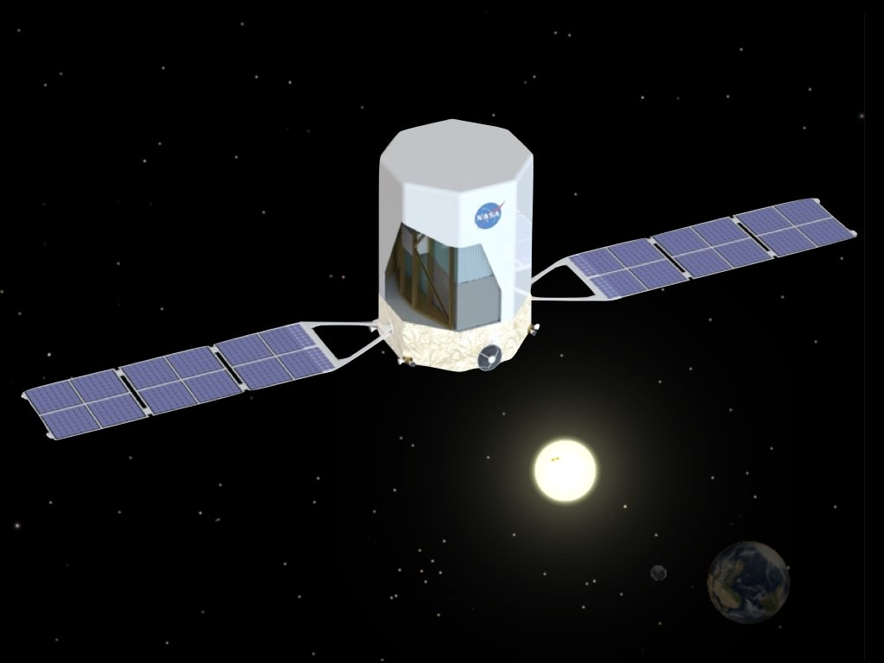
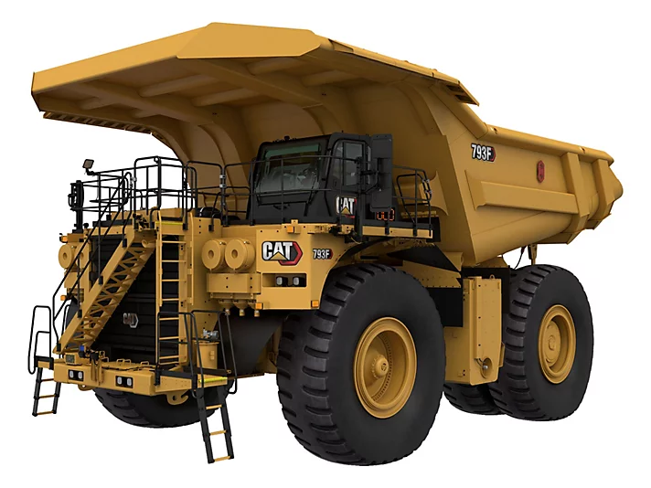

The Compton Spectrometer and Imager (COSI)
The Advanced Particle-astrophysics Telescope (APT)

Slide 3
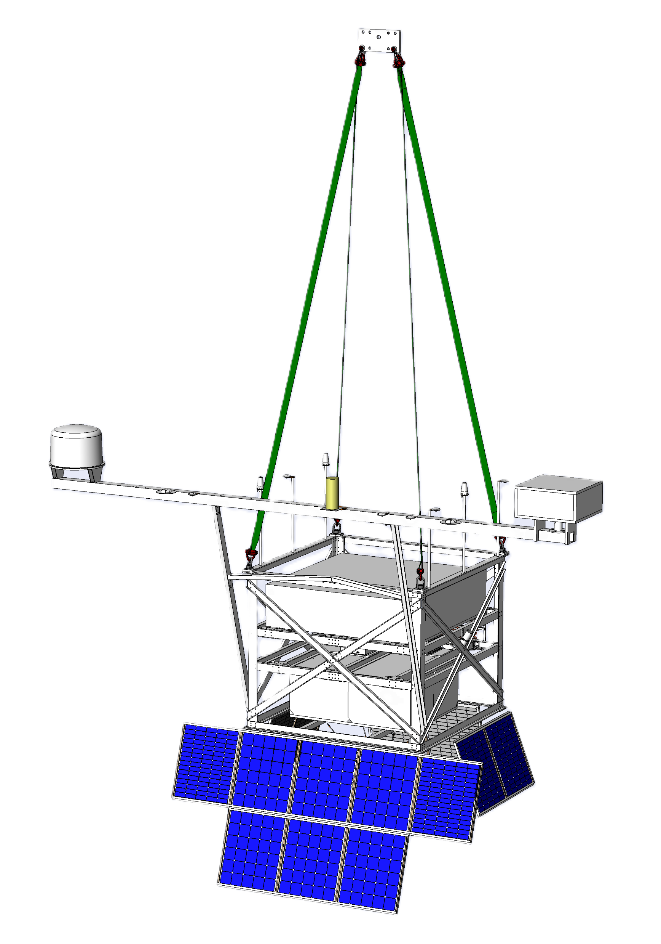

1.1M m³ zero-pressure high-altitude balloon
The Antarctic Demonstrator for APT (ADAPT)

Slide 4
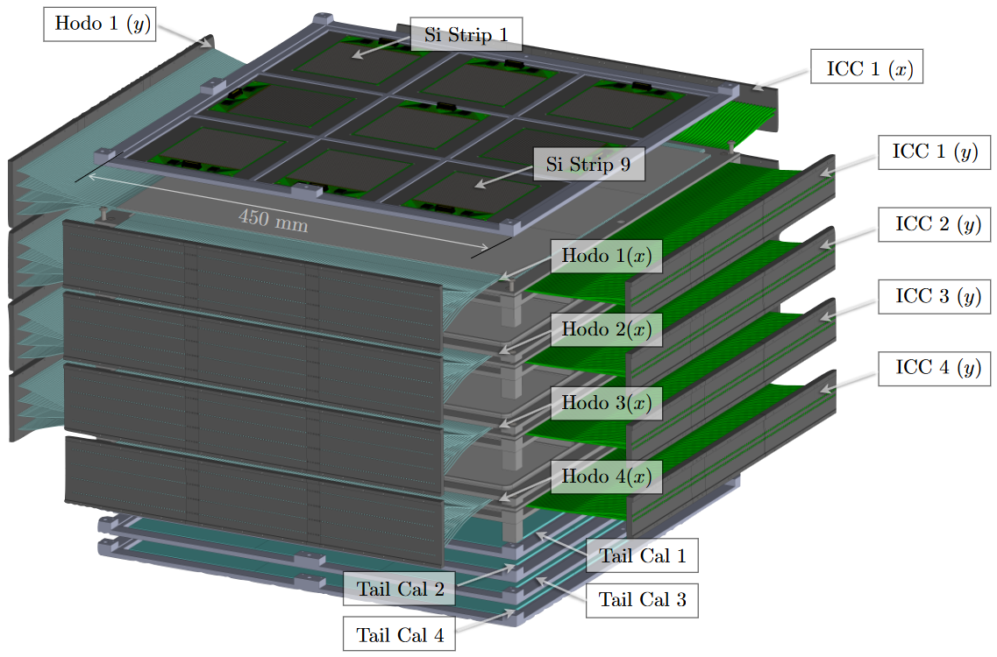

Slide 6
3 m
20 ICC Layers
20 Hodo Layers

Slide 7
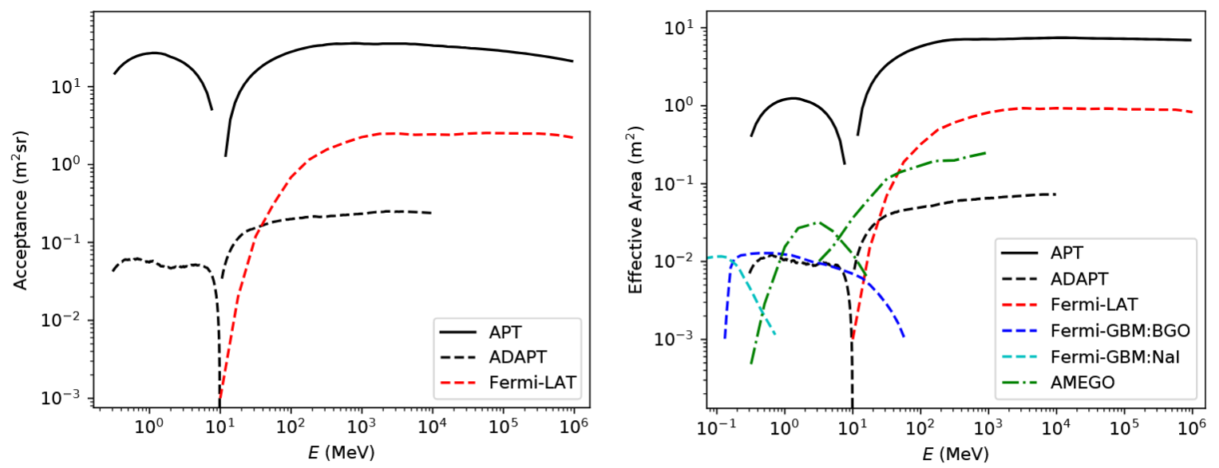
Acceptance/Geometry Factor
Effective Area

Slide 8
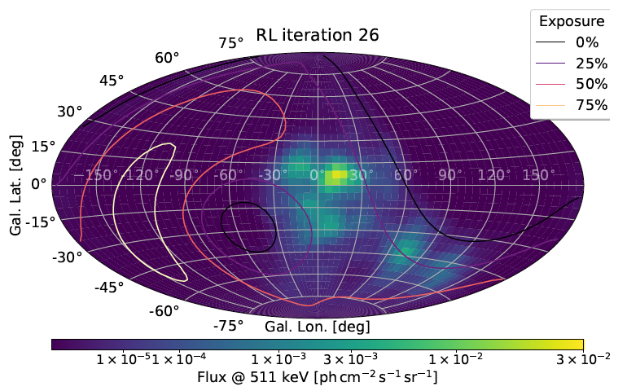
Analysis Pipeline

Slide 9
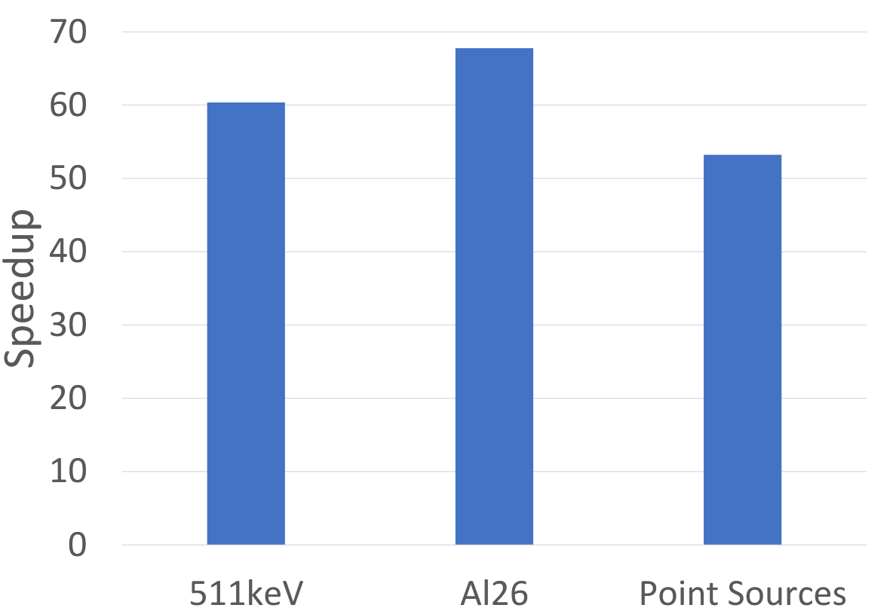
Accelerating Offline Analysis …
JIT-compiled, parallelized Python implementation of Richardson-Lucy deconvolution from DC1

Slide 10
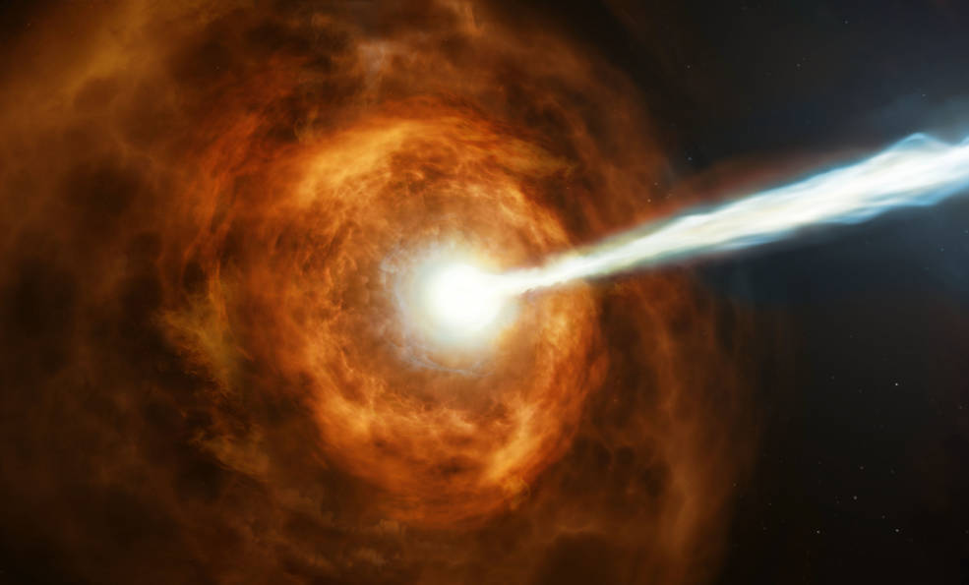
Image courtesy NASA, ESA and M. Kornmesser (https://www.nasa.gov/feature/goddard/2019/hubble-studies-gamma-ray-burst-with-highest-energy-ever-seen)

Slide 11
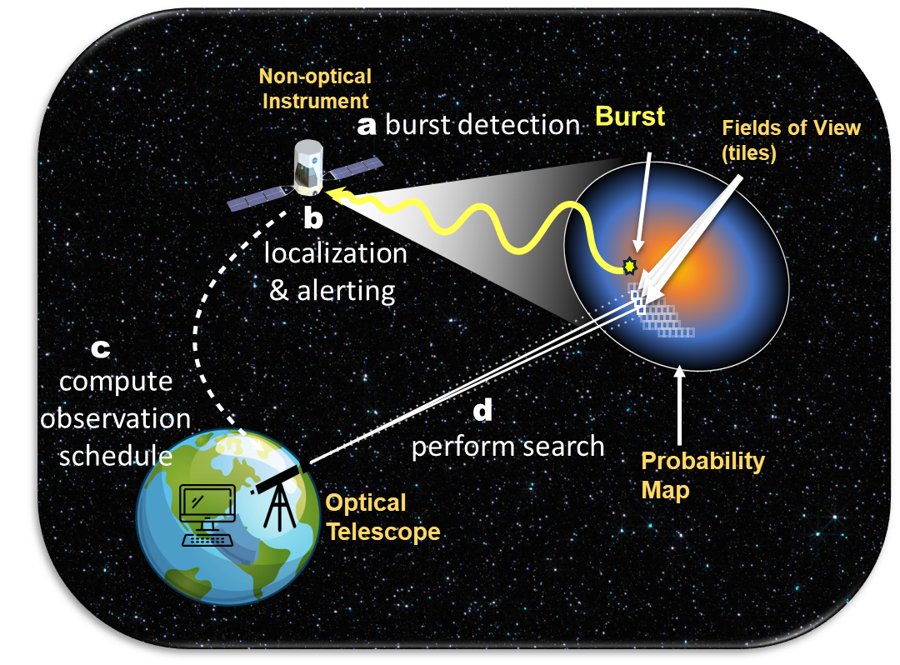
Can we enable prompt follow-up observations?
(a) Burst Detected
By COSI, APT, or ADAPT
(b) Onboard Localization
Onboard system performs likelihood mapping or point-source localization and transmits to ground.
(c) Schedule Observations
Promptly generate a deadline-aware search plan.
(Wang 2025)
(d) Automated Optical Search:
Robotic telescopes execute follow-up observations autonomously.

Slide 12
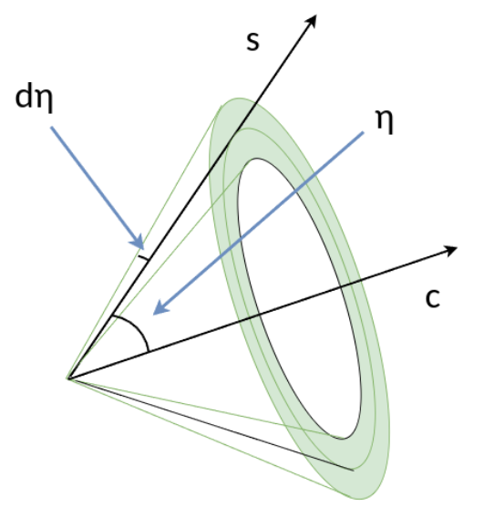
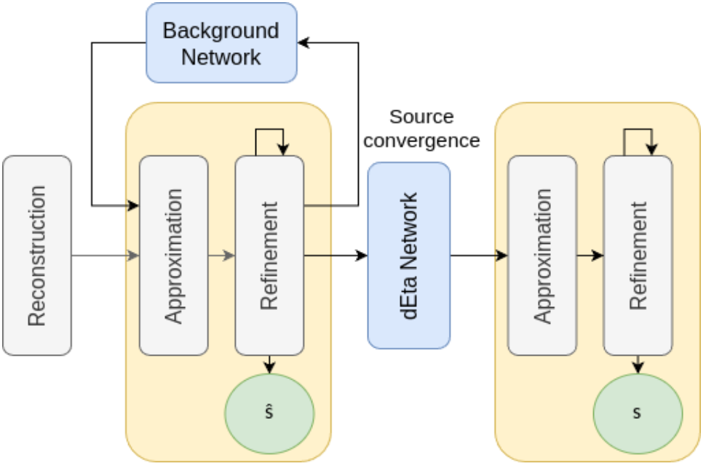
Compton Reconstruction and Localization

Slide 13
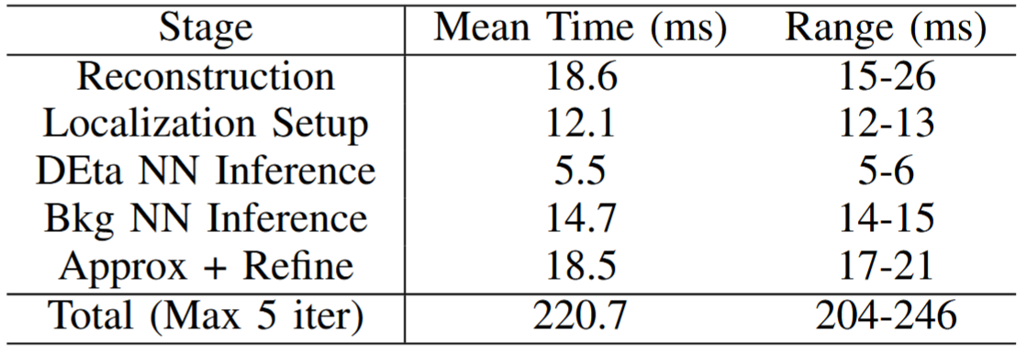
Reconstruction + localization latency
1 second, 1MeV/cm² GRB in presence of atmospheric background
Timing results on 4-core Intel Atom-based embedded PC (ADAPT flight instrument computer)
(Htet 2024)

Slide 14
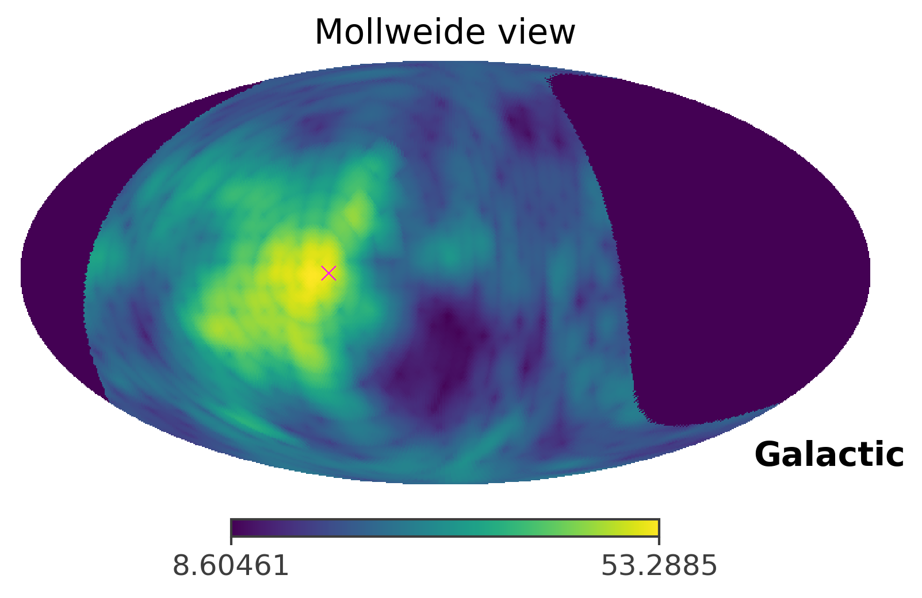
Simulated likelihood map for GRB GBM08127680 in COSI DC3

Slide 15
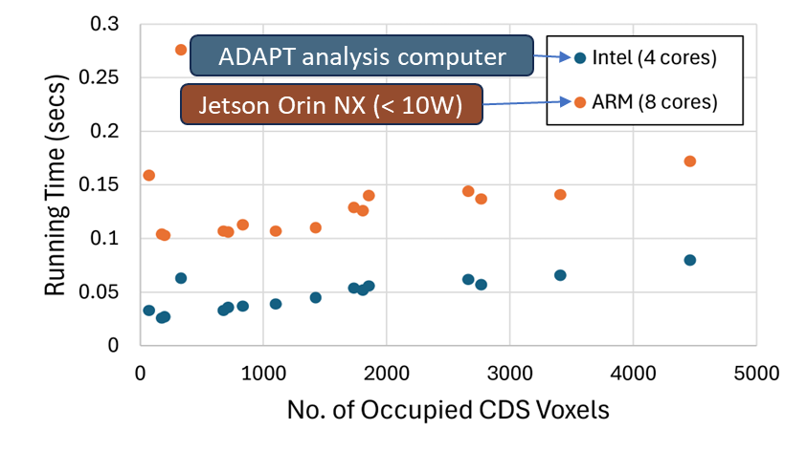
Time to Produce N_{side}=64 Map of 90% Containment Region
(Buhler, ICRC 2025)

Slide 16
Can we enable prompt follow-up observations?
(a) Burst Detected
By COSI, APT, or ADAPT
(b) Onboard Localization
Onboard system performs likelihood mapping or point-source localization and transmits to ground.
Estimated exposure time calculations may require spectral fit!
(c) Schedule Observations
Promptly generate a deadline-aware search plan.
(d) Automated Optical Search:
Robotic telescopes execute follow-up observations autonomously.

Slide 17
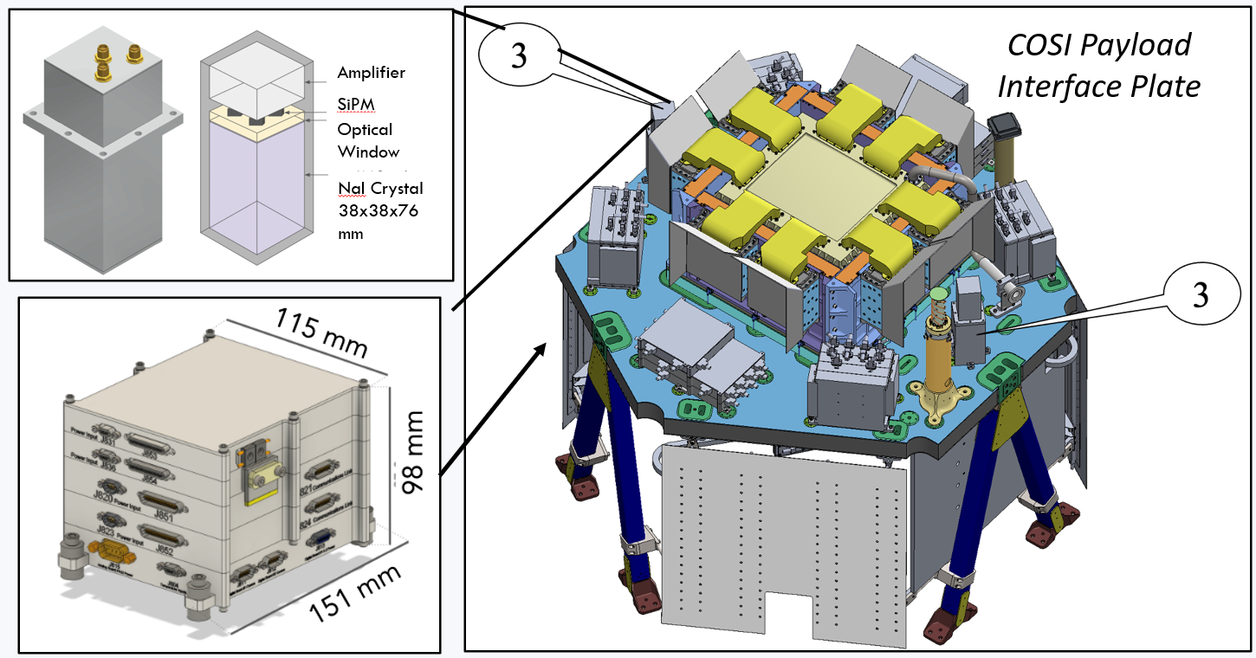
Takeaway and Pitch
ADAPT and APT will benefit from the amazing work of the COSI team (analysis pipeline, GRB trigger, etc.)
We’ve successfully accelerated some analysis code.
Next steps: unbinned instrument response.
ADAPT to run COSI’s likelihood mapping and spectral fitting in real time.
Can we think about running these on COSI?
Or on BTO? (Science Goal 1: Monitor transient events, e.g., GRB, magnetars, TGF)

